Slide 1
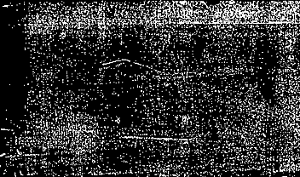
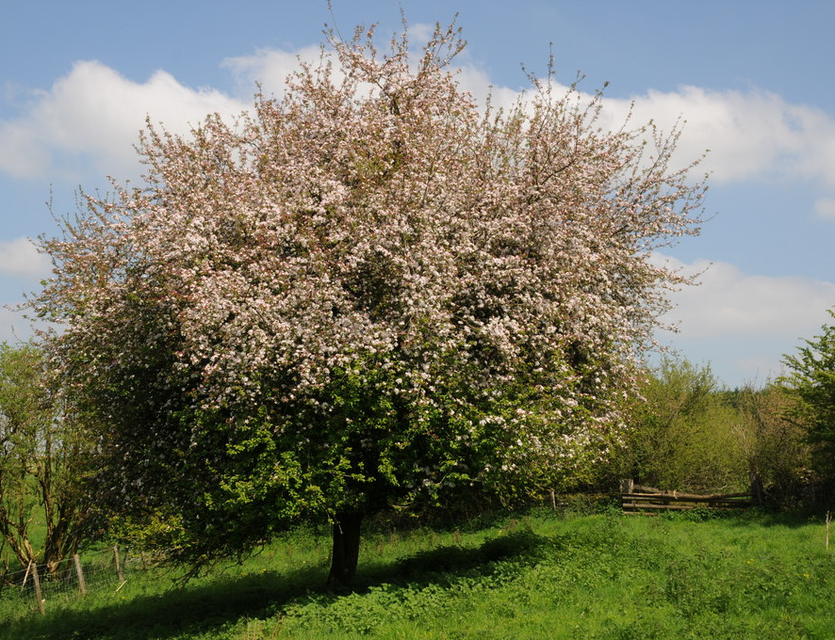



The Tree of Life
Starter: Hurston makes clear distinctions between men and women. Note down at least two examples. How could you explain these?
Image: by Philip Halling, license at https://commons.wikimedia.org/wiki/File:Hawthorn_tree_in_blossom_-_geograph.org.uk_-_5770175.jpg

Slide 2
Objectives today:
Understand Nanny’s role in Janie’s life
Explore how black women were affected by heritage
Explore how the symbol of the pear tree suggests Janie’s attitude towards this

Slide 3
Title: the tree of Life
Starter Task
Collect 3 quotes referencing Janie, and 3 quotes referencing her grandmother
What is the main difference between them,?
What’s a similarity?
ON your sheet of paper…

Slide 4
The Tree of Life: Analysis Questions
(‘she was stretched on her back” – beglamoured his rags and her eyes”)
Highlight any sensory imagery (smells, sounds, sensations…). What atmosphere does this create? Which sensory imagery is openly sexual, which is more traditionally natural?
What is meant by the ‘inaudible voice of it all’? What can you infer about Janie? What voice does she follow in her life?
Explain the exclamation ‘so this was a marriage’. What can you infer about Janie’s attitude towards social norms?
Explain the phrase ‘pain remorseless sweet’. Is this oxymoronic? What can you infer about Janie?
Trace the narrative voice. How does Hurston use free indirect discourse with Janie as focalizer?
Explain the changes between exclamations and questions. What’s the effect?
Explain the use of verbs – ‘stumbled’; ‘tumbling and singing’ – what effect do these create?
How does the description of her grandmother juxtapose the rest of the passage?
Is the last paragraph (through pollinated air…) humorous or ironic, or serious? What does the ‘pollinated air’ metaphorically stand for?
Slavery is a man-made system; what could that tell you about Hurston’s motivations for associating Janie with nature?
Image: by Philip Halling, license at https://commons.wikimedia.org/wiki/File:Hawthorn_tree_in_blossom_-_geograph.org.uk_-_5770175.jpg

Slide 5
The Tree of Life: Analysis Questions
(‘she was stretched on her back” – beglamoured his rags and her eyes”)
Highlight any sensory imagery (smells, sounds, sensations…). What atmosphere does this create? Which sensory imagery is openly sexual, which is more traditionally natural?
What is meant by the ‘inaudible voice of it all’? What can you infer about Janie? What voice does she follow in her life?
Explain the exclamation ‘so this was a marriage’. What can you infer about Janie’s attitude towards social norms?
Explain the phrase ‘pain remorseless sweet’. Is this oxymoronic? What can you infer about Janie?
Trace the narrative voice. How does Hurston use free indirect discourse with Janie as focalizer?
Explain the changes between exclamations and questions. What’s the effect?
Explain the use of verbs – ‘stumbled’; ‘tumbling and singing’ – what effect do these create?
How does the description of her grandmother juxtapose the rest of the passage?
Is the last paragraph (through pollinated air…) humorous or ironic, or serious? What does the ‘pollinated air’ metaphorically stand for?
Slavery is a man-made system; what could that tell you about Hurston’s motivations for associating Janie with nature?

Slide 6
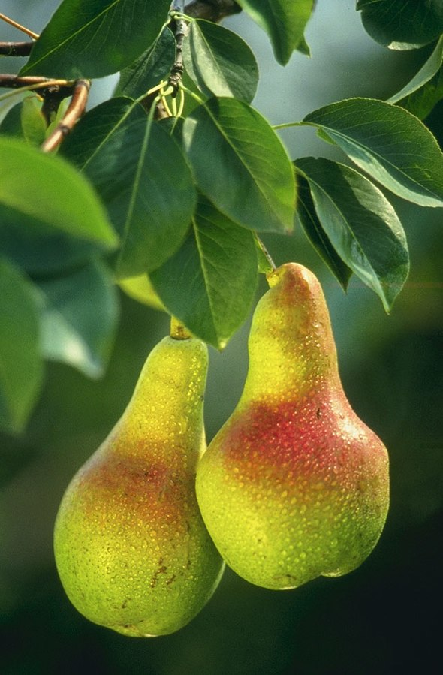
The Tree of Life: What is Janie’s attitude to all this?
Symbolism: The Pear Tree
The pear tree and the horizon represent Janie’s idealized views of nature. In the bees’ interaction with the pear tree flowers, Janie witnesses a perfect moment in nature, full of erotic energy, passionate interaction, and blissful harmony. She chases after this ideal throughout the rest of the book.
P. 13-14
Nanny’s version of the ‘tree’ symbol: p. 15, 19
Image: by Keith Weller, US Dept of Agriculture (public domain)

Slide 7
Symbolism: the ‘mule’
P. 17
‘De nigger woman is de mule of the world’
How does Hurston develop the ‘mule’ symbolism she introduced on p. 2?

Slide 8
How to write critically about a novel
Attempt 1:
How is Nanny’s reaction presented? (p. 14)
Zora Neale Hurston creates the impression that Nanny reacts to Janie’s flirtation with shock and surprise. The old woman’s sleep is suddenly interrupted. “Whispery snatches” of “voices far-off but persistent:” the adjective “whispery” suggest a dream-like quality, but this is changing very quickly, with ‘persistent’ introducing a sense of urgency. Nanny “bolted upright”, and this negative reaction is reinforced with the description of the kiss: “lacerating” is a verb with violent connotations. To Nanny, it seems Janie is in danger of being wounded.
What should this student do to improve this?

Slide 9
How to write critically about a novel
What have I done to improve the paragraph to arrive at this version?
What could be added or improved? Why?
Zora Neale Hurston creates the impression that a generation conflict might be unfolding, as Nanny reacts to Janie’s flirtation with shock and surprise. The old woman’s sleep is suddenly interrupted by “whispery snatches” of “voices far-off but persistent.” While the adjective “whispery” suggest a dream-like quality, this is changing very quickly, with ‘persistent’ introducing a sense of urgency. The dynamic verb which Hurston chooses as Nanny “bolted upright” has connotations of shock, and this negative reaction is reinforced with the description of the kiss: Hurston describes Johnny to be “lacerating” Janie, a verb with violent connotations. To Nanny, it seems Janie is in danger of being wounded. Hurston is here commenting on the theme of gender; Nanny embodies a generation to whom the institution of marriage still signifies the only way to secure status and stability in life. This might be ironic as she herself was never married, but the argument between grandmother and granddaughter which follows shows Janie to be a much more free-spirited character, ready to escape from societal expectations. Hurston reinforces this through her technique of free indirect discourse; she moves in and out of both women’s perspectives, illustrating both sides of this disagreement in what is otherwise a close and intimate relationship.

Slide 10
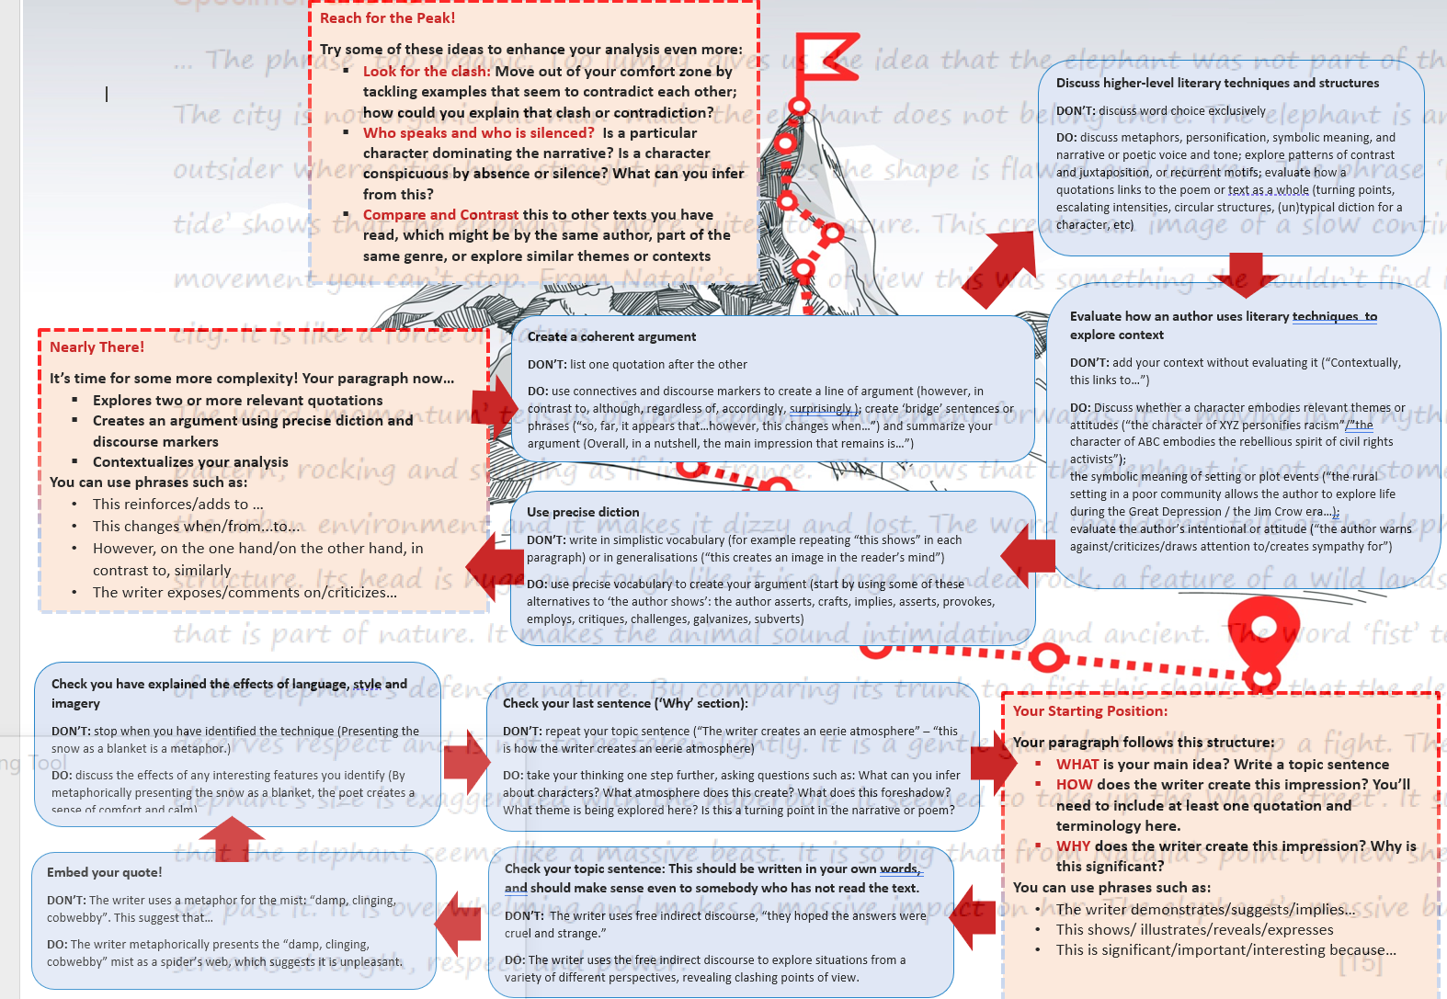

Slide 11
Evaluating Narrative style
omniscient, third-person narrator’s voice - decidedly literary and intellectual, full of metaphors, figurative language, and other poetic devices; this weaves in and out of characters’ perspectives in free indirect discourse
Long passages of dialogue without any comment from the narrator.
Why might Zora Neale Hurston have chosen such a split style of writing?

