Slide 1
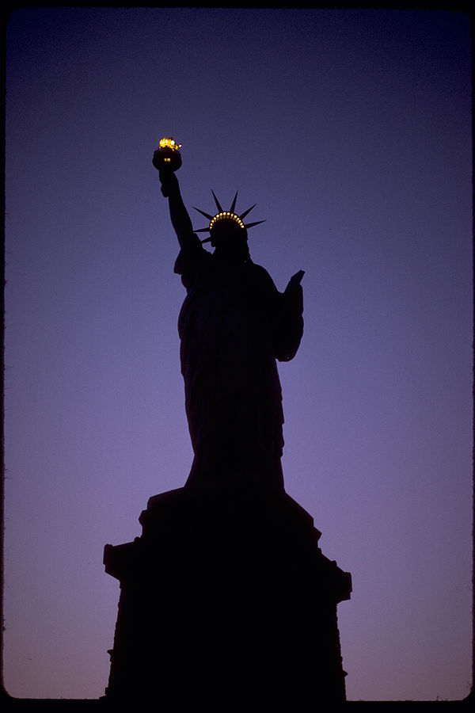
Gender and US Politics
Voting behaviour and gendered campaigning

Slide 2
Lecture outline
History of Gender and US Politics
Political Power and Gender Equality
Participation
Representation
Gender Politics of US Elections
Campaigns
2016 and 2020 Election
Gender and US Society
Economic Power
Access to Abortion

Slide 3
terminology
What do we mean by gender?
Socially constructed characteristics about human behaviour, actions and roles in relation to ideas of ‘masculinity’ and ‘femininity’ (Brook, 2022).
Research into US political participation (especially voting) and representation lags behind on nonbinary and transgender roles, largely focusing on men and women.
Is this lecture only about women and US politics?
Absolutely not! Focus on gender inequality, femininity and masculinity.

Slide 4
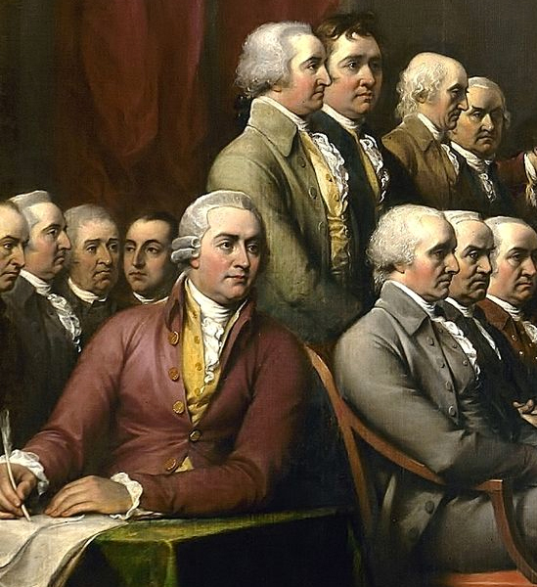
Patriarchal Founding
US as a patriarchal society
All Men Created Equal
Founding Fathers
Social Dominance of Men – male education prioritised, voting rights only to white men, political office held by men.

Slide 5
Women’s Suffrage
Feminist political activism was first inspired by women’s involvement in other reformist movements. Women played a major role in the abolitionist movement. There were up to 100 women’s antislavery societies in the 1830s.
By 1910: women in Colorado, Idaho, Wyoming and Utah had suffrage.
During the 1910s, suffragettes managed to mobilised fears about immigration and the potential undermining of the political hegemony of White Anglo-Saxon Protestants together with the growing economic participation of women in the workforce during WWI to secure the vote in 1920 (19th Amendment).

Slide 6
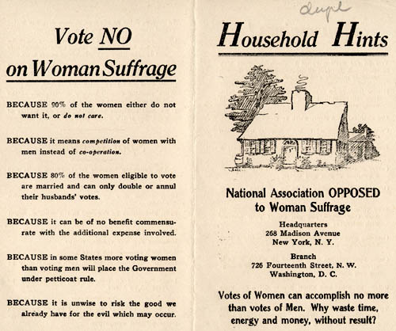

Slide 7
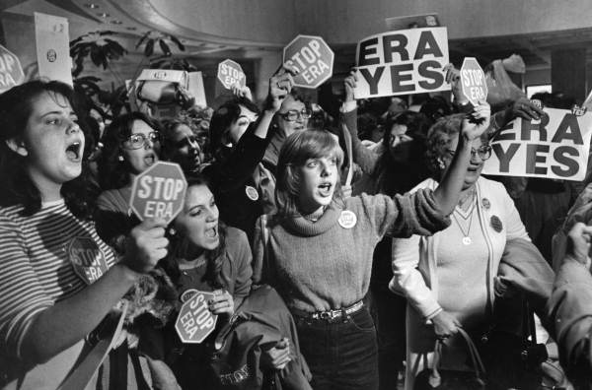
Equal Rights Amendment
In 1923 the Equal Rights Amendment (ERA) was first introduced into Congress
1960s Second Wave of the Women’s Movement:
Aiming to pass the ERA
Wanted to get more women in office
ERA passed in 1972 in Congress
States failed to ratify by 1982

Slide 8
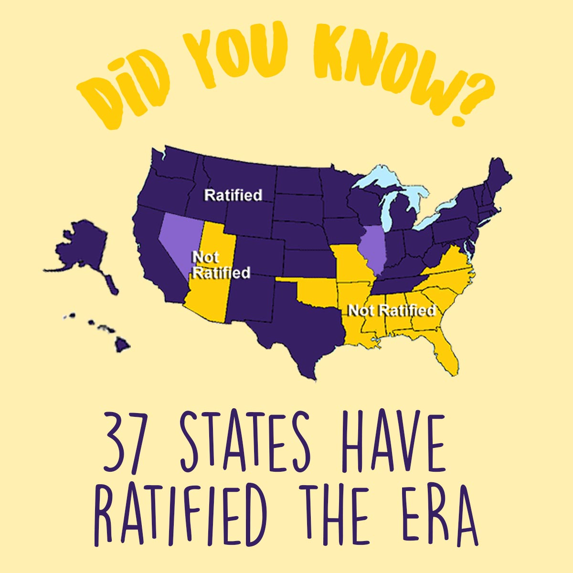
Image: created by Laila Salaam, equalrightsamendment.org

Slide 9
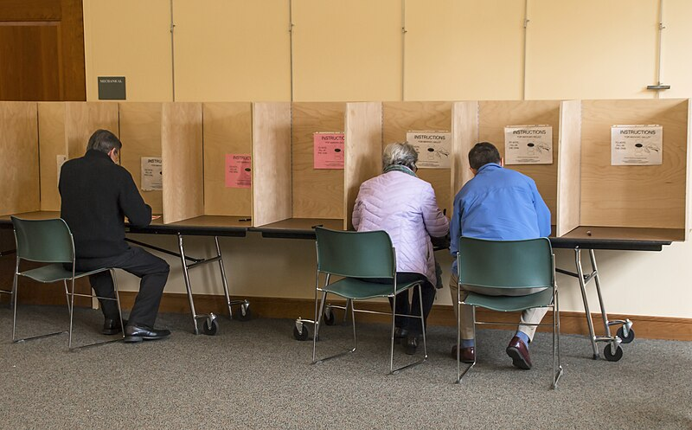
Political Power and Gender Equality
What is the ‘gender gap’?
The difference between the proportion of women and men supporting a given candidate, political party, or issue. (Center for American Women and Politics, 2022)
Apparent in every presidential election since the 1980s.
Image by Liz West, license: https://commons.wikimedia.org/wiki/File:Voting_in_Boxborough,_Massachusetts_during_the_2016_primaries_(25054460549).jpg

Slide 10
Gender Gap: StaT Attack
 | Democratic candidate – Women (%) | Democratic candidate – Men (%) | Republican candidate – Women (%) | Republican candidate – Men (%) | Gender Gap
2000 | 54 | 42 | 43 | 53 | 10
2004 | 51 | 44 | 48 | 55 | 7
2008 | 56 | 49 | 43 | 48 | 7
2012 | 55 | 45 | 44 | 52 | 10
2016 | 54 | 41 | 41 | 52 | 11
2020 | 57 | 45 | 42 | 53 | 12
Source: CAWP using Edison data https://cawp.rutgers.edu/gender-gap-voting-choices-presidential-elections

Slide 11
Why is there a gender gap?
Party Difference on Social Issues
Democratic Party: more inclusive, progressive, ‘modern’ values
Republican Party: traditional, conservative values
Policy Difference
Abortion, paid family leave
Candidate Diversity
Turnout: women turnout in higher numbers and therefore have a greater impact upon electoral politics:
Women vote in higher numbers than men since 1964
In 2020, 57% of voters were women
More women registered to vote than men (10m more in 2016)

Slide 12
Demographic Intersection
If we break down the gender gap further, however, it is divided by ethnicity in the US.
2016
2020
69% of Hispanic women voted Clinton
4% of Black women voted Trump
69% of Hispanic
women voted Biden
9% of Black women voted Trump
43% of white women voted Clinton
44% of white women voted Biden
25% of Latinx women voted Trump
94% of Black women voted Clinton
52% of white women voted Trump
30% of Latinx women voted Trump
90% of Black women voted Biden
55% of white women voted Trump
Source: CAWP using Edison data https://cawp.rutgers.edu/gender-gap-voting-choices-presidential-elections

Slide 13
Gender Representation
Historically, US political office dominated by men
Since 1789, 12,028 have been men (97%) and 387 have been women (3%)
In 1966, 2 women senators, 10 women in the House
By 1993, 6 women senators, 52 women in the House
Widow’s Succession led to some progress
Increasing, but slow, demographic representation
1964: Patsy Matsu Mink (D – HI) first woman of colour in the House
1992: Carol Moseley Braun (D – IL) first woman of colour in the Senate
1998:Tammy Baldwin (D – WI) first openly gay woman in Congress.

Slide 14
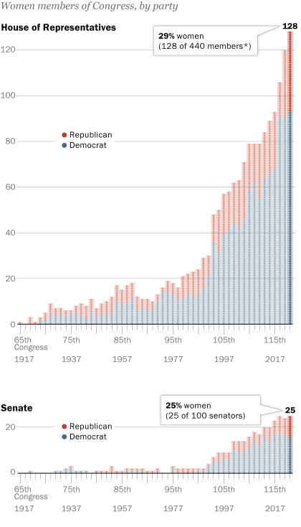
2023: 118th Congress
27.9% of Congress held by women:
106 Democratic women, 42 Republican women, one independent.
A 59% increase in women in Congress in last decade
58 of the 149 women are women of colour
27 are Black (none in the Senate), 19 are Hispanic, 10 are Asian American/Pacific Islanders, 2 are Native American, 1 is Middle Eastern/North African.
California has sent more women to Congress than any other state (47)
CFR.org
PEW Research Center

Slide 15
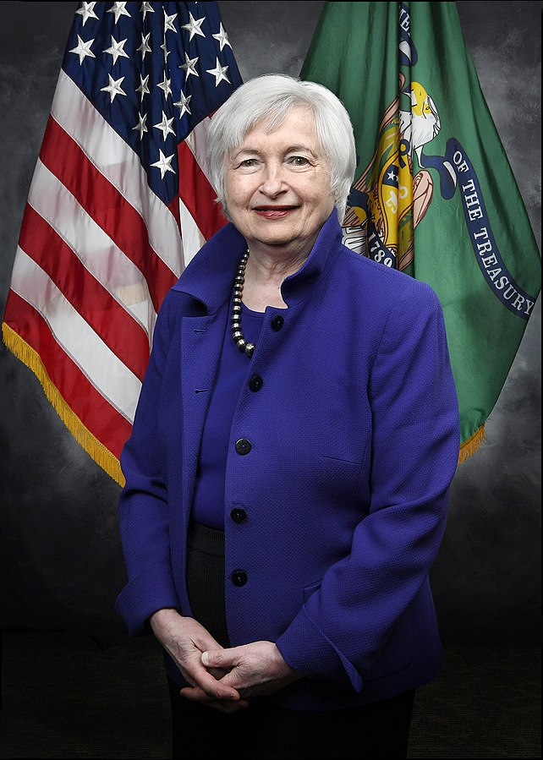
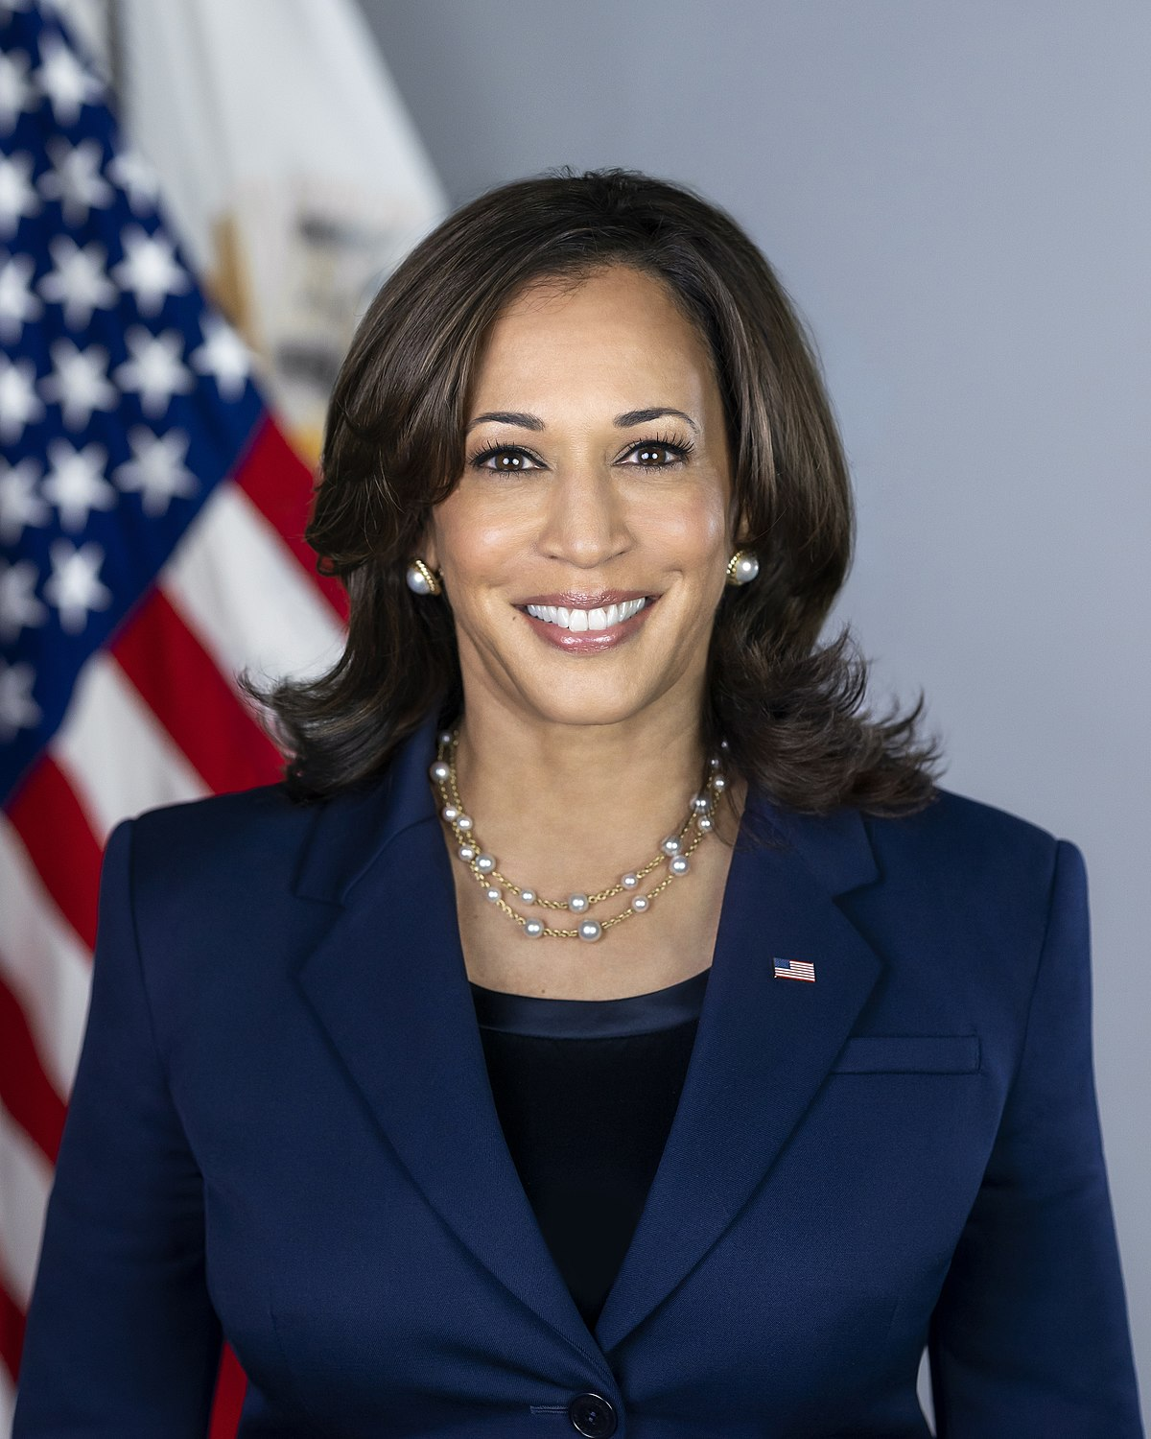
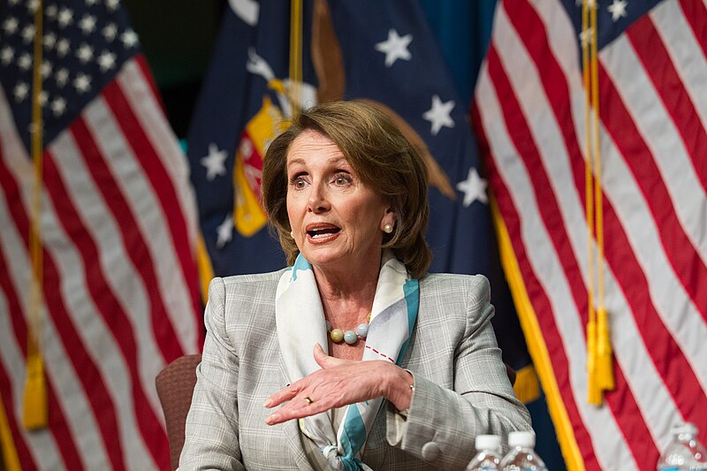
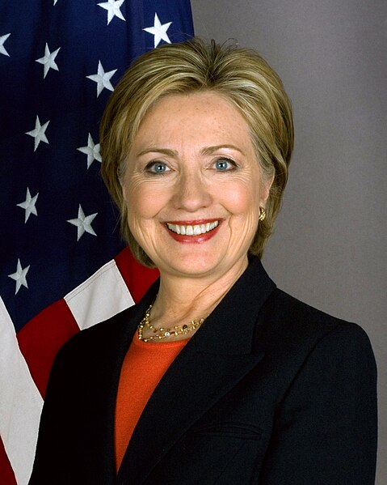
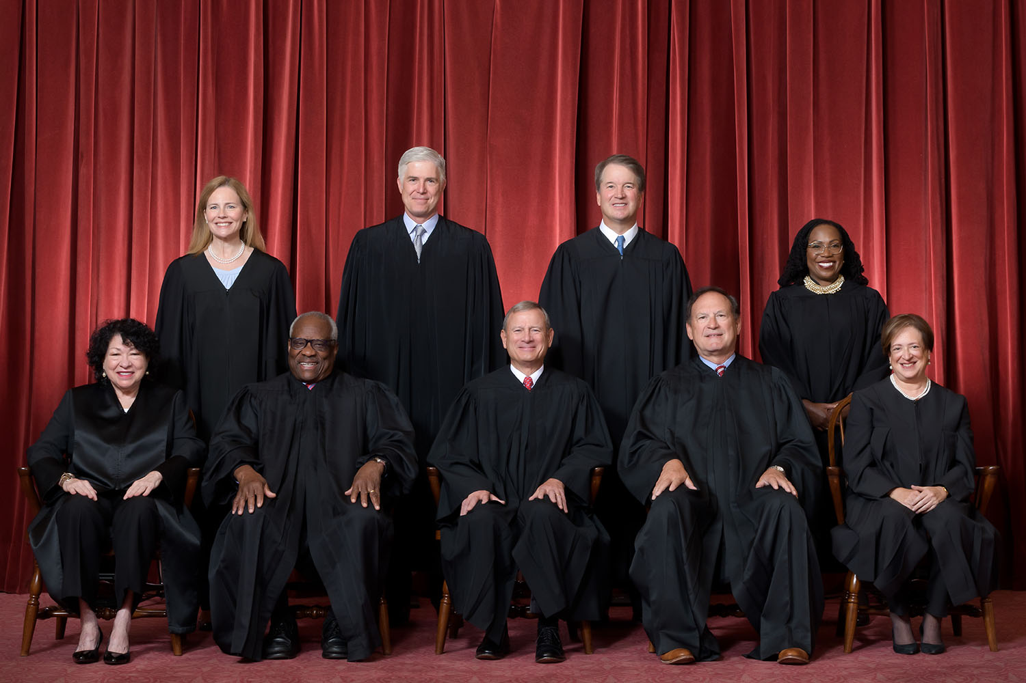
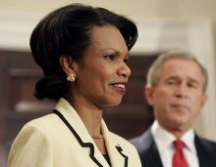
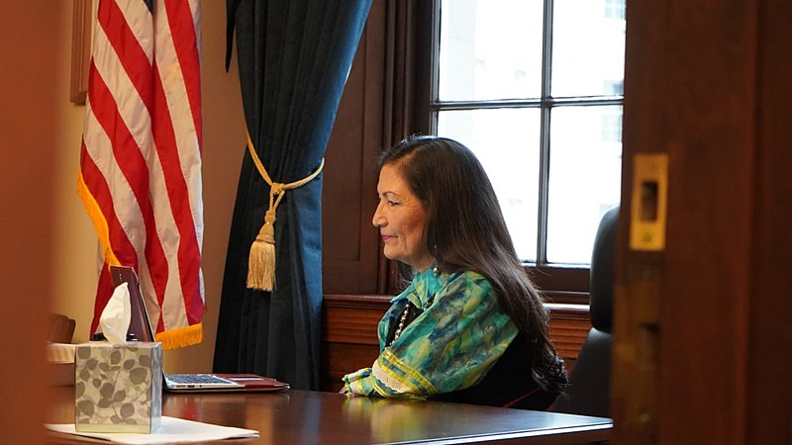
Women in US politics
Image credit: Fred Schilling, Collection of the Supreme Court of the US

Slide 16
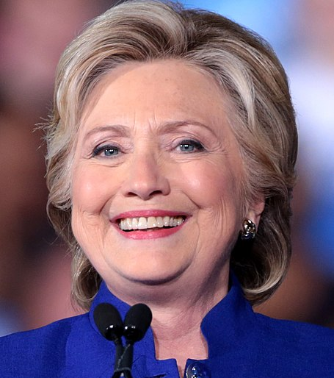
Gender Politics of Presidential elections
The US has only seen male presidents
Masculinity in US politics is taken for granted.
Presidential timber: what it takes to construct a president has always been viewed as masculine.
Charisma
Stature
Warrior Leader
Protector
Image credit: Gage Skidmore, license here: https://commons.wikimedia.org/wiki/File:Hillary_Clinton_Arizona_2016_.jpg

Slide 17
Contesting Masculinities
Duest-Lahti and Oakley (2018) discuss dominance versus technical expertise in masculinity.
Women have better success in trying to achieve technical expertise masculinity, as harder to be perceived as leaders if aim for dominance masculinity.
Dominance Masculinity | Technical Expertise Masculinity
Commanding/controlling Bending others to one’s will Competitive and hierarchical Rooted in physical and financial prowess | Emerges from capacity to govern Intellectual ability Working with others Trustworthiness

Slide 18
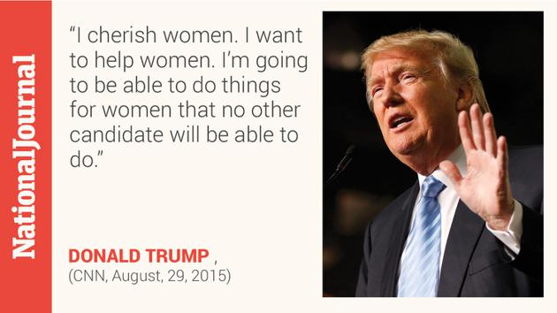
2016 Election
A competition over masculinity:
Trump aimed to feminise his opposition: ‘little Marco’, questioning opponents masculine prowess in the Republican primaries.
Two attributes of leadership granted to women more than men are trustworthiness and honesty. Trump’s strategy against Clinton was to undermine her claims to both, labelling her ‘Crooked Hillary’.

Slide 19
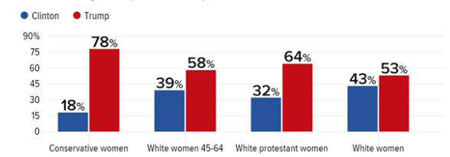

Slide 20
Women in 2020 Presidential Race
Six women ran in Democratic primaries
In a primary, voters are seeking the most ‘electable’ candidate.
66% of Americans say it is easier for men to be elected.

Slide 21
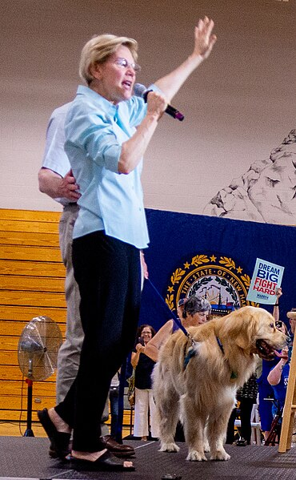
“Gender in this race — you know, that is the trap question for every woman. If you say, ‘Yeah, there was sexism in this race,’ everyone says, ‘Whiner.’ And if you say, ‘There was no sexism,’ about a bazillion women think, ‘What planet do you live on?’”
- Elizabeth Warren (2020).
Image credit: Marc Nozell, license: https://commons.wikimedia.org/wiki/File:Warren_20190727-DSC00917_(48391530386).jpg

Slide 22
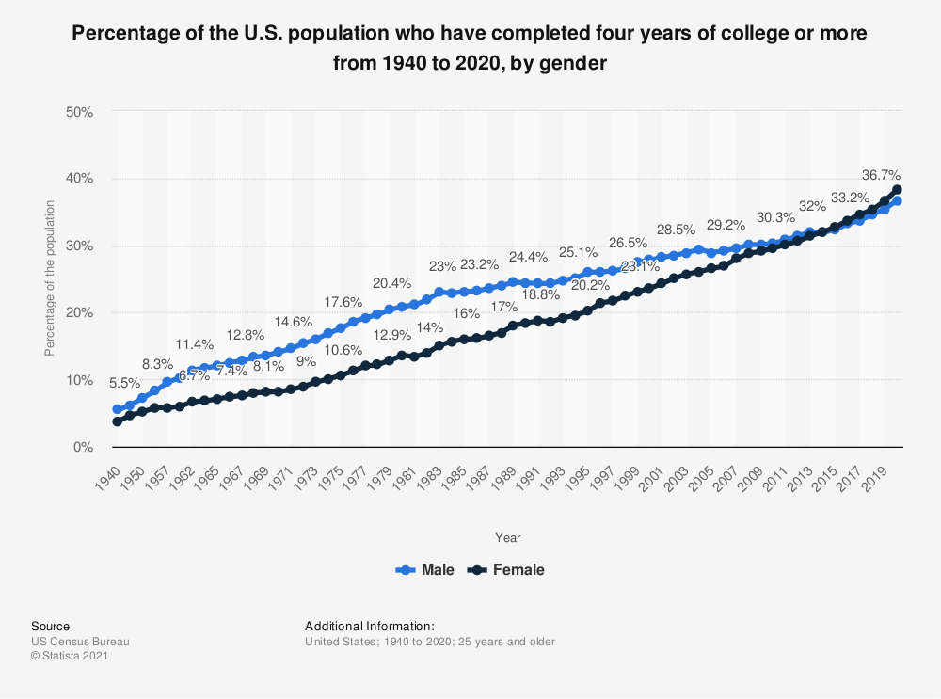
Gender in US society

Slide 23
Leadership Gap
However, there is a disparity between men and women in who has leadership roles in the United States:
In the legal profession, make up only 20% of partners
In academia, make up only 32% of full professors
In finance, they are only 12.5% of CFOs in Fortune 500 companies
Since 2016, there have been no black women heading Fortune 500 companies.
Women account for 18% of all film directors, producers, writers and editors of top grossing films. (CAP, 2020)

Slide 24
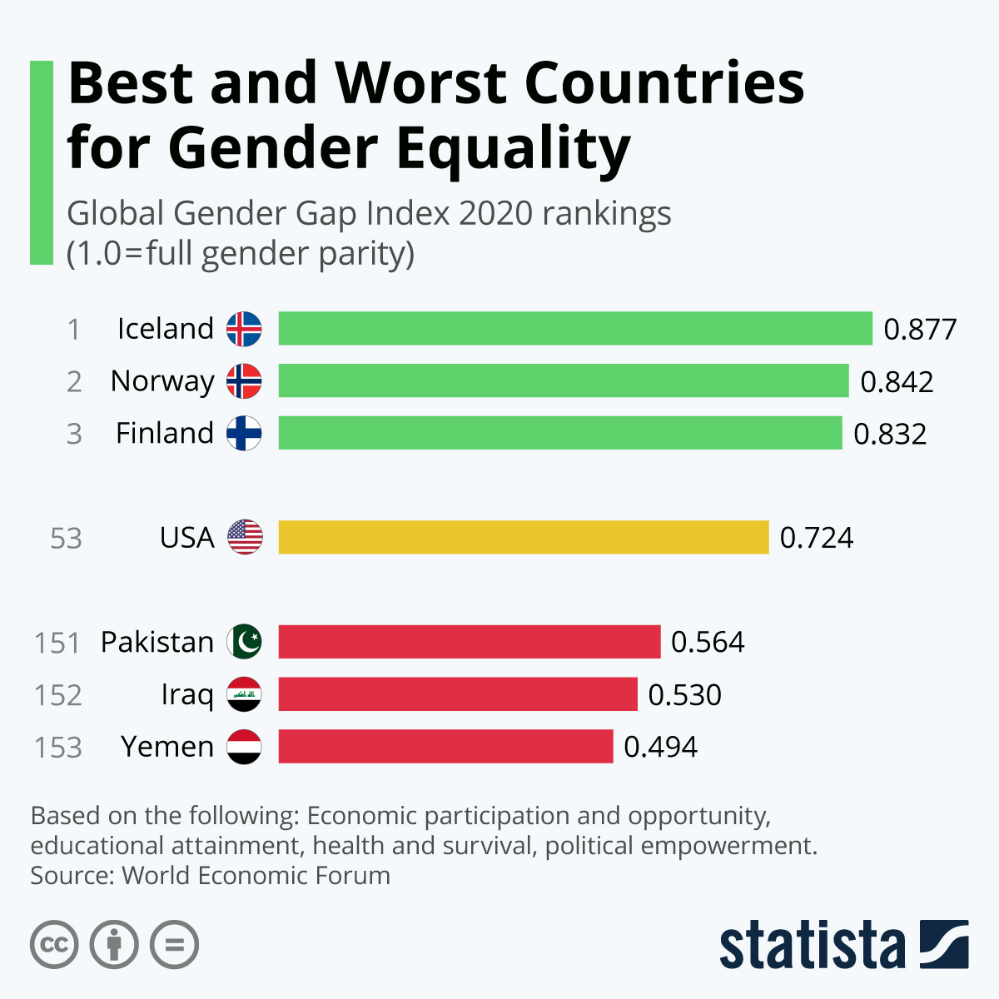
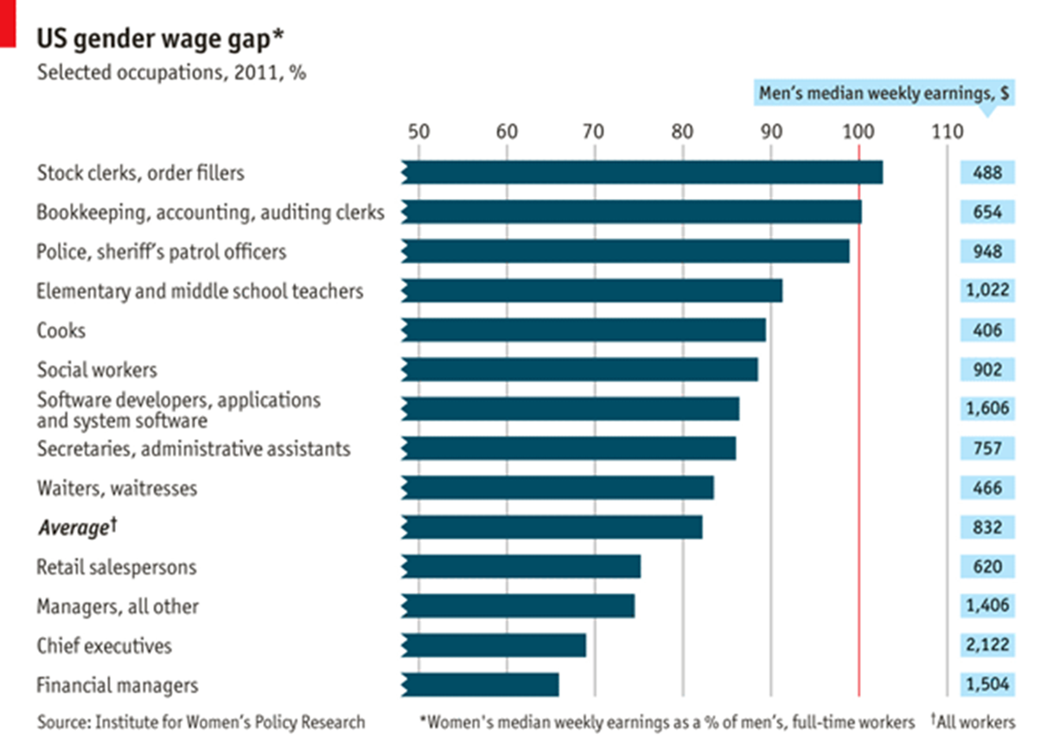
Gendered Economic Power in the US

Slide 25
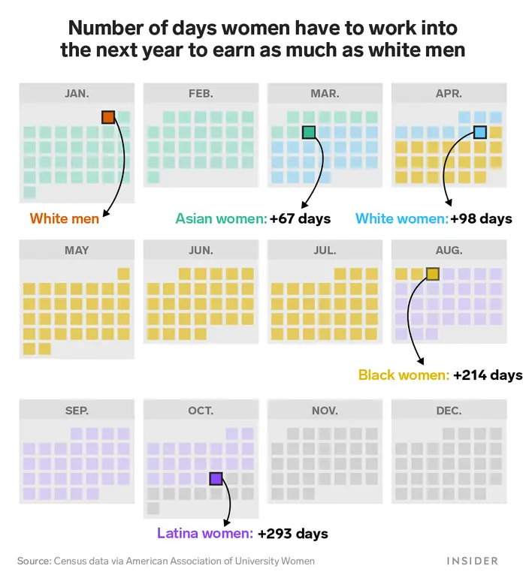

Slide 26
Anti-Feminism in the US
The New Right, especially the evangelical Christian Right, celebrate ‘traditional family values’
The New Right believes the traditional nuclear family to be the most important pillar of a moral and successful society.
Changing nature of family in the US
The Working Woman

Slide 27
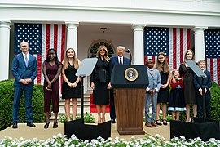
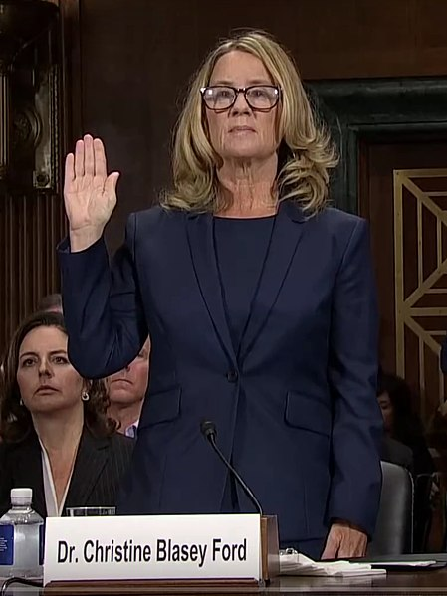
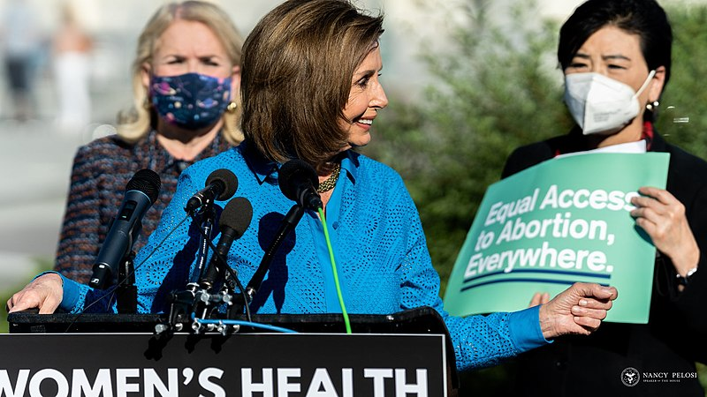
Political Issues and Gender

Slide 28
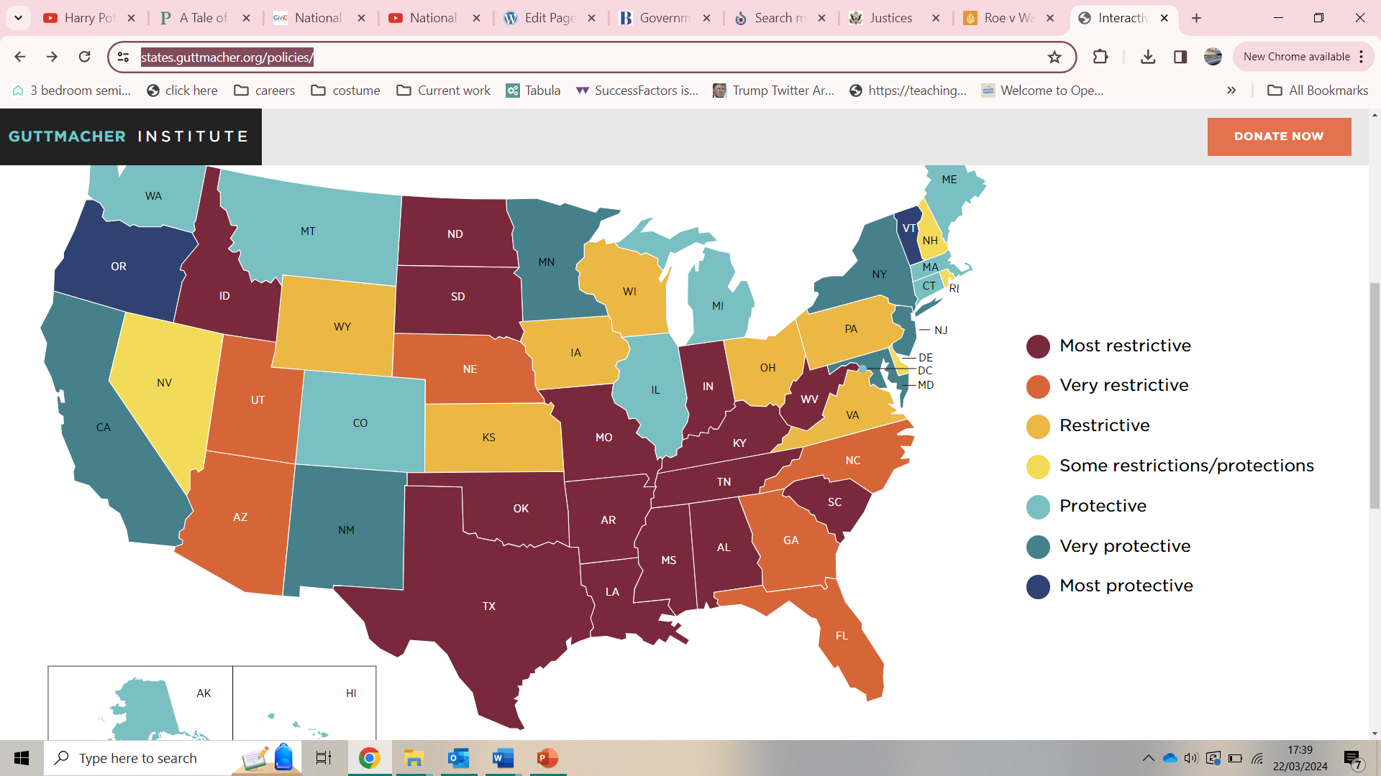
Source: Guttmacher Institute, https://states.guttmacher.org/policies/

Slide 29
Conclusion
Have examined how gender has played a role in US politics historically.
How gender influences voting behaviour, and how far descriptive representation has been achieved with regard to gender.
To what extent masculinity and femininity impact campaigning, using 2016 and 2020 as examples.

