Slide 1
The past intrudes into the present
For Sethe,“the future was a matter of keeping the past at bay’
LO: to explore different forms of memory in ‘Beloved’

Slide 2
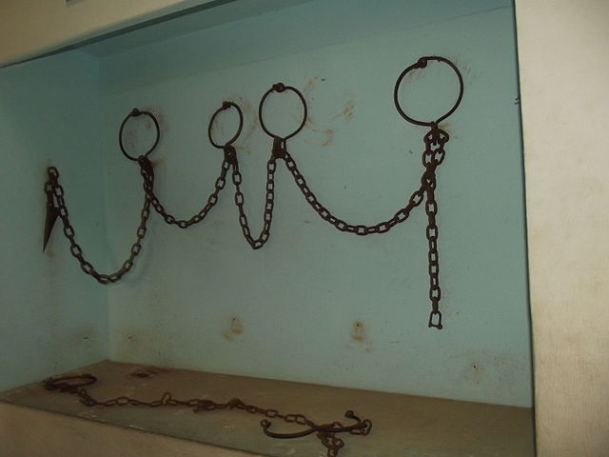
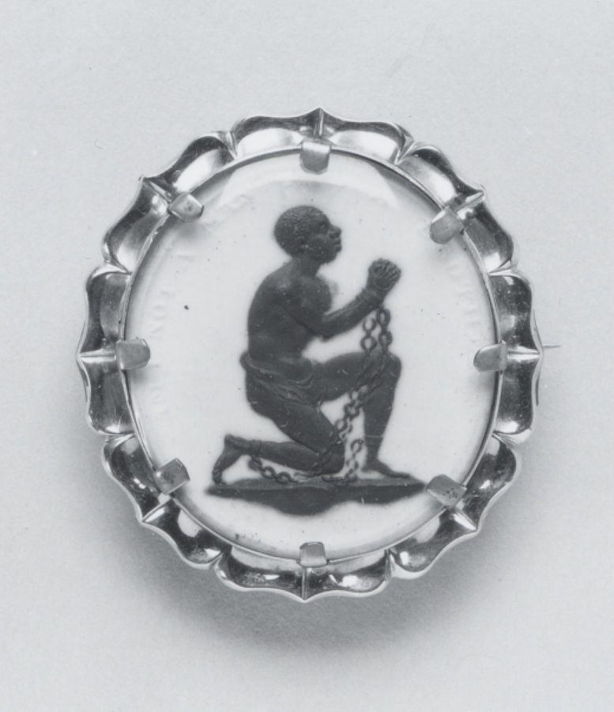
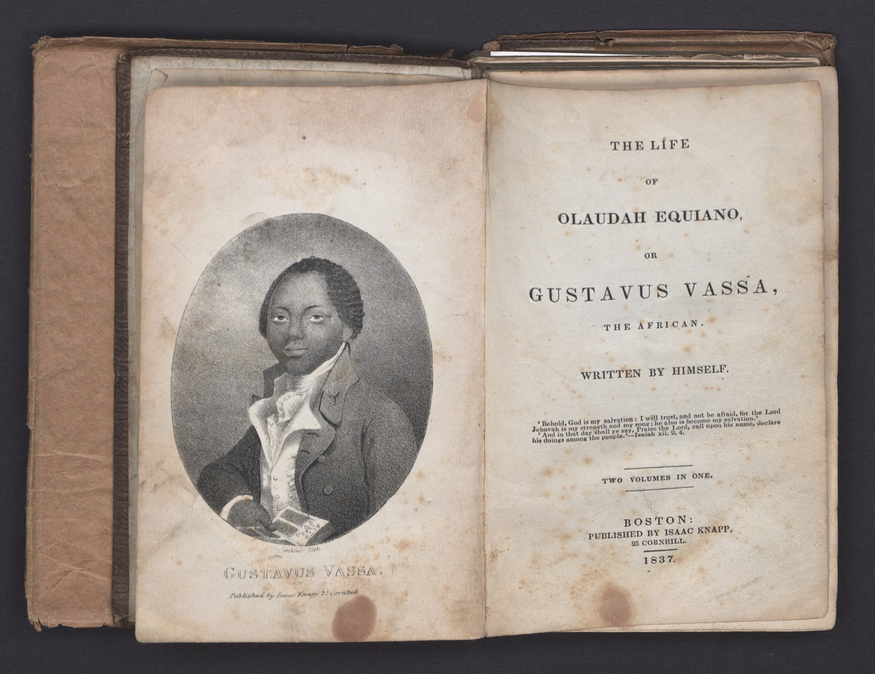
Image: Chains used in slave trade
Image: Wedgwood Anti-Slavery Medallion, Walters Art Museum. Below: Decks of Slave Ship, William O. Blake, 1861.
Objects and History:
What can these artefacts tell you about the history of slavery and its different facets?
Middle passage and Roots : https://youtu.be/0IJrhQE6DZk
Reconstruction, in U.S. history, the period (1865–77) that followed the American Civil War and during which attempts were made to redress the inequities of slavery and its political, social, and economic legacy.
Watch this video to learn more: https://www.britannica.com/event/Reconstruction-United-States-history

Slide 5
Starter: mind-map the protagonists!
Inside the figure: What desires does the character have / What does the character wish for?
Inside the figure: What are their main fears or traumata?
Inside the figure: How would you describe their personality?
Outside the figure: What is their situation and environment like? Add contextual ideas (key words: slavery, underground railroad, Margaret Garner, Middle Passage / triangle trade, abolition, fugitive slave acts)
On the ‘skin’ / border between inside and outside: What conflicts and struggles emerge from this?

Slide 6
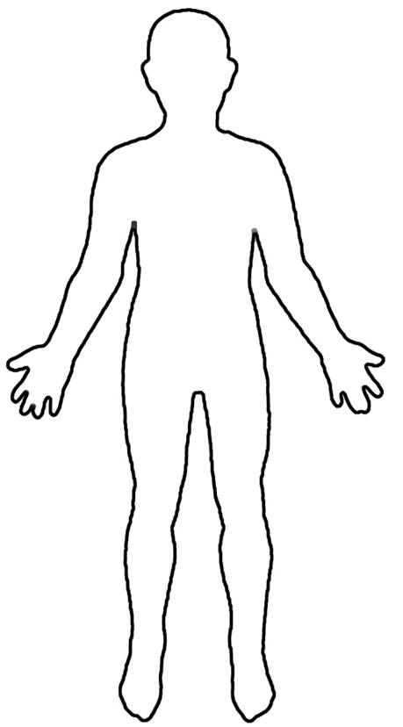
Sethe
Halle's girl--the one with iron eyes and backbone to match. […]A face too still for comfort; irises the same color as her skin, which, in that still face, used to make him think of a mask with mercifully punched out eyes. […] Even in that tiny shack, leaning so close to the fire you could smell the heat in her dress, her eyes did not pick up a flicker of light. They were like two wells into which he had trouble gazing. Even punched out they needed to be covered, lidded, marked with some sign to warn folks of what that emptiness held.
Image: Public Domain

Slide 7
Paul D
For a man with an immobile face it was amazing how ready it was to smile, or blaze or be sorry with you. As though all you had to do was get his attention and right away he produced the feeling you were feeling. With less than a blink, his face seemed to change—underneath it lay the activity.
Image: Public Domain

Slide 8
Baby Suggs
Her past had been like her present--intolerable—and since she knew death was anything but forgetfulness, she used the little energy left her for pondering color. "Bring a little lavender in, if you got any. Pink, if you don’t.”
Image: Public Domain

Slide 9
Denver
DENVER'S SECRETS were sweet. Accompanied every time by wild veronica until she discovered cologne. The first bottle was a gift, the next she stole from her mother and hid among boxwood until it froze and cracked. That was the year winter came in a hurry at suppertime and stayed eight months.
Image: Public Domain

Slide 10
Sixo
The kind of thing Sixo would do--like the time he arranged a meeting with Patsy the Thirty-Mile Woman. It took three months and two thirty-four-mile round trips to do it. To persuade her to walk one-third of the way toward him, to a place he knew. A deserted stone structure that Redmen used way back when they thought the land was theirs. Sixo discovered it on one of his night creeps, and asked its permission to enter. Inside, having felt what it felt like, he asked the Redmen's Presence if he could bring his woman there. It said yes and Sixo painstakingly instructed her how to get there,
Image: Public Domain

Slide 11
Who’s Beloved?
The name ‘Beloved’ is non the gravestone, but it’s not actually the name of Sethe's daughter
This word is used at funerals and weddings – what does this signify?
She might be…
The executed daughter come to life (and perhaps willed into existence by Sethe and Denver)
A physical embodiment of the spiteful poltergeist and therefore a malignant presence
Incarnation of Sethe's guilt and her unforgiving memory
America’s past of slavery and the Middle Passage

Slide 12
What is memory?
Which of these ideas about memory are most relevant to ‘Beloved’? Why?
“Those who cannot remember the past are condemned to repeat it” (George Santayana, 1905)
Memory is the ‘past made present’(Michael Rothberg 2009)
“Our memory has no guarantees at all, and yet we bow more often than is objectively justified to the compulsion to believe what it says.” (Sigmund Freud)
On trauma: Pierre Janet (late 19th century) contrasted “traumatic” and “narrative” memory. Janet links traumatic memory to a bodily memory – might be triggered by smells, sounds, other sensations, or might occur in nightmares, too
On cultural memory: “Memory is cultural: it is our symbolic heritage conveyed in texts, rites, monuments, celebrations, objects, sacred scriptures and other media that serve as mnemonic triggers” (Jan Assmann)
TS Eliot: “Why, for all of us, out of all we have heard, seen, felt, in a lifetime, do certain images recur, charged with emotion, rather than others? The song of one bird, the leap of one fish, at a particular place and time, the scent of one flower, […]: such memories may have symbolic value, but of what we cannot tell, for they come to represent the depths of feeling into which we cannot peer.”

Slide 13
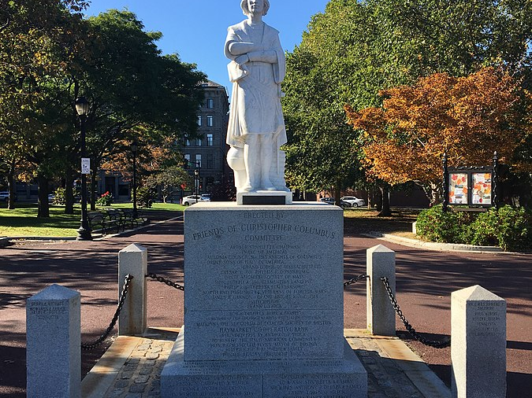
Cultural Memory: Contested Memory
Questions to discuss:
In Beloved, Toni Morrison evokes the memory of Margaret Garner, who is a contested figure, and was at the heart of controversies surrounding slavery and emancipation. Why would she have chosen this controversial figure? What kind of cultural memories is she interested in?
African American memory is often linked to oral culture / storytelling and folklore. Does this echo in Beloved, too? How does this influence Toni Morrison's style?
Watch this video as an example: https://youtu.be/-L5xOMTKf2A
Why is this the case? Read up on this here: https://theconversation.com/how-african-american-folklore-saved-the-cultural-memory-and-history-of-slaves-98427
Image above: Christopher Columbus Statue, Boston, whose head was removed by protesters in June 2020. Photographer: Slugger O’Toole, subject to the following license https://commons.wikimedia.org/wiki/File:Columbus_Statue.jpg

Slide 14
So how does Toni Morrison present the past and memory?
Key Idea:
For Toni Morrison, memory (the deliberate act of remembering) is a form of willed creation. It is not an effort to find out the way it really was- that is research. The point is to dwell on the way it appeared and why it appeared in that particular way
Questions to ask:
Authoritative or subjective? Shared or solitary?
Reliable or unreliable?
Willed or suddenly occurring?
How related to forgetting?
Is remembering thinking or feeling?
Reminder on Style:
Beloved is characterised by a style that is elliptical, and time-scales that are quite elastic:
references are made to events or characters that are only explained later on: coherence is denied
memories (of Sweet Home, Sethe’s escape, etc) start here and there, so that the present is ‘shot through’ with the past – but they aren’t developed chronologically
Also, language is open to ambivalence, multiple meanings, and contradictory connotations:

Slide 15
Annotate your extract!
Key Idea:
For Toni Morrison, memory (the deliberate act of remembering) is a form of willed creation. It is not an effort to find out the way it really was- that is research. The point is to dwell on the way it appeared and why it appeared in that particular way
Questions to ask:
Authoritative or subjective? Shared or solitary?
Reliable or unreliable?
Willed or suddenly occurring?
How related to forgetting?
Is remembering thinking or feeling?
Reminder on Style:
Beloved is characterised by a style that is elliptical, and time-scales that are quite elastic:
references are made to events or characters that are only explained later on: coherence is denied
memories (of Sweet Home, Sethe’s escape, etc) start here and there, so that the present is ‘shot through’ with the past – but they aren’t developed chronologically
Also, language is open to ambivalence, multiple meanings, and contradictory connotations:

Slide 16
Sum it up!
In what ways does the past intrude into the present in Beloved?

