Slide 1
Exploring nature
In what ways is it significant that Amy Denver suggests Sethe’s scar looks like a tree?
Map out this ,metaphor – what is the difference between a scar and a tree?
What happens when we describe a scar to be like a tree?
LO: Why and how does Toni Morrison craft her novel relying on nature and animal imagery?

Slide 2
Explore Sethe’s escape On A3 sheets, track the escape narrative from one symbolic image to the next; add quotations and annotate how these figurative elements shape the narrative Evaluate: Which images are related to nature, which are related to man-made culture? Which dominates? How does Sethe relate to either?
2. Denver and Beloved: Two crossings (88-99)
What is the link between Beloved’s memory of a ‘dark’ place and the story of Sethe’s escape?
P. 91: mossy teeth
P. 92/93: Amy’s “tender-hearted mouth” and the tree
P. 95/96: Lady Button Eyes
P. 98: water
p. 99: bluefern
1. Denver’s birth in Sethe’s rememory (36-42)
P. 36: antelope
P. 38: snake
P. 40: velvet
P. 42: imagery relating to death and life
P. 50: A charmed child? Sethe telling Paul D about Denver
3. Arrived: Stamp Paid and Ella
p.106-111:
from the Ohio river to crystal earrings

Slide 3
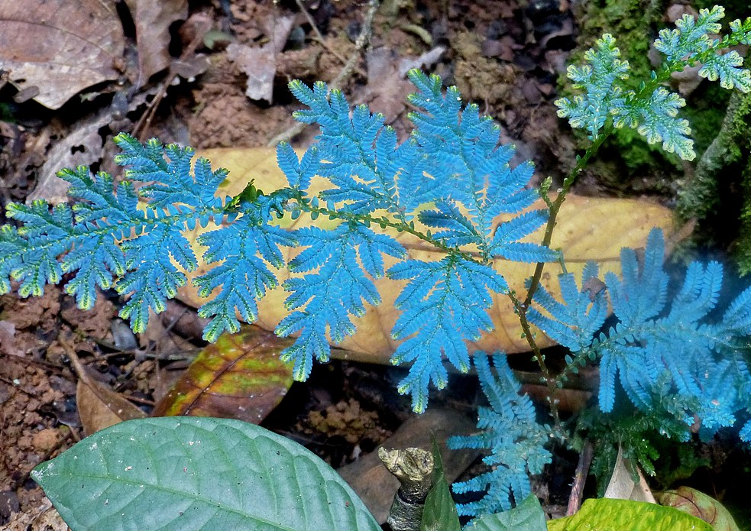
Bluefern and the Ohio river
Images: Left, Ohio River (public domain); Right, peacock fern, photographer: Bernard Dupont, https://commons.wikimedia.org/wiki/File:Peacock_Fern_(Selaginella_wildenowii)_(8681119528).jpg

Slide 4
How do oral storytelling and folk tales influence Toni Morrison’s style?

Slide 5
Why does Toni Morrison shape her novel via nature and animal imagery? Context: Folk tales
When slaves arrived in the New World from Africa in the 1700s and 1800s, they brought with them a vast oral tradition.
The details and characters of the stories evolved over time in the Americas, though many of the motifs endured.
Oral cultures are so significant because slaves were forced into illiteracy – this was a means to keep control and stifle ideas of freedom and independence
One important way counteracting this was through folk tales, which the African slaves used as a way of recording their experiences – these were retold in secret, adapted to their enslaved situation, adding in elements of freedom and hope
As regards languages, slaves were often multi-lingual, speaking creole or English as well as other languages, which could include American indigenous languages
Listen to an example of such a folk tale here: https://youtu.be/-L5xOMTKf2A
Typical motifs:
Although folktales reflected the uncertainties of life for enslaved African Americans, they also provided a message of stability and assurance.
The mother image found in some tales, for example, represents tenderness and goodness
the child-hero is a symbol of purity and innocence
smaller, less-powerful creatures, such as Brer Rabbit, always outsmart the larger, stronger characters, such as Brer Fox and Brer Bear.
They often reflect the slaves’ desire to outwit their stronger, more-powerful owners. In the brutal world of the slaves, these images meant a great deal.

Slide 6
Zora Neale Hurston’s collected folk tales: How the snake got his poison
God looked off towards immensity and thought about de subject for awhile, then he said, "Ah didn't mean for nothin' to be stompin' you snakes lak dat. You got to have some kind of a protection. Here, take dis poison and put it in yo' mouf and when they tromps on you, protect yo’ self.“
So de snake took de poison in his mouf and went on back. So after awhile all de other varmints went up to God.
"Good evenin', God."
"How you makin' it, varmints?"
"God, please do somethin' 'bout dat snake. He' layin’ in de bushes there wid poison in his mouf and he's strikin' everything dat shakes de bush. He's killin' up our generations. Wese skeered to walk de earth."
So God sent for de snake and tole him:
"Snake, when Ah give you dat poison, Ah didn't mean for you to be hittin' and killin' everything dat shake de bush. I give you dat poison and tole you to protect yo'self when they tromples on you. But you killin' everything dat moves. Ah didn't mean for you to do dat."
De snake say, "Lawd, you know Ah'm down here in de dust. Ah ain't got no claws to fight wid, and Ah ain't got no feets to git me out de way. All Ah kin see is feets comin' to tromple me. Ah can't tell who my enemy is and who is my friend. You gimme dis protection in my mouf and Ah uses it."
God thought it over for a while then he says:
"Well, snake, I don't want yo' generations all stomped out and I don't want you killin' everything else dat moves. Here take dis bell and tie it to yo' tail. When you hear feets comin' you ring yo' bell and if it's yo' friend, he'll be keerful. If it's yo' enemy, it's you and him."
So dat's how de snake got his poison and dat's how come he got rattles.
"Well, anyhow, Mr. Jim, please tell us how come de snakes got poison.“
Well, when God made de snake he put him in de bushes to ornament de ground. But things didn't suit de snake so one day he got on de ladder and went up to see God.
"Good mawnin', God."
"How do you do, Snake?"
"Ah ain't so many, God, you put me down there on my belly in de dust and everything trods upon me and kills off my generations. Ah ain’t got no kind of protection at all.”
How could you use the idea of folk tales (and the snake in this particular folk tale ) to explain Sethe’s identification with a snake with more nuance?

Slide 7
More Context: Why Antelopes?
Chiwara, (Chi wara or Tyiwar): antelope figure of the Bambara (Bamana) people of Mali
represents the spirit that taught humans the fundamentals of agriculture. The Bambara honour Chiwara though art and dance.
About the Antelope Headcrest (Chi Wara) from Mali:
https://youtu.be/NwvOmp131e4
Mali – masked dance: https://youtu.be/i3tTZAZT65I
Image: Antelope Headdress (Public Domain)

Slide 8
Sum it up!
What does nature signify in Toni Morrison's Beloved?

