Slide 1



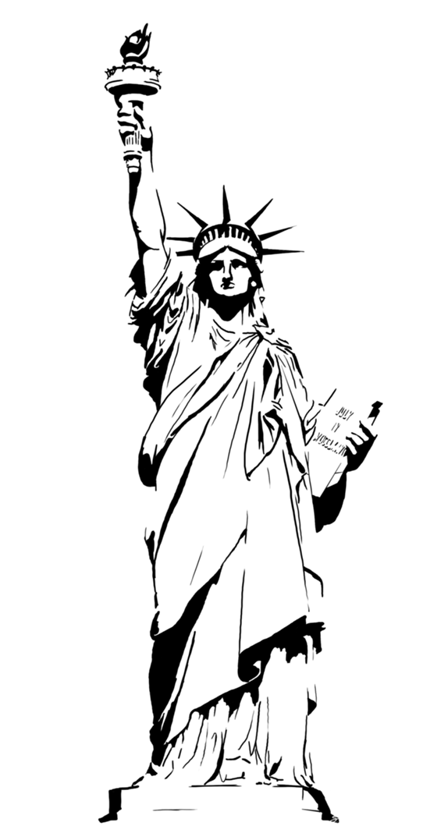

The Supreme Court
Why did the Court overturned Roe v Wade?

Slide 2
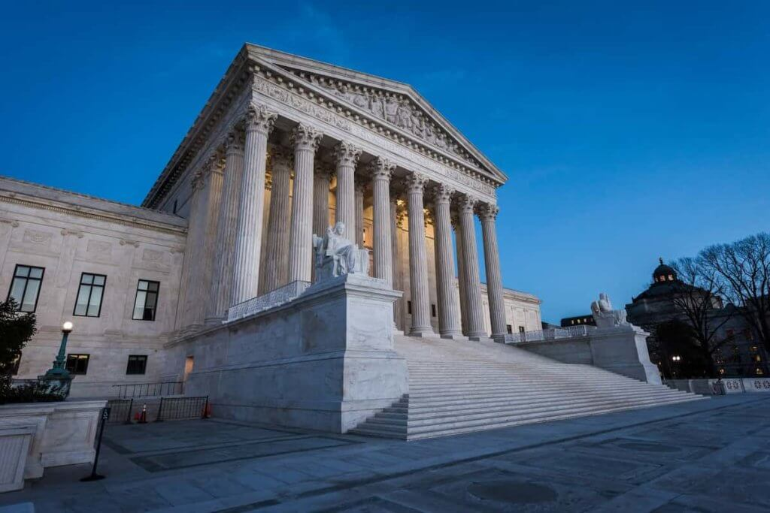

Lecture outline
The Powers of the Supreme Court
The Current Supreme Court
Momentous decisions
How does the Court make decisions?
Overturning Roe v. Wade

Slide 3
The Powers of the Supreme Court
Article III Section 1 of the Constitution
  “The judicial Power of the United States, shall be vested in one supreme Court, and in such inferior Courts as the Congress may from time to time ordain and establish. The Judges, both of the supreme and inferior Courts, shall hold their Offices during good Behaviour, and shall, at stated Times, receive for their Services, a Compensation, which shall not be diminished during their Continuance in Office.”
Marbury v Madison (1803) – the power of judicial review
  A ‘discovered’ power, not in the Constitution. It is the role of the judiciary to decide what the law is, and decide what is constitutional and what is not.
Not the power of enforcement

Slide 4
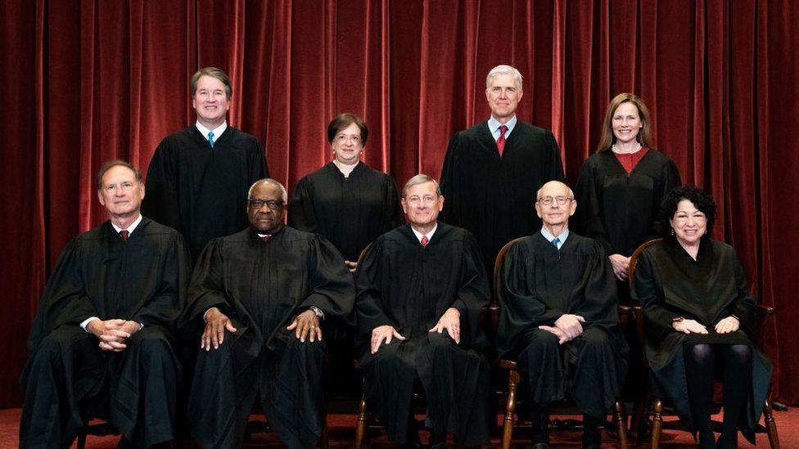
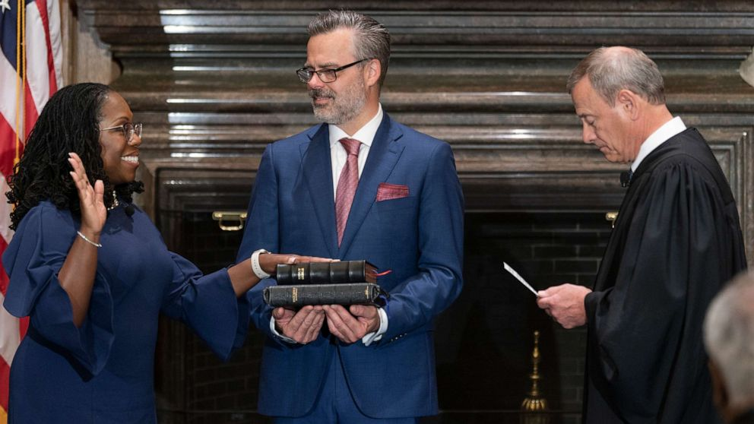
The Current Court
Nine Justices
Nominated by the President, confirmed by a simple majority in the Senate
No term limits
Justice Breyer retired, and Justice Brown Jackson sworn in on 30 June, 2022.
Getty Images
Fred Schilling, Collection of the Supreme Court of the United States

Slide 5
Momentous Decisions
Dred Scott v. Sanford (1857) – No descendent of slaves could be a citizen of the United States.
Plessy v. Ferguson (1896) – the 14th amendment allows for segregation
Brown v. Board of Education (1957) – segregation is unconstitutional
Miranda v. Arizona (1966) – established ‘Miranda rights’
Roe v. Wade (1973) – the right to access abortion is protected
Citizens United v. FEC (2010) – political donations are an act of ‘free speech’
Obergefell v. Hodges (2015) – all states must recognise same-sex marriages, and issue marriage licenses to same-sex couples.

Slide 6
How Do Justices
Make Decisions?
Key Concepts
Strategic Model
Attitudinal Model
Activism vs Restraint
Legal Model
Conservative vs Liberal
Attitudinal Model: there are now six ‘conservative’ justices and three ‘liberal’ justices on the Supreme Court

Slide 7
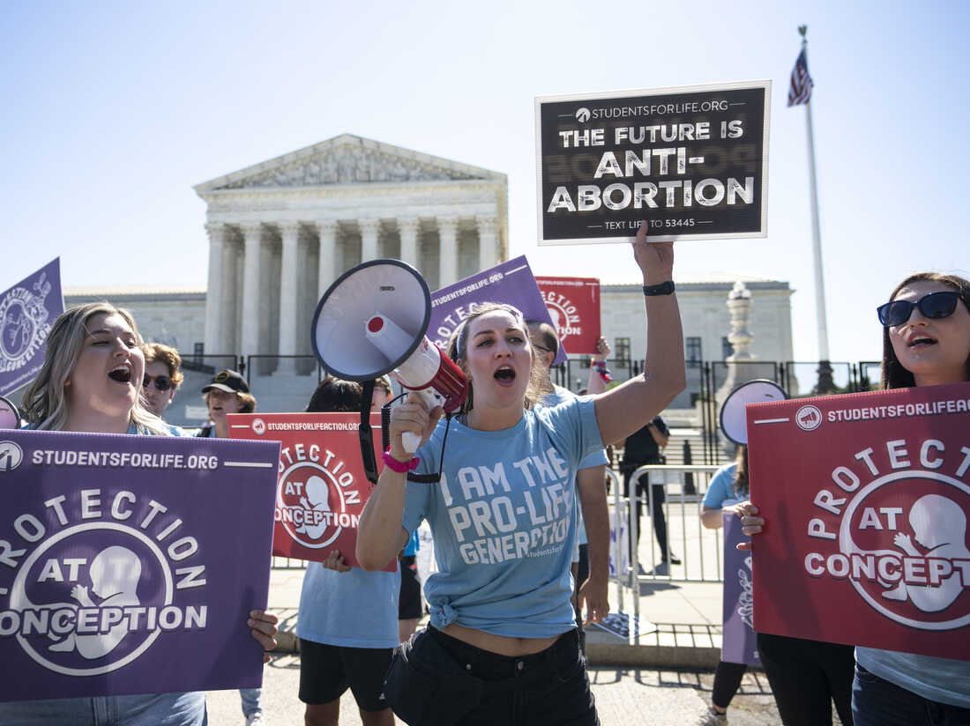
The Challenge to
Roe v. Wade
Drew Angerer/Getty Images
With the Court becoming more ‘conservative’ since Trump’s appointments, Republican-led states began to put in place laws which challenge Roe v. Wade and Planned Parenthood v. Casey (1992)
Dobbs v Jackson Women’s Health Organization, from Mississippi is taken up by the Court. Argued December 2021.
On 3 May, 2022 – Justice Alito’s draft opinion is leaked
24 June, 2022 – Roe v. Wade is overturned

Slide 8
What does the Decision Say?
“The Constitution does not confer a right to abortion; Roe and Casey are overruled; and the authority to regulate abortion is returned to the people and their elected representatives.”

Slide 9

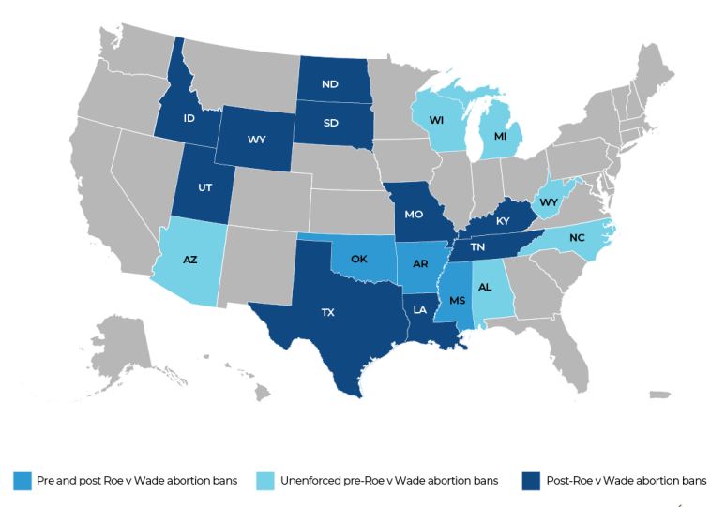
Where will Abortion be illegal?
Source: Al Jazeera

Slide 10

Does the Supreme Court need Reform?
Currently, Justices are independent, and appointed by democratically-elected presidents.
Checks on the Court: the power to impeach Justices.
Court Expansion.
Term limits for Justices.
To protect ‘policy areas,’ enshrine rights into the Constitution.

Slide 11
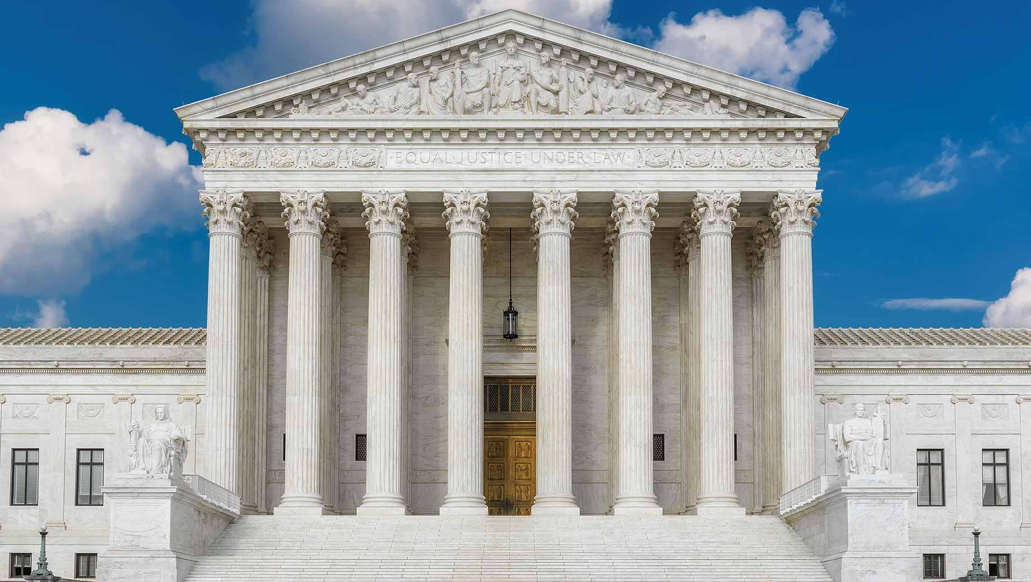
Questions for Seminars
Has the Supreme Court become too political?
Should Supreme Court justices have term limits?
Should some ‘policy areas’ be off-limits to the Supreme Court?

Slide 12
Summary
The Role of the Supreme Court
Decision-making by the Court
The Overturning of Roe v. Wade (1973)
Should the Court be Reformed?

