Slide 1


Analysing Photography in History
BAAS History Resources Series: History Skills

Slide 2
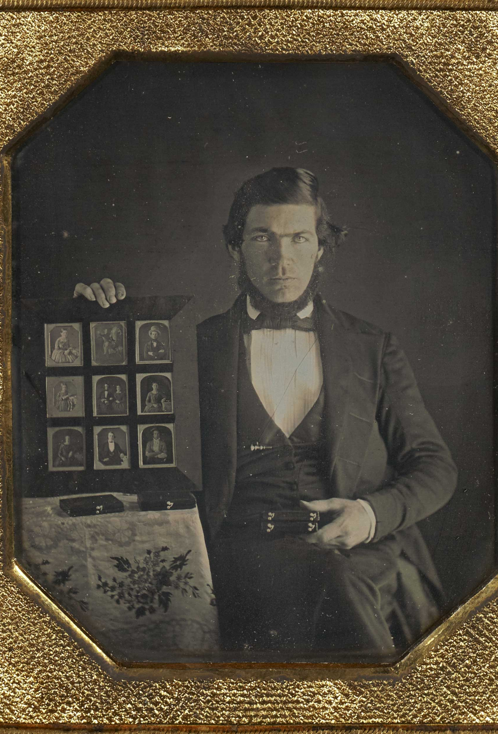
History of Photography
Photography was first invited in France in 1839 by Louis-Jacque-Mandé Daguerre, when he invented the daguerreotype. These were images produced under glass, that was fragile and expensive.
Marcy J. Dinius notes that “photography begun as daguerreotype, yet daguerreotypy is both like and unlike subsequent forms of photography.”
The daguerreotype would fall out of fashion with the emergence of easier and cheaper techniques, such as the calotype and the tintype.
Nonetheless, the invention of photography had a significant impact on American history, as people began to visualize themselves in new ways.

Slide 3
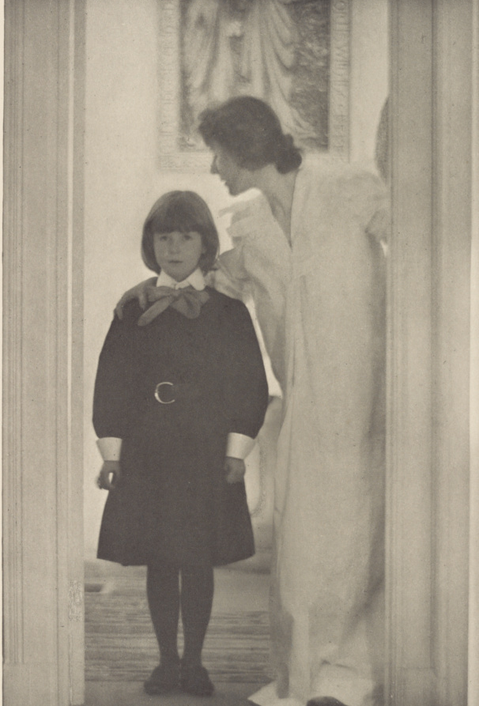
History of Photography
In the nineteenth century, photography would occupy a contested middle-ground between ‘science’ and ’art.’ Because of long exposure times, much of early photography focused on architecture and botany.
It was when ‘pictorialism’ emerged in the late nineteenth century that photography began to be increasingly considered for its artistic merit. Judith Fryer Davidov writes: “Pictorialist photographers, one might say, wished to preserve in their carefully crafted pictures the very thing Walter Benjamin would declare dead after the invention of photography: the aura, the unique and irreproducible quality that made a pictorial work ‘art.’”
Notable pictorialists include Peter Henry Emerson, Alfred Stieglitz, and Gertrude Käsebier (see her image Blessed Art Thou Among Women (1899) on the left).
This, paired with the increased accessibility of the camera with the invention of the Kodak camera in 1888, led to its expansion as a leisure activity.

Slide 4
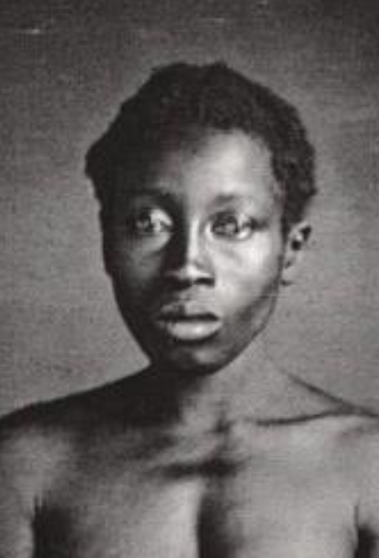
Role of Photography in American history
Beaumount Newhall argues that “of all countries, America adopted the daguerreotype with the most enthusiasm, and excelled in its practice.”
In 1850, the US census reported that there were 892 male daguerreotypists. Women’s occupations were not listed.
White supremacists attempted to use the camera to ‘prove’ African American inferiority. Thomas Zealy’s portraits of enslaved African Americans, taken at the behest of Louis Agassiz, attempted to find markers of ‘inferiority’ on their naked bodies.
Deborah Willis and Barbara Krauthamer wrote: “the pictures of Delia and Drana represented carefully composed images of black women’s bodies and faces that were designed to demonstrate their inherent racial difference and inferiority.”

Slide 5
Photographic Theories
There is no one right way to analyze a photograph. You can adopt a historical, cultural, art history approach – or all three. Some important photographic theorists include:
Susan Sontag – In On Photography (1977), Sontag argues that photography has encouraged an anti-intervention, voyeuritstic relationship with the world. If photography renders everything equally, then important events have no more meaning than anything else.
Deborah Willis – In books such as Reflections in Black (2000), Willis asserts the importance of a Black photographic history. She argues that African Americans utilized the camera to represent themselves in ways that countered notions of white supremacy.
John Szarkowski – In a 1964 exhibition entitled The Photographer’s Eye, Szarkowski articulated five parts of “the photographer’s special language: ‘The Thing Itself,’ ‘The Detail,’ ‘The Frame,’ ‘Time Exposure,’ and ‘Vantage Point.’”
We will explore one important photographer in more depth – Roland Barthes.

Slide 6
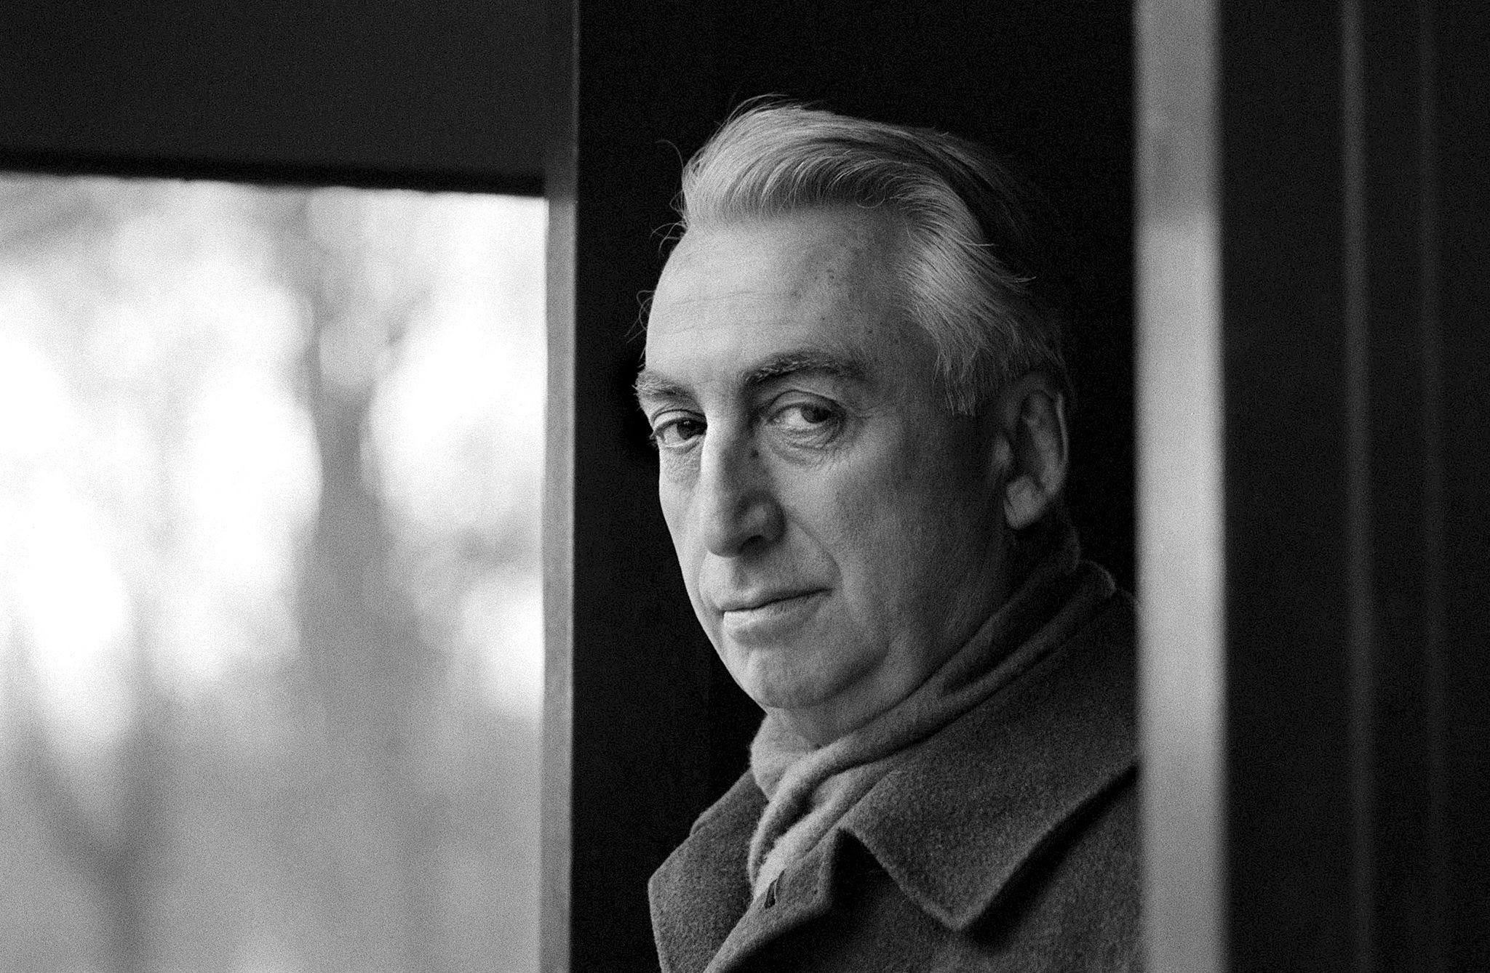
Who Is Roland Barthes?
Roland Barthes (1915-1980) was a French philosopher and literary theorist, who wrote on a number of topics, including popular culture.
One of his last works was Camera Lucida (1980). It is simultaneously a reflection on photography, and a eulogy to Barthes’s late mother.
In Camera Lucida, Barthes reflects on death and its relation to photography. He explores the ideas of the ‘stadium’ and the ‘punctum.’

Slide 7
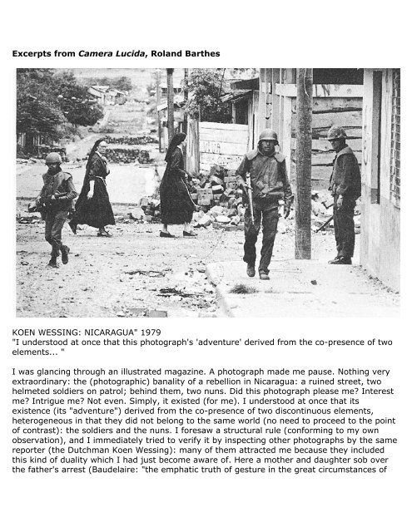
Understanding Photographic Theory and Roland Barthes: THE STUDIUM
According to Barthes, the ‘Studium’ is…
The interest in the photograph, and the broader reading of it.
It indicates the historical, social or cultural meanings of images.
“A kind of education (civility, politeness) that allows discovery of the operator.”
“I glance through them, I don't recall them; no detail (in some corner) ever interrupts my reading: I am interested in them (as I am interested in the world), I do not love them.”
In other words, he can absorb and interpret the image, but is not personally affected by it.

Slide 8
Photographic Theory and Roland Barthes: THE STUDIUM
Roland Barthes explains the studium using the Koen Wessing’s photograph Nicuragua (1979) to the right:
“I was glancing through an illustrated magazine. A photograph made me pause. Nothing very extraordinary: the (photographic) banality of a rebellion in Nicaragua: a ruined street, two helmeted soldiers on patrol; behind them, two nuns. Did this photograph please me? Interest me? Intrigue me? Not even.
Simply, it existed (for me). I understood at once that its existence (its 'adventure') derived from the co-presence of two discontinuous elements, heterogeneous in that they did not belong to the same world (no need to proceed to the point of contrast): the soldiers and the nuns.”

Slide 9
Photographic Theory and Roland Barthes: THE PUNCTUM
Roland Barthes describes the ‘punctum’ as…
An element which stands out to the individual in a photograph. It is often a small detail which takes on a personal significance to the viewer. This may reflect your personal values or experiences and is an emotional sensation.
“That accident which pricks, bruises me.”
This is the interpretation of an image which is unique to you and is often found in a detail in a photograph.

Slide 10
Photographic Theory and Roland Barthes: THE PUNCTUM
Roland Barthes explains the punctum using William Klein’s photograph Little Italy (1954) to the right:
“Yet the punctum shows no preference for morality or good taste: the punctum can be ill-bred. William Klein has photographed children of Little Italy in New York (I954); all very touching, amusing, but what I stubbornly see are one child's bad teeth.”

Slide 11
Works Cited
Roland Barthes, Camera Lucida (New York: Hill and Wang, 1981)
Judith Fryer Davidov, Women’s Camera: Self / Body / Other in American Visual Culture (Durham: Duke University Press, 1998).
Marcy J. Dinius, The Camera and the Press: American Visual and Print Culture in the Age of the Daguerreotype (Philadelphia: University of Pennsylvania Press, 2012).
Jeanne Moutoussamy-Ashe, Viewfinders: Black Women Photographers (New York & London: Readers and Writers Press, 1993).
Beaumont Newhall, The History of Photography: From 1839 to Present (New York: The Museum of Modern Art, 1984).
Susan Sontag, On Photography (New York: Penguin, 1979).
John Szarkowski, The Photographer’s Eye (New York: The Museum of Modern Art, 2007).
Deborah Willis, Reflections in Black: A History of Black Photographers, 1840 to Present (New York & London: W. W. Norton, 2000).
Deborah Willis and Barbara Krauthamer, Envisioning Emancipation: Black Americans and the End of Slavery (Philadelphia: Temple University Press, 2013).

