Slide 1


Mathew Brady and War Photography
BAAS History Resources Series: The Civil War

Slide 2
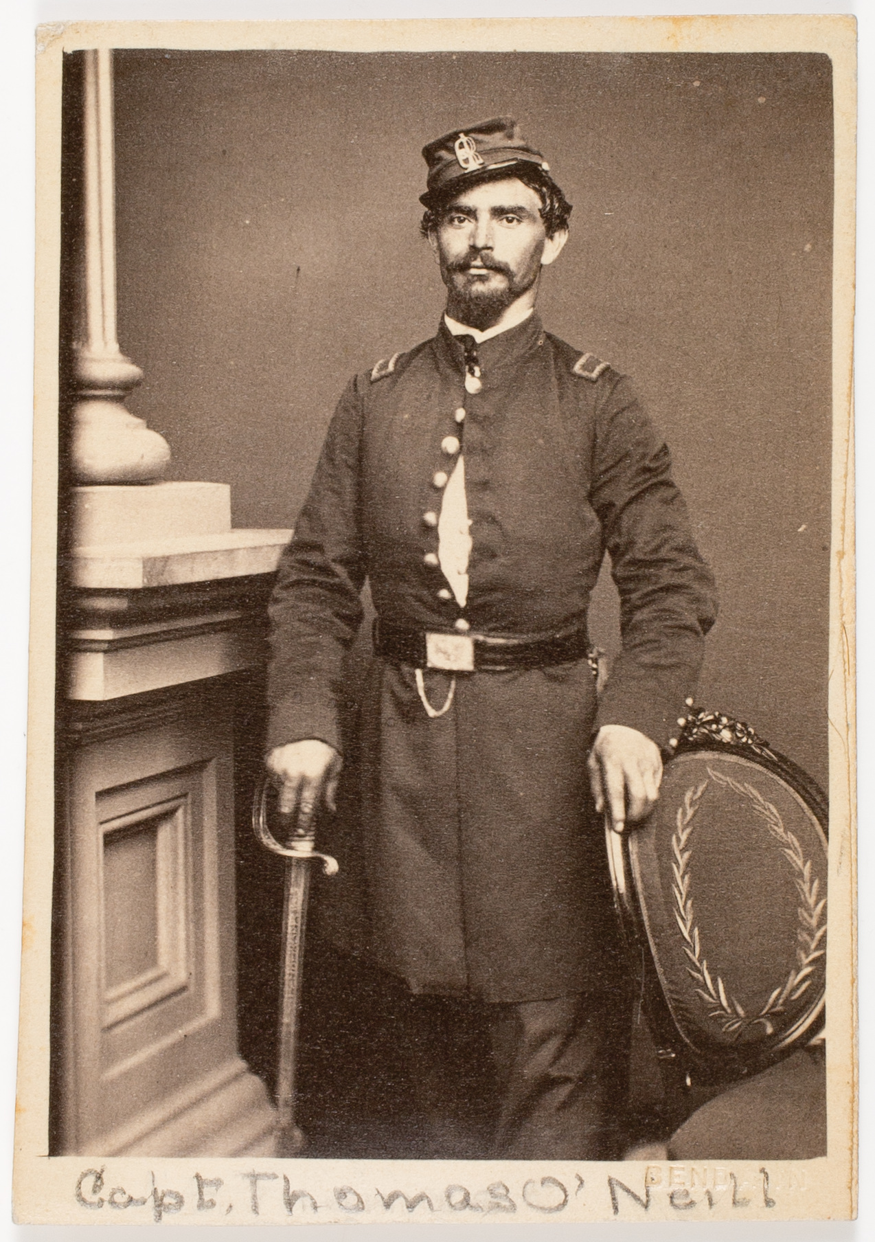
The Civil War and Photography
It is estimated that a million photographs were taken between 1860-1965, as there were 3,154 photographers active in the US in 1860.
When the Civil War started in 1861, photographer Mathew Brady and others jumped at the chance to photograph the conflict.
The Civil War would become one of the earliest conflicts to be photographed in-depth. Dozens of photographers used mobile darkrooms to create carte-de-visites. These were a kind of photograph that was mounted onto card.
Soldiers were keen to have images sent home to their families, and there was a public demand for images of the war.

Slide 3
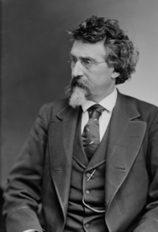
Mathew Brady
Prior to the start of the war, Brady was a successful portrait photographer. He was forty years old and most famous for his images of celebrities, including Abraham Lincoln.
There is debate over whether Brady chose to document the war out of economic self-interest, or out of a need to document the historical moment. Brady is quoted as saying: "I had to go. A spirit in my feet said 'Go,' and I went."
Brady did not often work as a field photographer himself due to his poor eyesight. He did, however, coordinate many photographers who worked in his name.
Brady was given permission to photograph the war, but at his own expense. He did not expect the war to last four years.
James Horan called him: “a historian with a camera.”

Slide 4
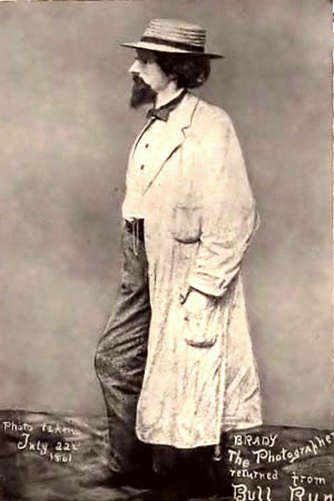
Portrait Photography
Mathew Brady has this portrait taken on his return from the Battle of Bull Run, wearing a saber which was given to him for defense by New York Fire Zouaves. The Battle of Bull Run was the first major battle of the war.
William A. Croffut wrote about seeing Brady for the New York Tribune:
  “His name was Brady, he added, and the protuberance on his back was a camera… I saw him afterwards dodging shells on the battlefield. He was in motion, but his machine did not seem effective, and when about two o’clock a runaway team of his horses came dashing wildly past us, dragging a gun carriage bottom side up, I saw Brady again and shouted, ‘Now’s your time!’ But I failed to stir him. I have often wondered how many pictures he took that day and whether he got out of the battle on our side or the other.”
This was one of the few times Brady saw combat. Brady was not able to take images of the battle, but still had this portrait taken. Why do you think that was?
He would also take portraits of leaders in the Civil War, including Abraham Lincoln (see next slide). Approximately 75% of Brady’s wartime photos were portraits.

Slide 5
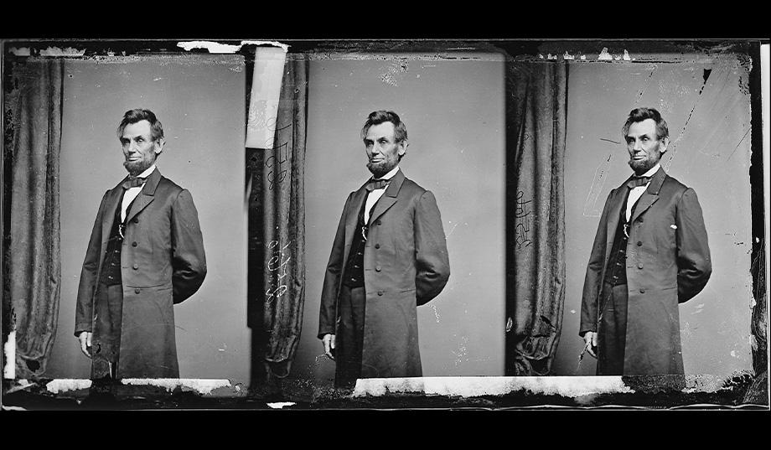

Slide 6
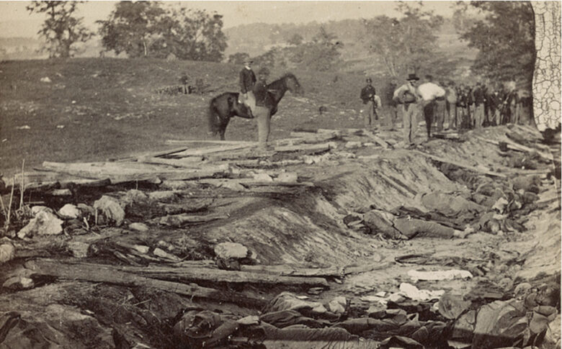
Battlefield Photography
It is notable that photography only captured the aftermath of battle, rather than battle itself. This was due to the danger of the battlefield and the long exposure times, making scenes with movement difficult to capture.
Photographs of the aftermath of Antietam were produced in the Brady name, which showed dead soldiers on the battlefield. When Brady exhibited the photographs in the window of his New York studio, hundreds of people crowded to see them. However, the photographers – Alexander Gardner and James Gibson – received no credit.
“It is so nearly like visiting the battlefields to look over these views that all the emotions excited by the actual sight of the stained and sordid scene, strewed with rags and wrecks, came back to us, and we buried them in the recesses of our cabinet as we would have buried the mutilated remains of the dead they too vividly represented.” – Author Oliver Wendell Holmes, who visited Antietam and saw Gardner’s images.

Slide 7
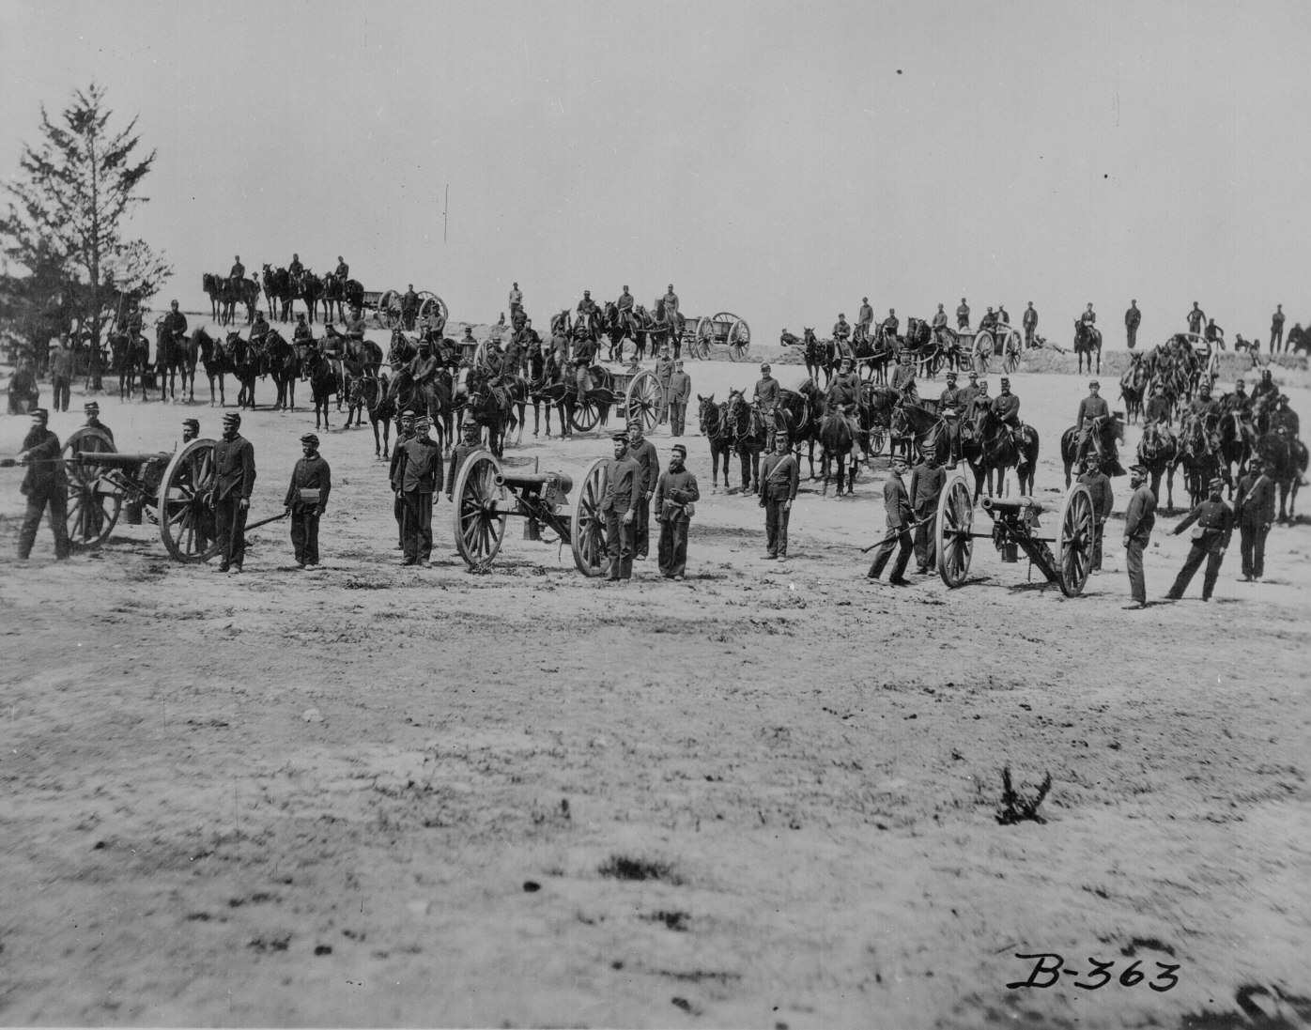
Camp Photography
Mathew Brady recognized that patriotic images would sell better with the general public.
He also wanted to document the war for historical record, hence Brady and his team took images of camp life, daily routines and chores.
Because of long exposure times and light levels, images of camps and units were easier to capture than scenes of conflict.

Slide 8
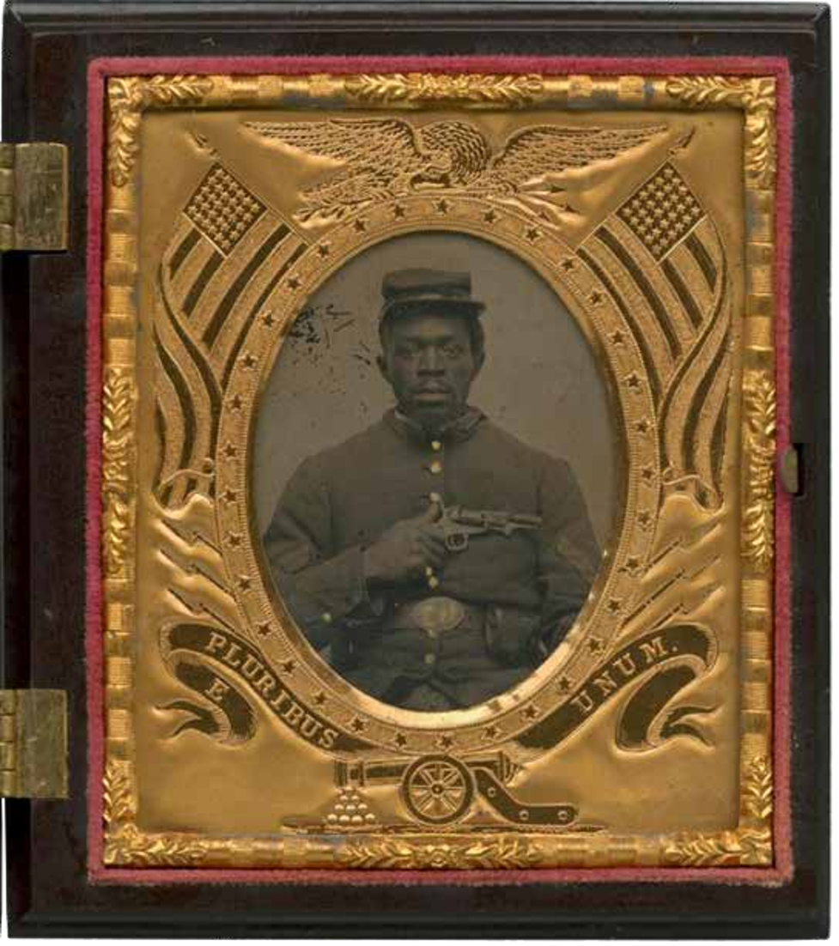
The Black Soldier
More than 186,000 Black Americans served in the Civil War in the United States. Photographers such as James Horace Wells, David C. Collins, John Ritchie, W H Leeson and Benjamin Powelson took photographs of African Americans involved in the Civil War.
Whilst there are some African Americans in Brady’s images, including a portrait of noted abolitionist Frederick Douglass, most of his archive focuses on white soldiers and leaders.
“Once [you] let the black man get upon his person the brass letter, US, let him get an eagle on his button, and a musket on his shoulder, and bullets in his pocket; and there is no power on the earth, or under the earth, that can deny that he has earned the right to citizenship in the United States.” – Frederick Douglass.
Historian Deborah Willis has argued “rediscovered voices and photographs help us grapple with a history that has often excluded stories about the bravery of black soldiers and the uncelebrated work of black women teachers and nurses.”
Why do you think so many African American soldiers wanted to have their portraits taken?

Slide 9
Mathew Brady’s Legacy
Once the war was over, the demand for images of war sharply declined amongst the public. Brady had hoped that the US government would buy his archive, but they refused.
Brady had spent a huge amount of his own money to photograph the war. When he was unable to sell his archive, he was unable to make back the cost or pay his debtors. His debts were covered when he sold the collection to Congress in 1875. However, Brady died in significant debt in 1896.
James Horan has called Brady “the father of photojournalism.”
The beginnings of photojournalism – Kari Cornell argues that Antietam marked the beginning of demands for ”realistic images of newsworthy events are taken as they are happening.”

Slide 10
Works Cited
Kari Cornell, Mathew Brady Records: the Civil War (Minneapolis: Essential Library, 2018)
James Horan, Mathew Brady: Historian with a Camera (New York: Crown Publishers, 1955)
Mary Panzer, Mathew Brady and the Image of History (Washington DC: Smithsonian Books, 1997)
Jeff L. Rosenheim, “ ‘Illustrations of Camp Life’: Thoughts on Mathew Brady’s overlooked early war series,” Military Images Detail, March 8, 2022, https://www.militaryimagesmagazine-digital.com/2022/03/08/illustrations-of-camp-life-thoughts-on-mathew-bradys-overlooked-early-war-series/
George Sullivan, In the Wake of Battle: The Civil War Images of Mathew Brady (Munich & London: Prestel, 2004)
Deborah Willis, The Black Civil War Soldier: A Visual History of Conflict and Citizenship (New York: New York University Press, 2021).
Online archive of Civil War photography: https://catalog.archives.gov/id/524418

