Slide 1


ZNH’s world
Starter:
What do you know about life in the 1920s and 1930s? How about life at that time in the US? Write a list with as many items as you can!
Learning Objective: to explore the context of Their Eyes Were Watching God, by Zora Neale Hurston.

Slide 2
ZNH Soundbites
Is this quote…
Self-ironic?
Offering wisdom?
Trying to respond to something painful?
…
“There are years that ask questions and years that answer.”
“Love makes your soul crawl out from its hiding place.”
“I love myself when I am laughing. . . and then again when I am looking mean and impressive.”
“Love is lak de sea. It’s uh movin’ thing, but still and all, it takes its shape from de shore it meets, and it’s different with every shore.”
“Sometimes, I feel discriminated against, but it does not make me angry. It merely astonishes me. How can any deny themselves the pleasure of my company? It’s beyond me.”
“If you are silent about your pain, they’ll kill you and say you enjoyed it.”
“If you kin see de light at daybreak, you don't keer if you die at dusk. It's so many people never seen de light at all.”
“Ships at a distance have every man's wish on board. For some they come in with the tide. For others they sail forever on the same horizon, never out of sight, never landing until the Watcher turns his eyes away in resignation, his dreams mocked to death by Time. That is the life of men.
Pick one quote that interests you. Why?

Slide 3
Zora Neale Hurston’s World
Create a mindmap with four sections:
Harlem Renaissance
Life in the Southern US
Remembering Slavery
ZNH – biography

Slide 4

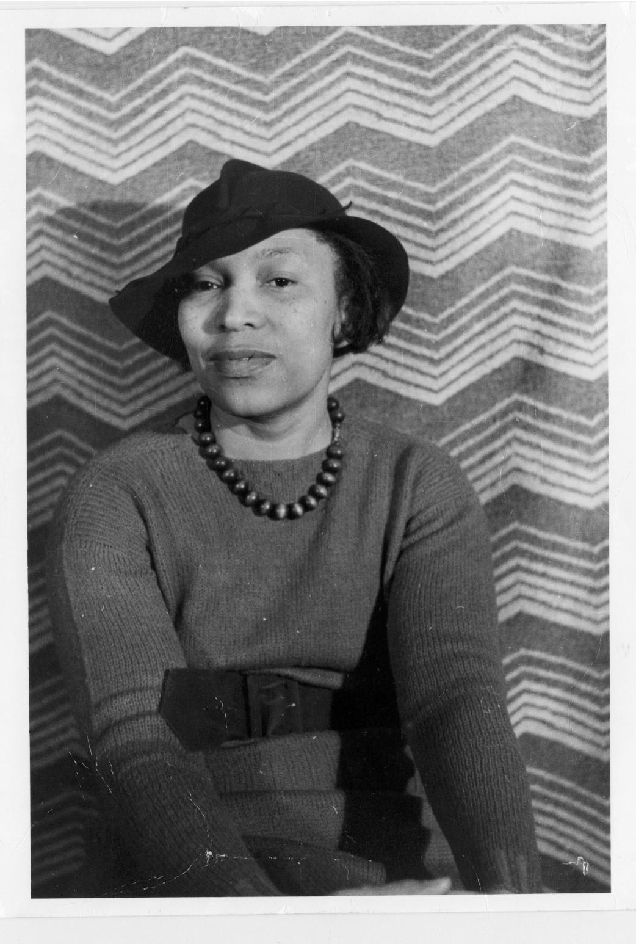

Meet Zora Neale Hurston
Born on Jan. 7, 1891, in Notasulga, Alabama
Brought up in Eatonville (established in 1887, the rural community near Orlando was the nation’s first incorporated black township)
1904: her mother dies “That hour began my wanderings. Not so much in geography, but in time. Then not so much in time as in spirit.”
Begins working in a series of menial jobs “Bare and bony of comfort and love”
1919: moves to Baltimore – in order to complete a school diploma, she presents herself to be 10 years younger (and would stick to this to the end of her life)
Graduates from college in 1928
Becomes a prolific writer, of anthropological research and fiction
Never reaps any financial rewards from this and dies in poverty on Jan. 28, 1960–at age 69

Slide 5
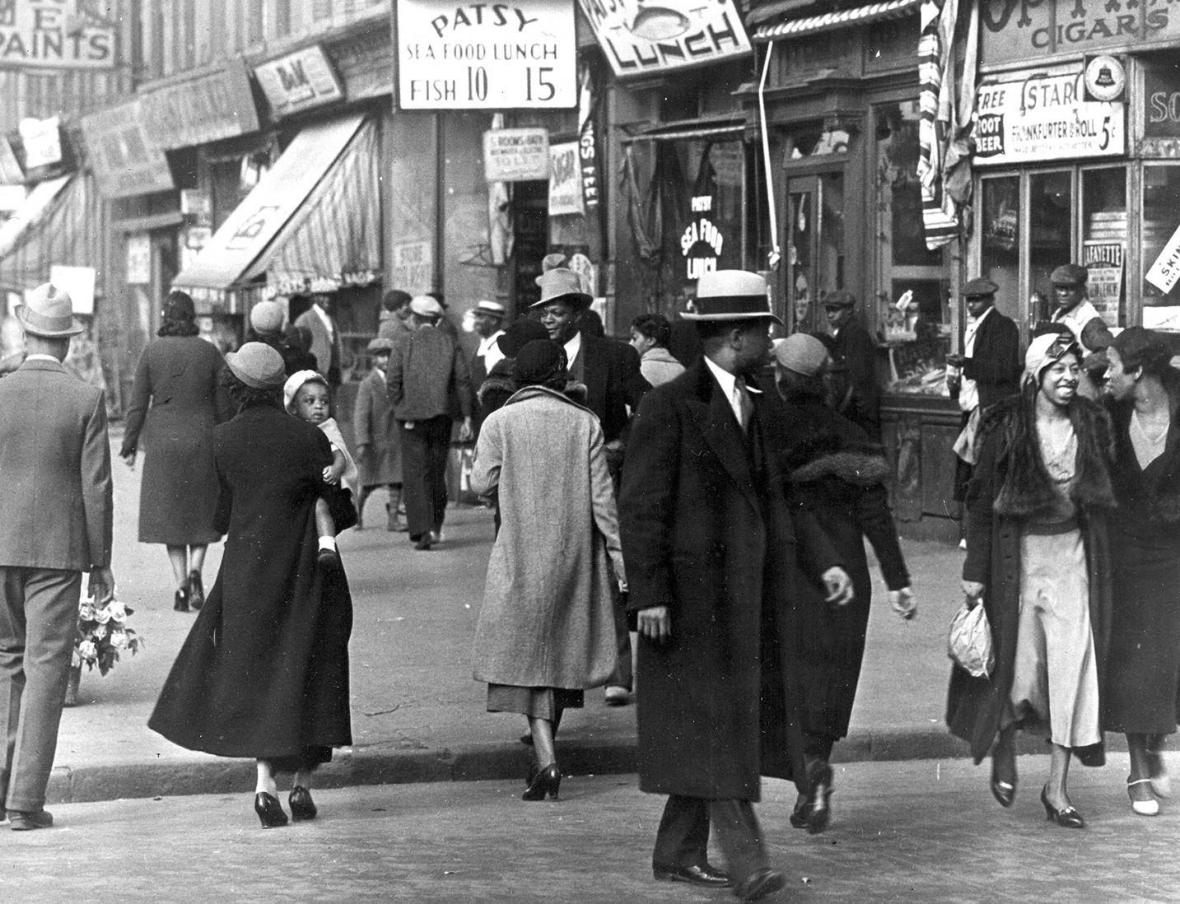
The Harlem Renaissance
The Harlem Renaissance Introduction: https://www.youtube.com/watch?v=9gboEyrj02g&ab_channel=BlackHistoryinTwoMinutesorso
We younger Negro artists who create now intend to express our individual dark-skinned selves without fear or shame. If white people are pleased we are glad. If they are not, it doesn’t matter. We know we are beautiful. And ugly too.
-Langston Hughes, “The Negro Artist and the Racial Mountain”

Slide 6
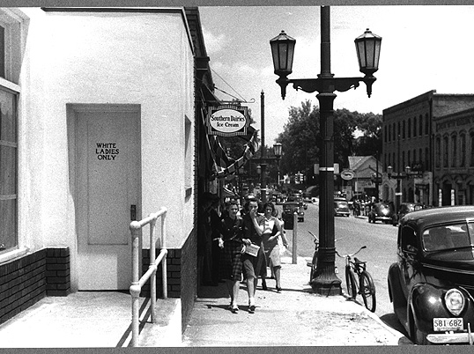
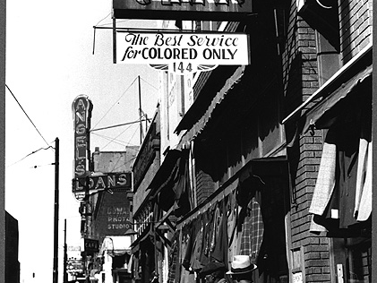
Life in the Southern States: Jim Crow Laws
Immediately after the Civil War ended, some states began imposing restrictions on the daily lives of African Americans, whether they were survivors of slavery or had always been free.
By the end of the 19th century, laws or informal practices that required that African Americans be segregated from whites were often called Jim Crow practices, believed to be a reference to a minstrel-show song, "Jump Jim Crow.“ By 1890, the legalization of Jim Crow had begun.
Slavery was gone but Jim Crow was alive. Almost all southern African Americans were shut out of the ballot box and the political power it could yield

Slide 7
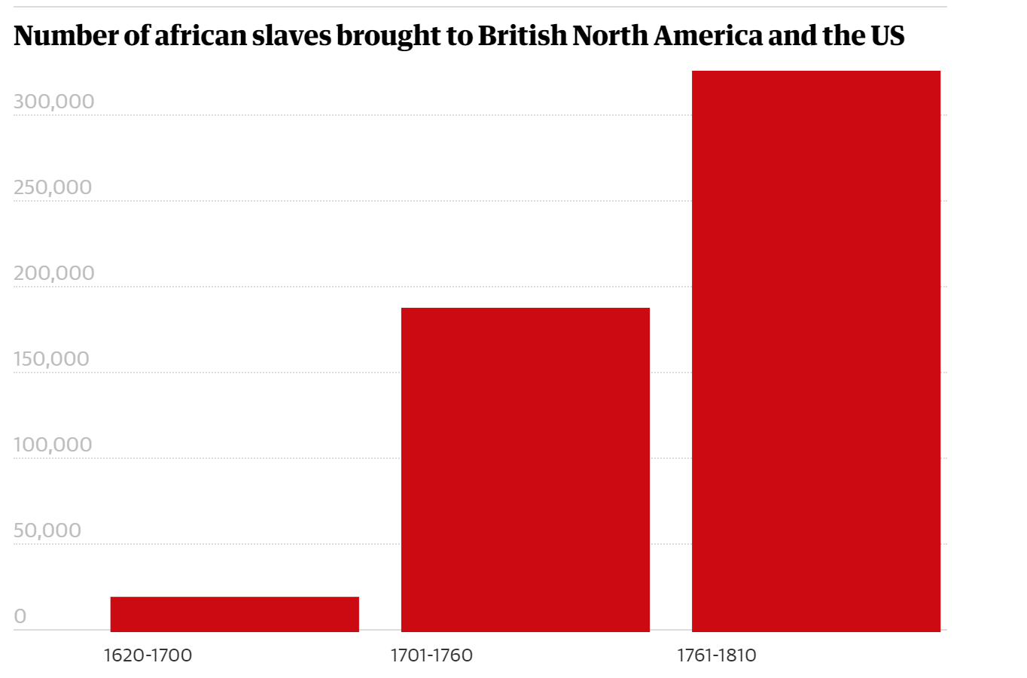
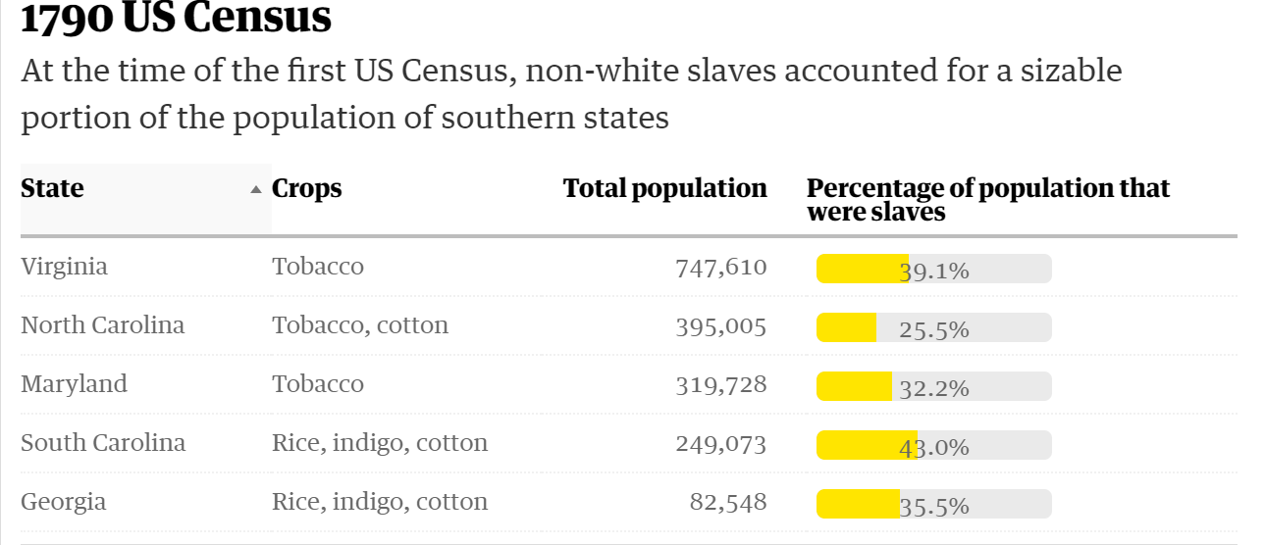
Remembering Slavery and Abolition
Factsheet:
In 1863, the Emancipation Proclamation symbolically established a national intent to eradicate slavery in the United States. Decades of state and federal legislation around civil rights followed. In January of 1865, the 13th amendment to the Constitution officially abolished slavery in this country.
During the period of slavery, free Blacks made up about one-tenth of the entire African American population. In 1860 there were almost 500,000 free African Americans—half in the South and half in the North. The free Black population originated with former indentured servants and their descendants. It was augmented by free Black immigrants from the West Indies and by Blacks freed by individual slave owners.
But free Blacks were only technically free. In the South, where they posed a threat to the institution of slavery, they suffered both in law and by custom many of the restrictions imposed on slaves. In the North, free Blacks were discriminated against in such rights as voting, property ownership, and freedom of movement, though they had some access to education and could organize. Free Blacks also faced the danger of being kidnapped and enslaved.
How does this link to British History?
The British-operated slave trade across the Atlantic was one of the biggest businesses of the 18th century. Approximately 600,000 of 10 million African slaves made their way into the American colonies before the slave trade – not slavery – was banned by Congress in 1808. By 1860, though, the US recorded nearly 4 million enslaved black people – 13% of the population – in the country as the American-born population grew.
Primary Sources:
You can explore the photo gallery at the Library of Congress: https://www.loc.gov/items/2018666163,2018666988,2016809838,2016809839?st=gallery

Slide 8
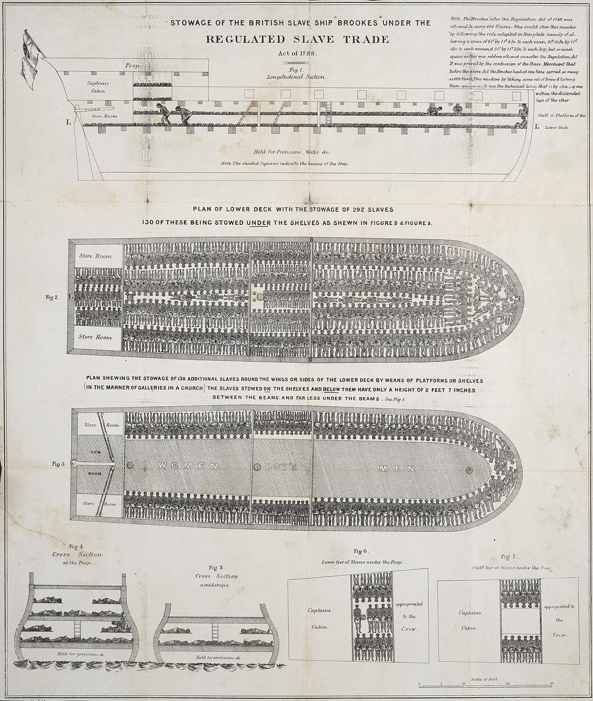
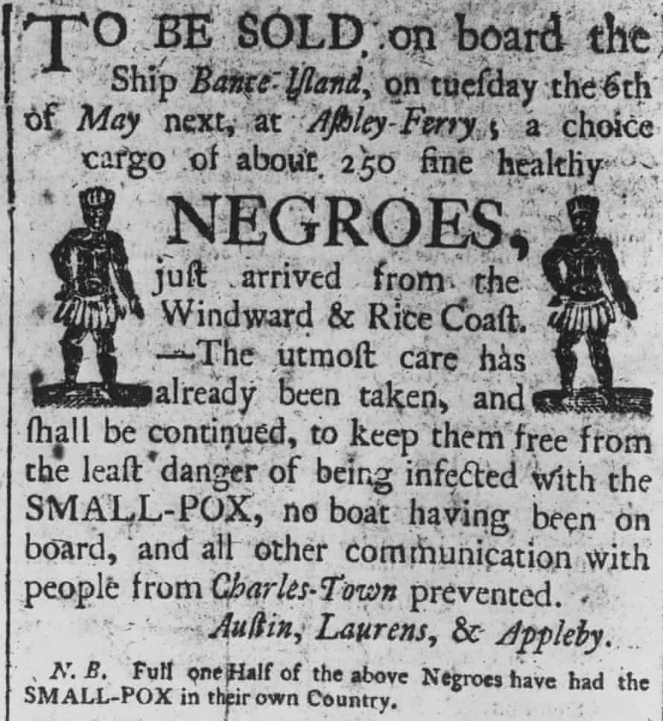

Slide 9
How did ZNH see herself in this Context?
Read the extract from ‘how it feels to be coloured me’
How does Hurston present herself here?
What does she mean when she says she is not ‘tragically coloured’?
When she says ‘the cosmic Zora emerges’, what might she mean by that? How would you characterize her tone here?
When she portrays herself as “a brown bag of miscellany propped against a wall,” how would you understand this? Is this metaphor serious, humorous – or both?
Overall, what can you infer about her opinions on identity?

Slide 10
ZNH’s world
How might she answer this question:
What makes for a happy / fulfilled life?

