Slide 1




Power, leadership, or hubris?
On your sheets / books…
How would you define these three terms? What is the difference between them?
LO: to explore how ZNH develops Joe Starks’ character

Slide 2
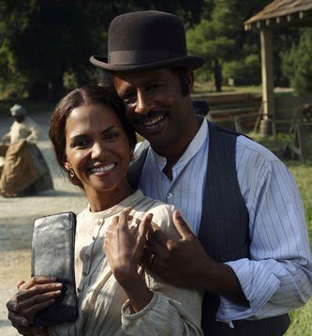
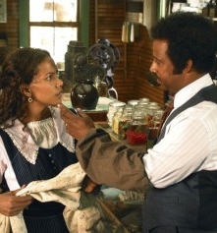
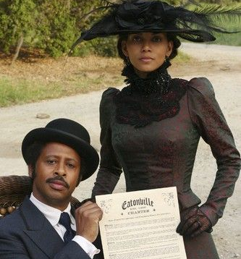
‘Buying in’ and opening THE SHOP

Slide 3
Exploring Context: Historic Eatonville
https://www.pbslearningmedia.org/resource/aml15.ela.lit.setting/setting-eatonville-florida/
How would you describe this town?
Which of Janie’s dreams might be fulfilled here?
How about Joe Starks’ dreams?
What challenges might they face when moving to a town like this?

Slide 4
while Reading
Create a visualizer for the chapter:
One graph showing Joe’s sense of power and achievement
One graph showing how Janie is feeling
Add the quotations to your graph (you can also use a number / letter code)
How do the two graphs relate?
What does that tell you about their relationship?

Slide 5
Janie’s feelings
Joe’s sense of Power and achievement
On the train the next day, Joe didn't make many speeches with rhymes to her, but he bought her the best things the butcher had, like apples and a glass lantern full of candies. Mostly he talked about plans for the town when he got there. They were bound to need somebody like him. Janie took a lot of looks at him and she was proud of what she saw. Kind of portly like rich white folks. Strange trains, and people and places didn't scare him neither. P. 39
"No wonder things ain't no better," Joe commented. "Ah'm buyin' in here, and buyin' in big. Soon's we find some place to sleep tonight us menfolks got to call people together and form a committee. Then we can get things movin' round here.” P. 40
So Joe Starks and his cigar took the center of the floor. "I thanks you all for yo' kind welcome and for extendin' tuh me de right hand uh fellowship. Ah kin see dat dis town is full uh union and love. Ah means tuh put mah hands nth de plow heah, and strain every nerve tuh make dis our town de metropolis uh de state. P. 49
"It is a whole heap littler than Ah thought." Janie admitted her disappointment. P. 39
She had her first taste of presiding over it the day it was complete and finished. Jody told her to dress up and stand in the store all that evening. Everybody was coming sort of fixed up, and he didn't mean for nobody else's wife to rank with her. She must look on herself as the bell-cow, the other women were the gang. So the put on one of her bought dresses and went up the new-cut road all dressed in wine-colored red. Her silken ruffles rustled and muttered about her. The other women had on percale and calico with here and there a headrag among the older ones. P. 47
"Naw! He didn't buy it sho nuff?"
"He sho did. Come off wid de papers in his pocket. He done called a meetin' on his porch tomorrow. Ain't never seen no sich uh colored man befo' in all mah bawn days. He's gointuh put up uh store and git uh post office from de Goven'ment."
That irritated Hicks and he didn't know why. He was the average mortal. It troubled him to get used to the world one way and then suddenly have it turn different. P. 44
"Brothers and sisters, since us can't never expect tuh better our choice, Ah move dat we make Brother Starks our Mayor until we kin see further." P. 49
"Thank yuh fuh yo' compliments, but mah wife don't know nothin' 'bout no speech-makin'. Ah never married her for nothin' lak dat. She's uh woman and her place is in de home." Janie made her face laugh after a short pause, but it wasn't too easy. She had never thought of making a speech, and didn't know if she cared to make one at all. It must have been the way Joe spoke out without giving her a chance to say anything one way or another that took the bloom off of things. But anyway, she went down the road behind him that night feeling cold. P. 49/50
He strode along invested with his new dignity, thought and planned out loud, unconscious of her thoughts. P. 50
Janie was astonished to see the money Jody had spent for the land come back to him so fast. Ten new families bought lots and moved to town in six weeks. It all looked too big and rushing for her to keep track of. P. 47

Slide 6
Vocabulary activity
Which words could you use to describe Janie's emotions?
Which words could you use to describe Joe Starks?
Add precise vocabulary to your graph.

Slide 7

Chapter 5
On. the train the next day, Joe didn't make many speeches with rhymes to her, …
-
…"Ah'm uh bitch's baby round lady people." "Ah's much ruther see all dat than to hear 'bout it. Come on less go see whut he goin tuh do 'bout dis town."

Slide 8
Chapter 5
They got up and sauntered over to where Starks was living for the present.
-
He was a long time thinking but finally he saw and stumbled down the steps with a surly "'Bye."
"Good bye."

Slide 9
Chapter 5
That night Coker asked him about it. "Ah saw yuh when yuh ducked back tuh Starks' house. Well, how didju make out?“
-
They argued a bit more then went on to the house where Joe was and found him in his shirt-sleeves, standing with his legs wide apart, asking questions and smoking a cigar.

Slide 10
Chapter 5
"Where's de closest saw-mill?" He was asking Tony Taylor.
-
Nobody was buying anything that night. They didn't come there for that. They had come to make a welcome. So Joe knocked in the head of a barrel of soda crackers and cut some cheese.

Slide 11
Chapter 5
Everybody come right forward and make merry. I god, it's mah treat." Jody gave one of his big heh heh laughs and stood back. Janie dipped up the lemonade like he told her. A big tin cup full for everybody. Tony Taylor felt so good when it was all gone that he felt to make a speech.
-
But anyway, she went down the road behind him that night feeling cold. He strode along invested with his new dignity, thought and planned out loud, unconscious of her thoughts. (p. 53)

Slide 12
Power, leadership, or hubris?
Debate!
Group A:
Joe Starks is a strong leader and precisely what this town needs
Group B:
Joe Starks is full of hubris – he is arrogant and uninterested in others’ feelings. This makes him a weak leader.

Slide 13
Which persuasive techniques did you use in this task?
You are Janie’s best friend. She has written to you about her feelings about Logan and Joe. You are now writing a letter in response, advising her on what to do.
Which were most effective?
Which could you use in your debate, too?
Power of three
Emotive language
Rhetorical question
Say again (repetition)
Undermine the opposing view
Anecdote
Direct address
Exaggeration
Statistics and facts
What If” Scenario
What if you flourished in life like a pear tree instead of ploughing like a mule?
“Imagine” Scenario
Imagine yourself at your Nanny’s age: an aged woman with grey hair, your face lined with wrinkles, the skin on your hands torn and cracked from decades of chopping potatoes and splitting firewood.
Imagine the swish of a silky dress as you step out for the evening to feel the cool evening air and watch the sunset
Question
Why should you repeat your Nanny’s mistakes?
Why would a smart girl like you be taken in by an arrogant …
Powerful Statement/Phrase
Be free!

Slide 14

You are Janie’s best friend. She has written to you about her feelings about Logan and Joe. You are now writing a letter in response, advising her on what to do.
The paragraph structure for Directed Writing could be as follows, using the PORE acronym:
Point: you outline your evaluation (opinion) based on one aspect of the topic.
Opposing view: what argument does the text make that you will refute?
Refutation of counterargument: what is the problem with the above argument?
Evaluation: how can you expand upon the point being made and thoroughly discredit the original argument?
Let’s write our opening together: create an opening that hooks the reader, and make clear what your opinion is

Slide 15
How to undermine the opposing viewpoint
Some might argue that…however…
Given that….such arguments must seem ludicrous.
In this day and age, how is it possible that voices clamouring for/decrying/advocating…are still being heard and listened to?
It is widely believed / Many people think …yet/but/actually…
At first glance it may seem…A closer look reveals
Surely, your Nanny might have thought….

Slide 16

Write a more engaging Opening
“What If” Scenario
What if you flourished in life like a pear tree instead of ploughing like a mule?
“Imagine” Scenario
Imagine yourself at your Nanny’s age: an aged woman with grey hair, your face lined with wrinkles, the skin on your hands torn and cracked from decades of chopping potatoes and splitting firewood.
Imagine the swish of a silky dress as you step out for the evening to feel the cool evening air and watch the sunset
Question
Why should you repeat your Nanny’s mistakes?
Why would a smart girl like you be taken in by an arrogant …
Powerful Statement/Phrase
Be free!

Slide 17

Create more urgency
Power of three
Emotive language
Rhetorical question
Say again (repetition)
Undermine the opposing view
Anecdote
Direct address
Exaggeration
Statistics and facts

Slide 18
Imagery in Non-fiction
Create metaphors for Janie’s situation
What could you compare her marriage with Logan to?
What could you compare Joe Stark’s promises to?
You could also use the mule – and – horizon imagery from the book!

Slide 19
Power, leadership, or hubris?
Debate!
To create your arguments, you’ll need:
Persuasive techniques
Examples from the text
Write your argument!

