Slide 1


What is love?
On your mini-whiteboards…
Which imagery is linked to love / intimacy so far?
What imagery would you create?
How does Hurston develop the imagery linked to Janie, Logan Killick and Nanny

Slide 2
Let’s read chapter 3
Underline key quotes relating to the topic of love
Underline any refences to ‘tree’ imagery
“did marriage end the cosmic loneliness of the unmated”?
“it was a lonesome place like a stump in the middle of the woods”
“got a house bought and paid for and sixty acres uh land right on de big road…Lawd have mussy! Dat’s de very prong all us black women git hung on. Dis love!”
“Ah wants things sweet wid mah marriage lak when you sit under a pear tree and think”

Slide 3
What do Janie’s and Nanny’s internal worlds tell you about each character?
Which metaphors does Hurston use for each of them? How do they compare?
Nanny:
Nanny sent Janie along with a stern mien, but she dwindled all the rest of the day as she worked. And when she gained the privacy of her own little shack she stayed on her knees so long she forgot she was there herself. There is a basin in the mind where words float around on thought and thought on sound and sight. Then there is a depth of thought untouched by words, and deeper still a gulf of formless feelings untouched by thought. Nanny entered this infinity of conscious pain again on her old knees. Towards morning she muttered, "Lawd, you know mah heart. Ah done de best Ah could do. De rest is left to you." She scuffled up from her knees and fell heavily across the bed. A month later she was dead.
Janie:
So Janie waited a bloom time, and a green time and an orange time. But when the pollen again gilded the sun and sifted down on the world she began to stand around the gate and expect things. What things? She didn't know exactly. Her breath was gusty and short. She knew things that nobody had ever told her. For instance, the words of the trees and the wind. She often spoke to falling seeds and said, "Ah hope you fall on soft ground," because she had heard seeds saying that to each other as they passed. She knew the world was a stallion rolling in the blue pasture of ether. She knew that God tore down the old world every evening and built a new one by sun-up. It was wonderful to see it take form with the sun and emerge from the gray dust of its making. The familiar people and things had failed her so she hung over the gate and looked up the road towards way off. She knew now that marriage did not make love. Janie's first dream was dead, so she became a woman.
How does this link back to the opening?

Slide 4
What is love?
Create a mind map on a blank A4 page
This should include:
Contextual ideas
Quotations from chapters 1-3, linked to important characters
Links to themes
Evaluate:
What points does Hurston make about love at the beginning of the novel?

Slide 5
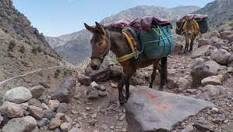
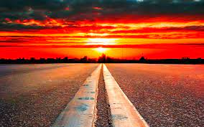


Enter Joe Starks
What does the mule symbolize in ‘Their Eyes Were watching God’?
What might the horizon symbolize?

Slide 6
The Dream Shattered…
Read chapter 4:
What Nanny considered treasures – home, possessions, land – leave Janie feeling empty.

Slide 7
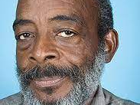
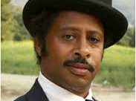
Janie’s Dilemma
LO: to evaluate the contrast between Logan Killick and Joe Starks
Janie’s dilemma: Who should she choose?

Slide 8
Chapter 4 – Quiz:
Consider Janie’s comment to her husband, “’Scuse my freezolity, Mist’ Killicks, but Ah don’t mean to chop de first chip.” What do you think the word “freezolity” means?
What is Killick’s nickname for Janie? What does this suggest about his attitude towards her? What does Janie call her husband? What does this suggest about her feelings towards him?
Describe the circumstances of the first meeting between Janie and Joe Starks. What was Janie doing before she met him? Describe your first impression of him.
Analyze the figurative language that Hurston uses on page 29 to describe Janie’s feelings about Joe: “Janie pulled back a long time because he did not represent sun-up and pollen and blooming trees, but he spoke for far horizon.” What does this description suggest about the future of her relationship with Joe?
The morning after Janie talks about leaving him, how does Logan treat Janie? Why do you think he behaves this way? How does Janie respond to him? Do you think he could have done anything that would have changed her decision to leave him?
Consider the following passage from page 32: “The morning air was like a new dress. That made her feel the apron tied around her waist. She untied it and flung it on a low branch beside the road and walked on, picking flowers and making a bouquet.” Explain why her actions are symbolic as well as literal.

Slide 9
Look at the objects / places described in these quotations. What do they symbolize? Who is the better husband for Janie?
Logan
Jody
“a citified, stylish dressed man with his hat set at an angle that didn’t belong in these parts” (31)
“he did not represent sun-up and pollen and blooming trees, but he spoke for far horizon. He spoke for change and chance” (34)
“Janie knew that God tore down the old world every evening and built a new one by sun-up. It was wonderful to see it take form with the sun and emerge from the gray dust of its making.” (p. 28/29)
“the morning road air was like a new dress. That made her feel the apron tied around her waist. She untied it and flung it…” (37))
“T’ain’t Logan killicks Ah wants you to have, baby, it’s protection” (18)
“Janie noticed that her husband had stopped talking in rhymes to her. He had ceased to wonder at her long black hair” (p. 30)
“Logan held his wad of tobacco real still in his jaw like a thermometer of his feelings” (p. 31)
“mah husband is gone to buy a mule fuh me to plow” (33)
“Logan with his shovel looked like a black bear doing some clumsy dance on his hind legs” (36)
“The sun from ambush was threatening the world with red daggers, but the shadows were gray and solid-looking around the barn” (36)

Slide 10
Write a paragraph: How does Hurston create contrast between Logan and Joe Starks?
Comparative Paragraph Structure
Top Tips
DON’T write: “Hurston creates contrast by using….
DO write:
“In the novel, Joe Starks personifies…while Logan stands for….
“When Janie considers the dilemma of who to choose, one difference between the two men is decisive: …”
Link to themes and other characters!
What values or themes does each man embody?
What do you know about Janie’s character? What might influence her decision?
Topic sentence summarizing a similarity or difference
Character A – quotation(s) with analysis and explanation
Bridge sentence: “Hurston contrasts this with….” / “However…”/ “In contrast to…” /“on the one hand…on the other hand…”
Character B – quotation(s) with analysis and explanation
Why is this contrast important?
“For Janie, this difference is decisive…”
“The decision Janie makes illustrates how she leaves behind her grandmother's values and…”
“This dilemma serves to illustrate Janie’s character…”

Slide 11
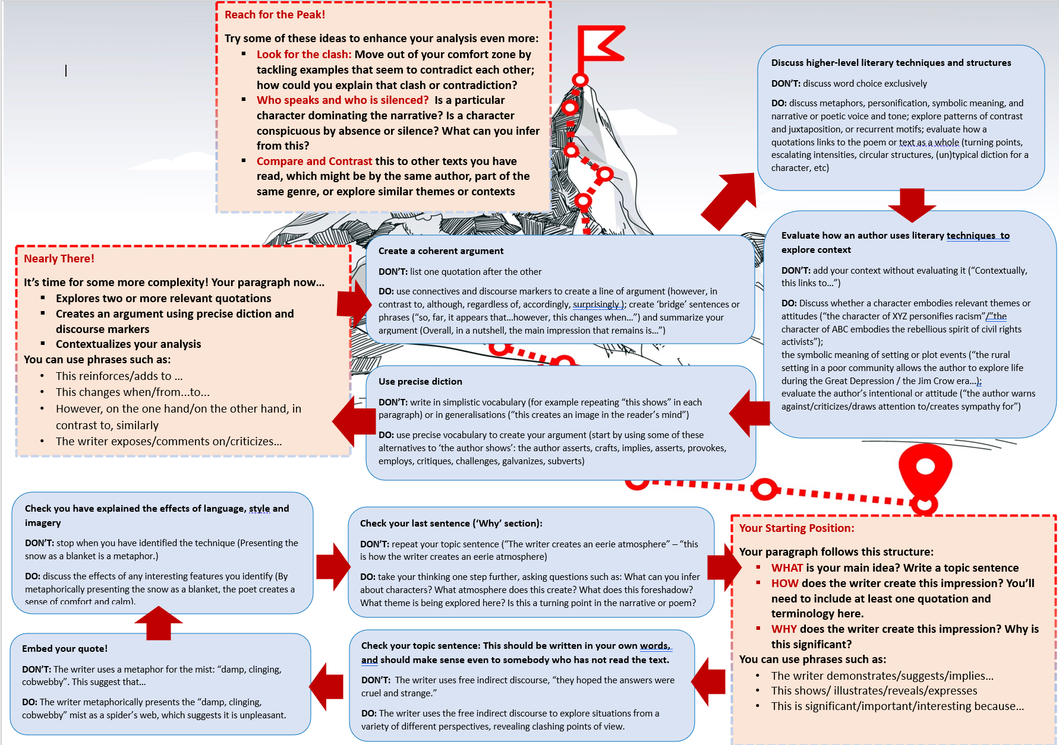

Slide 12
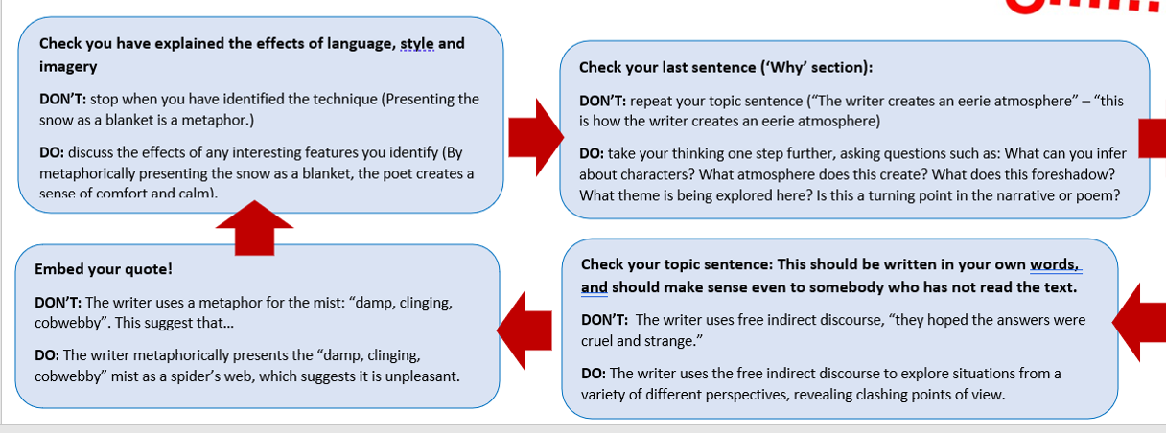

Slide 13
Persuasive task
You are Janie’s best friend. She has written to you about her feelings about Logan and Joe. You are now writing a letter in response, advising her on what to do.
Recap: Persuasive Writing:

Slide 14
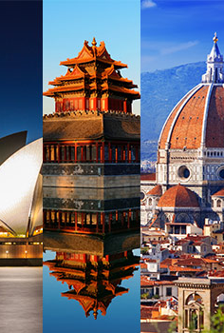
You are Janie’s best friend. She has written to you about her feelings about Logan and Joe. You are now writing a letter in response, advising her on what to do.
The paragraph structure for Directed Writing could be as follows, using the PORE acronym:
Point: you outline your evaluation (opinion) based on one aspect of the topic.
Opposing view: what argument does the text make that you will refute?
Refutation of counterargument: what is the problem with the above argument?
Evaluation: how can you expand upon the point being made and thoroughly discredit the original argument?
Let’s write our opening together: create an opening that hooks the reader, and make clear what your opinion is

Slide 15
How to undermine the opposing viewpoint
Some might argue that…however…
Given that….such arguments must seem ludicrous.
In this day and age, how is it possible that voices clamouring for/decrying/advocating…are still being heard and listened to?
It is widely believed / Many people think …yet/but/actually…
At first glance it may seem…A closer look reveals
Surely, your Nanny might have thought….

Slide 16

Write a more engaging Opening
“What If” Scenario
What if you flourished in life like a pear tree instead of ploughing like a mule?
“Imagine” Scenario
Imagine yourself at your Nanny’s age: an aged woman with grey hair, your face lined with wrinkles, the skin on your hands torn and cracked from decades of chopping potatoes and splitting firewood.
Imagine the swish of a silky dress as you step out for the evening to feel the cool evening air and watch the sunset
Question
Why should you repeat your Nanny’s mistakes?
Why would a smart girl like you be taken in by an arrogant …
Powerful Statement/Phrase
Be free!

Slide 17

Create more urgency
Power of three
Emotive language
Rhetorical question
Say again (repetition)
Undermine the opposing view
Anecdote
Direct address
Exaggeration
Statistics and facts

Slide 18
Choose your connotations carefully
What are the differences between…
Charming – dazzling – blinding – glaring – brilliant – shining
Secure – solid – unmoving

Slide 19
Dreams, the truth, and life
Having read these chapters about Janie and Nanny, how could you interpret the opening of the novel differently?
"Ships at a distance have every man's wish on board. For some they come in with the tide. For others they sail forever on the horizon, never out of sight, never landing until the Watcher turns his eyes away in resignation, his dreams mocked to death by Time. That is the life of men.
"Now, women forget all those things they don't want to remember, and remember everything they don't want to forget. The dream is the truth. Then they act and do things accordingly."

Slide 20
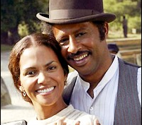
Janie and Jody
WHAT PREDICTIONS WOULD YOU MAKE FOR THEIR FUTURE?

Slide 21
Some Observations
Avoid the comma splice!
‘Janie is experiencing a moment of awakening, she is presented to be growing into an adult’
Vary your writing: find alternatives for “one way Hurston makes this an important novel”
Vary your writing: find alternatives for ‘we know this…’ / ‘this shows’
Be more precise! Re-write:
The quote ‘the gold of the sun and the panting breath of the breeze’ is an example of how detailed this extract is, and ‘gold of the sun’ tells us that Janie is enjoying this moment.

Slide 22
Marking exemplars
9076: 20/25
This is band 6 with hints of band 7 – band 6 for AO1, AO2; it is clear, careful and developed; the final paragraphs lifts this to band 7, as they offer a critical evaluation of the passage within the context of the novel as a whole; enough critical understanding to justify low band 7
9129: 18/25
A clear and carefully developed, relevant response, mid-band 6

