Slide 1

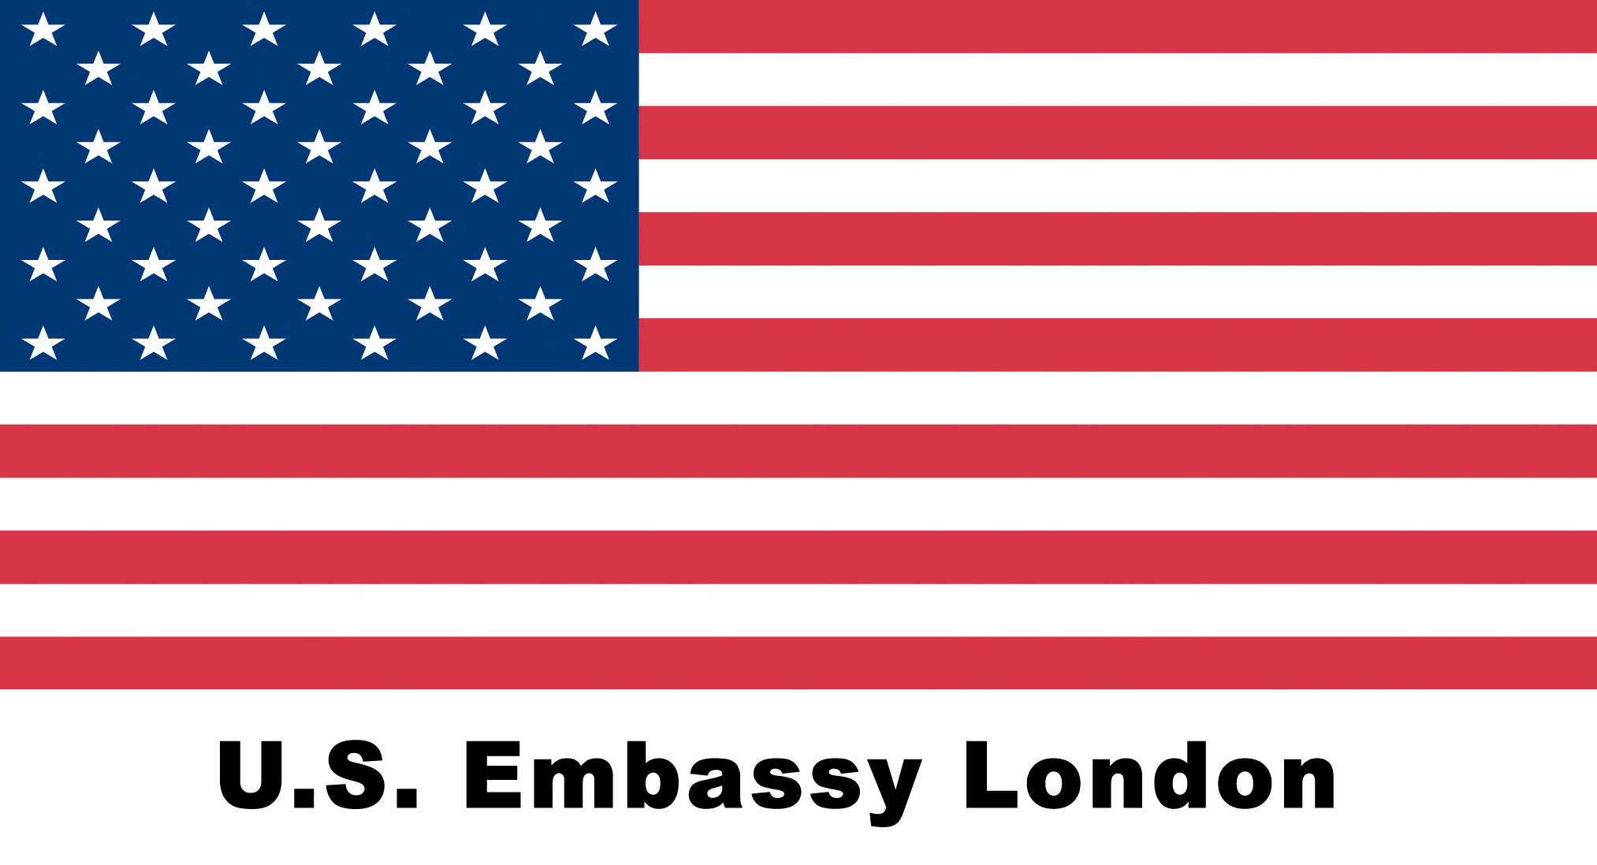
Exploring nature
In what ways is it significant that Amy Denver suggests Sethe’s scar looks like a tree?
Map out this ,metaphor – what is the difference between a scar and a tree?
What happens when we describe a scar to be like a tree?
LO: Why and how does Toni Morrison craft her novel relying on nature and animal imagery?

Slide 2
Explore Sethe’s escape
On A3 sheets, track the escape narrative from one symbolic image to the next; add quotations and annotate how these figurative elements shape the narrative
Evaluate: Which images are related to nature, which are related to man-made culture? Which dominates? How does Sethe relate to either?
2. Denver and Beloved: Two crossings (88-99)
What is the link between Beloved’s memory of a ‘dark’ place and the story of Sethe’s escape?
P. 91: mossy teeth
P. 92/93: Amy’s “tender-hearted mouth” and the tree
P. 95/96: Lady Button Eyes
P. 98: water
p. 99: bluefern
1. Denver’s birth in Sethe’s rememory (36-42)
P. 36: antelope
P. 38: snake
P. 40: velvet
P. 42: imagery relating to death and life
P. 50: A charmed child? Sethe telling Paul D about Denver
3. Arrived: Stamp Paid and Ella
p.106-111:
from the Ohio river to crystal earrings

Slide 3

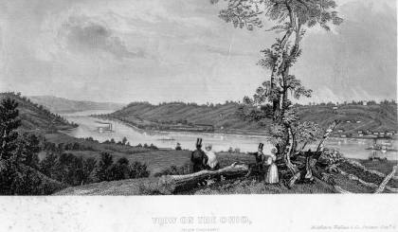
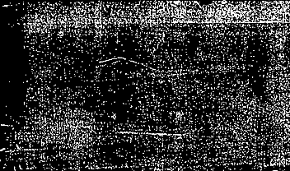

Bluefern and the Ohio river

Slide 4
How do oral storytelling and folk tales influence Toni Morrison’s style?

Slide 5
Why does Toni Morrison shape her novel via nature and animal imagery?
Context: Folk tales
When slaves arrived in the New World from Africa in the 1700s and 1800s, they brought with them a vast oral tradition.
The details and characters of the stories evolved over time in the Americas, though many of the motifs endured.
Oral cultures are so significant because slaves were forced into illiteracy – this was a means to keep control and stifle ideas of freedom and independence
One important way counteracting this was through folk tales, which the African slaves used as a way of recording their experiences – these were retold in secret, adapted to their enslaved situation, adding in elements of freedom and hope
As regards languages, slaves were often multi-lingual, speaking creole or English as well as other languages, which could include American indigenous languages
Listen to an example of such a folk tale here: https://youtu.be/-L5xOMTKf2A
Typical motifs:
Although folktales reflected the uncertainties of life for enslaved African Americans, they also provided a message of stability and assurance.
The mother image found in some tales, for example, represents tenderness and goodness
the child-hero is a symbol of purity and innocence
smaller, less-powerful creatures, such as Brer Rabbit, always outsmart the larger, stronger characters, such as Brer Fox and Brer Bear.
They often reflect the slaves’ desire to outwit their stronger, more-powerful owners. In the brutal world of the slaves, these images meant a great deal.

Slide 6
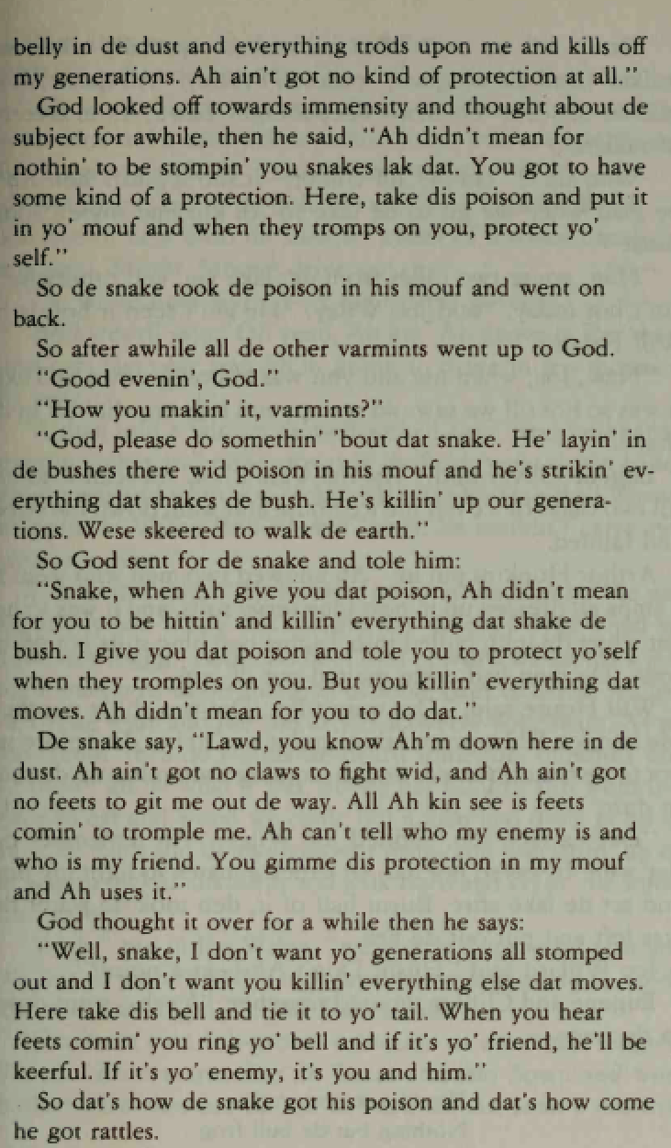
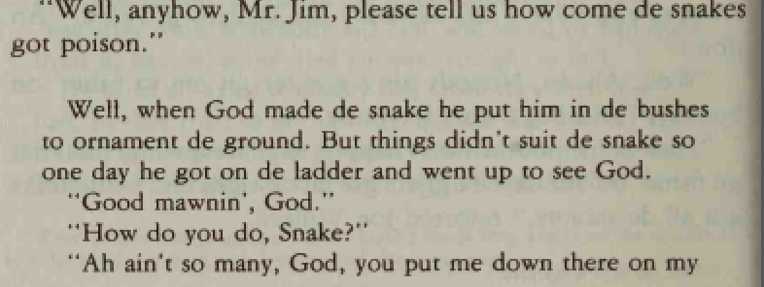
Zora Neale Hurston’s collected folk tales: How the snake got his poison
How could you use the idea of folk tales (and the snake in this particular folk tale ) to explain Sethe’s identification with a snake with more nuance?

Slide 7
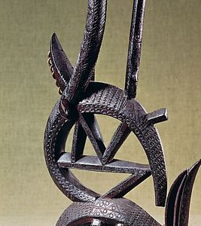
More Context:
Why Antelopes?
Chiwara, (Chi wara or Tyiwar): antelope figure of the Bambara (Bamana) people of Mali
represents the spirit that taught humans the fundamentals of agriculture. The Bambara honour Chiwara though art and dance.
About the Antelope Headcrest (Chi Wara) from Mali:
https://youtu.be/NwvOmp131e4
Mali – masked dance: https://youtu.be/i3tTZAZT65I

Slide 8

Sum it up!
What does nature signify in Toni Morrison's Beloved?

