Slide 1


Gender Trouble
LO: How does Toni Morrison present femininity and masculinity in Beloved?

Slide 2
Focus 1: Motherhood and femininity
LO: to explore Sethe and Baby Suggs in terms of gender roles

Slide 3
What do these quotations suggest about motherhood?
“All I knew was I had to get my milk to my baby girl.”
Paul D observes of Sethe and Denver, “to love anything that much was dangerous, especially if it was her children she had settled on to love.”
“in all of Baby’s life, as well as Sethe’s own, men and women were moved around like checkers. Anybody Baby Suggs knew, let alone loved, who hadn’t run off or been hanged, got rented out, loaned out, bought up, brought back, stored up, mortgaged, won, stolen or seized. So Baby’s eight children had six fathers. What she called the nastiness of life was the shock she received upon learning that nobody stopped playing checkers just because the pieces included her children.”
“I had eight. Every one of them gone from me. Four taken, four chased, and all, I expect, worrying somebody’s house into evil.”
“What Nan had told her she had forgotten, along with the language she told it in. The same language her ma’am spoke, and which would never come back. But the message – that was and had been there all along.”
“Right on her ribs was a circle and across burnt right in the skin. She said, ‘This is your ma’am. This,’ and she pointed. ‘I am the only one got this mark now. The rest dead. If something happens to me and you can’t tell me by the face, you can know me by this mark.’

Slide 4
Sethe and Baby Suggs - Key questions
Which ideas about femininity and gender do these two maternal figures suggest?
How does Toni Morrison explore motherhood?
How are both figures linked to a more spectral, ancestral presence of traditions integrated into African American Culture since the Middle Passage?
How would you describe the differences between these two characters?
Which characteristics or experiences do they share?

Slide 5
Sethe and Baby Suggs: how do they compare?
Which feminine, maternal roles does each personify?
Are they contrasts? Do they complement each other?
Are they more similar than they appear?
Sethe
Baby Suggs
Named after her father
Bought by Mr Garner to replace Baby Suggs as house slave for Mrs Garner
Key motifs: Tree, milk, sword and shield, iron eyes and back
Sethe: 10,14, 109-112
Named ‘Jenny’ on Sweet Home (name on her sales bill) – ‘Baby Suggs’ comes from her husband, who called her baby, and was called Suggs – p. 167
mother of Halle, which makes her Sethe’s mother-in-law.
She is noticed for being absent – and is much missed
served as an “unchurched” preacher in Cincinnati’s Black community
Key motifs: color, woods/clearing, dance
Baby Suggs: 6, 101-105, 111, 164-173
1. Collect key quotations for your character. These should be taken from each of the sections you read.
2. Evaluate: How does Toni Morrison use this figure to comment on / explore femininity and motherhood in the context of slavery?

Slide 6
Baby Suggs - Key Moments
165-168 (freedom)
101 – 105 (Clearing)
Evaluating Baby Suggs:
Baby Suggs is linked to themes of healing, dance, and nature – how would you interpret her role in the context of Gothic/ Supernatural fiction? Is there a comparable figure in Dracula?
In rendering the story of the life and death of Baby Suggs, Morrison explores the tension between attaining physical freedom, and claiming full ownership of your self and your life. What kind of freedom did Baby Suggs achieve (think about her final words on p. 105)?

Slide 7
Sethe’s voice in the chorus
Read Sethe’s monologue on p. 236
How does this synthesize and develop all the key motifs relevant for this character?
Milk, her mother’s sign, colour, hands/arms, colour, corn (33), speaking/stutter/silencing, water, scars, love, exploitation / abuse, claiming your own self (112)
Think about narrative perspective: What is the effect of switching to a first person monologue here, so late in the book?
To what extent is this novel about finding your voice?

Slide 8

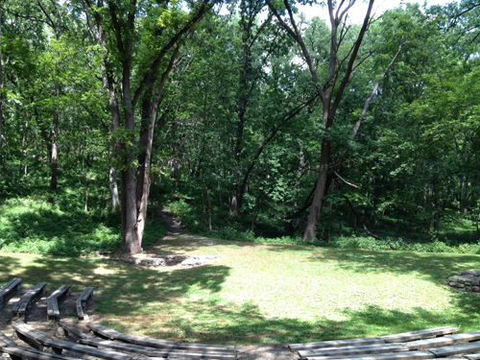
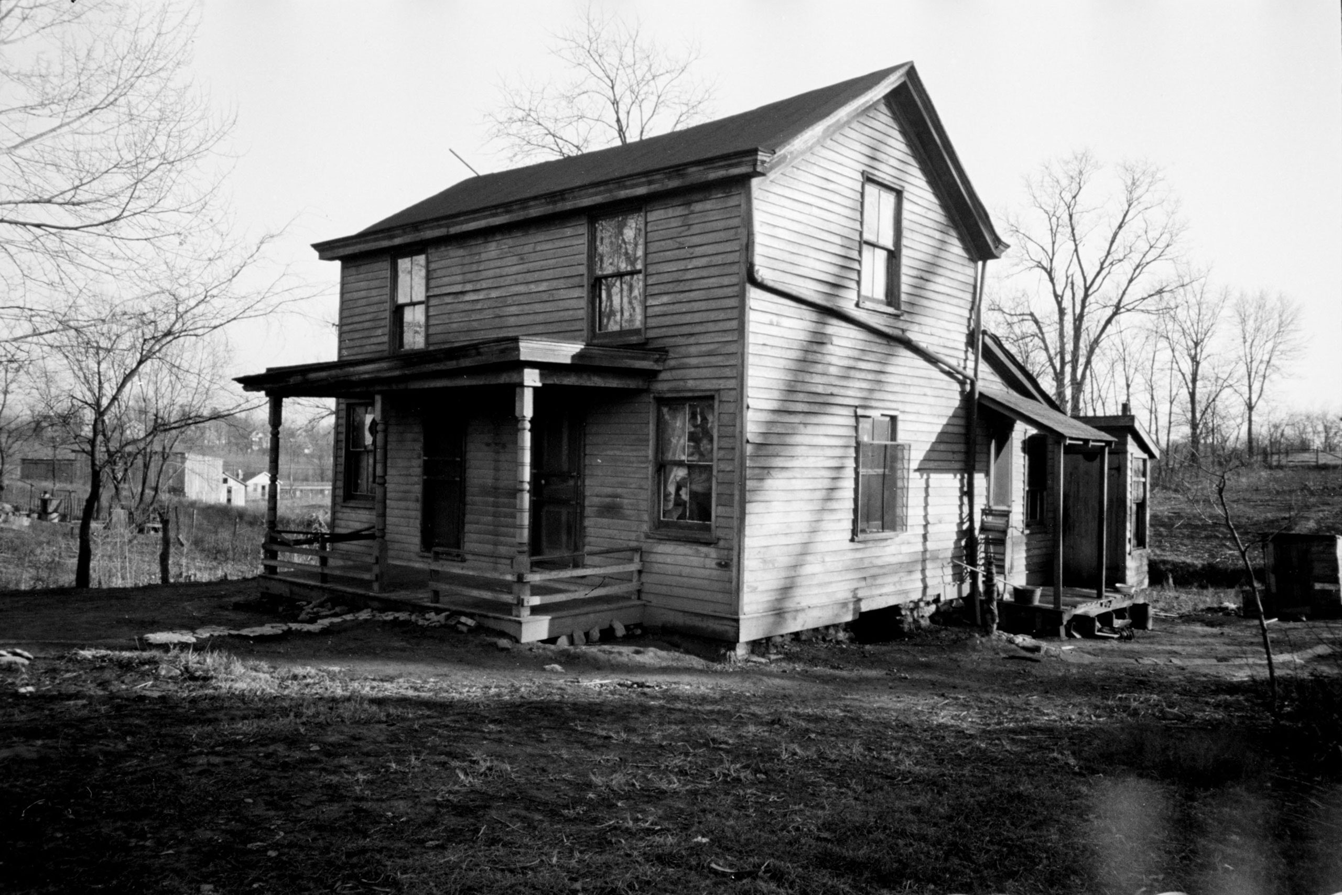

Evaluate the Recurring theme:
Man-made culture and nature
How do Settings develop these characters?
Sethe and the house on Bluestone Road: 26, 27
Baby Suggs and the Clearing

Slide 9
How does Morrison use these figures to evoke and explore the black feminist movements?
Contextualising Baby Suggs and Sethe

Slide 10
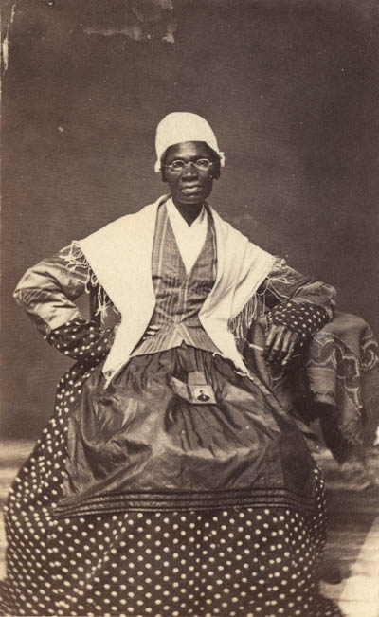
Slavery and Feminism: Sojourner Truth, “Ain’t I a Woman”
Sojourner Truth was born into slavery at the end of the 18th century, but she escaped — carrying her infant daughter with her — in 1826.
(“I did not run off, for I thought that wicked, but I walked off, believing that to be all right,” she would later say.)
When the son she left behind was sold illegally, she successfully sued for his freedom as well. Naming herself “Sojourner Truth,” she converted to Methodism and began campaigning for women’s rights and the abolition of slavery.
She improvised her “Ain’t I a Woman” speech in 1851 at the Ohio Women’s Rights Convention in Akron. It has been transcribed, but the exact wording of the speech has been contested.
Reading Questions:
Is this a feminist speech? How so?
How does this link to Sethe and Baby Suggs?
You can watch it being performed here (by Kerry Washington) https://youtu.be/Ry_i8w2rdQY

Slide 11
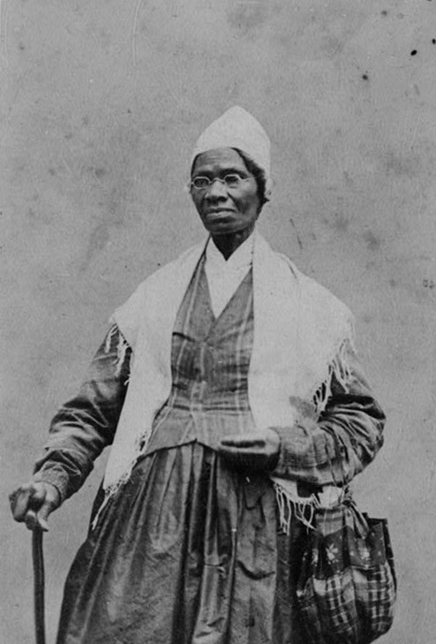
Sojourner Truth, “Ain’t I a Woman”
Here’s the speech in full:
Well, children, where there is so much racket there must be something out of kilter. I think that ‘twixt the negroes of the South and the women at the North, all talking about rights, the white men will be in a fix pretty soon. But what’s all this here talking about?
That man over there says that women need to be helped into carriages, and lifted over ditches, and to have the best place everywhere. Nobody ever helps me into carriages, or over mud-puddles, or gives me any best place! And ain’t I a woman? Look at me! Look at my arm! I have ploughed and planted, and gathered into barns, and no man could head me! And ain’t I a woman? I could work as much and eat as much as a man - when I could get it - and bear the lash as well! And ain’t I a woman? I have borne thirteen children, and seen most all sold off to slavery, and when I cried out with my mother’s grief, none but Jesus heard me! And ain’t I a woman?
Then they talk about this thing in the head; what’s this they call it? [member of audience whispers, “intellect”] That’s it, honey. What’s that got to do with women’s rights or negroes’ rights? If my cup won’t hold but a pint, and yours holds a quart, wouldn’t you be mean not to let me have my little half measure full?
Then that little man in black there, he says women can’t have as much rights as men, ‘cause Christ wasn’t a woman! Where did your Christ come from? Where did your Christ come from? From God and a woman! Man had nothing to do with Him.
If the first woman God ever made was strong enough to turn the world upside down all alone, these women together ought to be able to turn it back , and get it right side up again! And now they is asking to do it, the men better let them.
Obliged to you for hearing me, and now old Sojourner ain’t got nothing more to say.

Slide 12
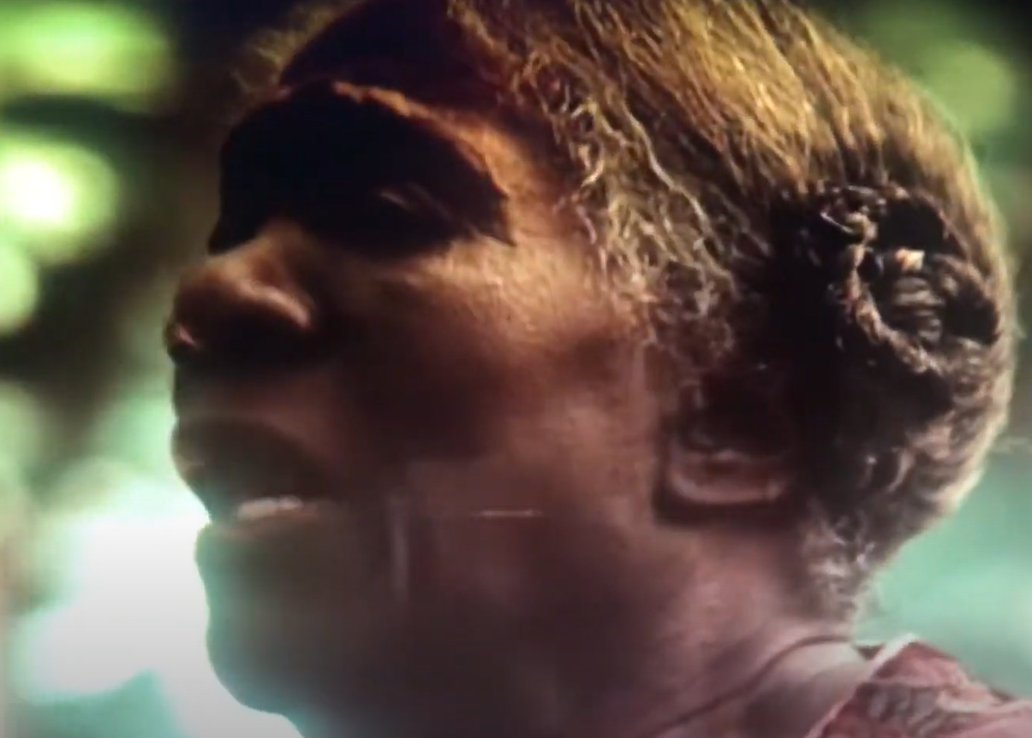
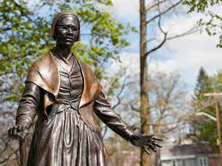
Why does toni Morrison make Baby Suggs an ‘unchurched preacher’?
female-led Holiness revival movement of the 1830s: defined American religious life as mass movements, converting or reclaiming thousands of people organized denominations did not reach.
African American women preached in these movements, meaning that they often worked at the center of 19th-century religious life rather than at its margins.
African American women also challenged church hierarchy that marginalized women as well as working-class African Americans
Their writings stressed their search for control over the Black female body through service to God, claimed authority through appeals to an inner voice, spiritual eye, or divine call to public voice, and often used itinerancy to circumvent both attempts to silence them and gain access to a wider community.
Early female black preachers also reinterpreted the Bible to liberate women – see Sojourner Truth!

Slide 13
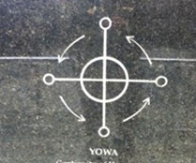
How do Mothers also represent a spectral African legacy?
Sethe, about her mother:
“Right on her ribs was a circle and across burnt right in the skin. She said, ‘This is your ma’am. This,’ and she pointed. ‘I am the only one got this mark now. The rest dead. If something happens to me and you can’t tell me by the face, you can know me by this mark.’
This is one of the most discernible African symbols in the Americas – it survived the Middle Passage and the transatlantic slave trade and took root in the Caribbean
Kongo’s Yowa or cosmogram: The cross within a circle, or ‘‘tree’’ within a circle, from Kongo became the signage under which many African peoples’ beliefs were preserved in the Western hemisphere
An ancestral cosmogram, the Yowa signifies reincarnation, renaissance, and mediation of spiritual power
It is also referred to as ‘‘the four moments of the sun:’’ east-west rise and descent of the sun; the right, east, or ‘‘sunrise’’ compass point of the horizontal axis of the cross indicates birth and the beginning of life; the left, west or ‘‘sunset’’ point indicates decline and approaching death. The ‘‘midday’’ or summit of the sun on the vertical axis indicates the strongest moment of life, while the southern or ‘‘midnight’’ moment of the sun indicates one’s descent into the afterworld.
Metaphorically, it suggests the process of the continuity of human life via the interaction between the realms of the living and the realms of the dead.

Slide 14

Fcous 2: Masculinity in Gothic fiction
Discussing Paul D

Slide 15
Test the cliché!
Which of these masculine roles have you encountered in Gothic fiction?
Jonathan Harker
Dr John Seward
Van Helsing
Arthur Holmwood
Quincey Morris
Count Dracula
The predatory male
The saviour
The wealthy landowner (often troubled and mysterious)
The hero
Which roles would you need to add?
How about these cliché female roles:
Femme fatale
Victim
Which roles would you need to add?

Slide 16
What makes masculinity such an important topic in Gothic Fiction?
“Personality swallowed up the sordid idea of property! manhood lost in chattelhood!” (Frederick Douglass)
“To you he [ the black man] is a mark on the score-card of your achievement, a thing and not a man; a child, or even less - a black amorphous thing.”
(Ralph Ellison)
Making Links to Gothic literature in the 19th century (think of Dracula, Frankenstein, Jekyll and Hyde…)
This tradition was deeply concerned with threats to masculinity. Why?
Transition to a Darwinian scientific model – ‘man’ is less of a crown of creation now / creates a world view not centered around (male) reason and creation
Emerging model of the New Woman to contrast the Victorian feminine ideal embodied in the “angel in the house.”
These changes threatened the foundation upon which masculinity and thus, patriarchal society, rested its dominance.
What about Beloved? In Post-Civil war, Reconstruction US:
Linked to the male domain of the military
Wide-spread authoritarian, violent model of masculinity, especially in slaver gender roles (who sught mastery over both male and female enslaved bodies by abuse and violence)
Entwined with notions of race - within the military service, white officers who commanded African American regiments would use their power to establish themselves as self-made men

Slide 17
Paul D at the beginning of the novel
He chuckled. "Running off pregnant."
"Had to. Couldn't be no waiting." She
lowered her head and thought, as he did, how
unlikely it was that she had made it. And if it
hadn't been for that girl looking for velvet, she
never would have.
"All by yourself too."
He was proud of her
and annoyed by her. Proud she had done it; annoyed that she had not needed Halle or him in the doing.
Paul D tied his shoes together, hung them
over his shoulder and followed her through the
door straight into a pool of red and undulating
light that locked him where he stood.
"You got company?" he whispered, frowning.
"Off and on," said Sethe.
"Good God." He backed out the door onto the
porch. "What kind of evil you got in here?“
[…]
"Who then?"
"My daughter. The one I sent ahead with the
boys."
"She didn't live?"
"No. The one I was carrying when I run away is all I got left.
Boys gone too. Both of em walked off just
before Baby Suggs died."
Paul D looked at the spot where the grief had soaked him. The red was gone but a kind of weeping clung to the air where it had been. Probably best, he thought. If a Negro got
legs he ought to use them. Sit down too long, somebody will figure out a way to tie them up.
Still... if her boys were gone...
"No man? You here by yourself?"
"Me and Denver," she said.
"That all right by you?"
It took him a while to realize that his legs were not shaking because of worry, but because the floorboards were and the grinding, shoving floor was only part of it. The house itself was pitching. Sethe slid to the floor and
struggled to get back into her dress. While down on all fours, as though she were holding her house down on the ground, Denver burst from the keeping room, terror in her eyes, a vague smile on her lips.
"God damn it! Hush up!" Paul D was shouting, falling, reaching for anchor. "Leave the place alone! Get the hell out!" A table rushed toward him and he grabbed its leg. Somehow he managed to stand at an angle and, holding the table by two legs, he bashed it about, wrecking
everything, screaming back at the screaming
house. "You want to fight, come on! God damn it!
She got enough without you.
She got enough!"
The quaking slowed to an occasional lurch, but Paul D did not stop whipping the table around until everything was rock quiet.
Not even trying, he had become the kind
of man who could walk into a house and make
the women cry. Because with him, in his
presence, they could. There was something
blessed in his manner.
Women saw him and wanted to weep--to
tell him that their chest hurt and their knees did
too. Strong women and wise saw him and told
him things they only told each other: that way
past the Change of Life, desire in them had
suddenly become enormous, greedy, more
savage than when they were fifteen, and that it
embarrassed them and made them sad; that
secretly they longed to die--to be quit of it--that
sleep was more precious to them than any
waking day. Young girls sidled up to him to
confess or describe how well-dressed the
visitations were that had followed them straight
from their dreams.
"Call me my name."
"No."
"Please call it. I'll go if you call it."
"Beloved." He said it, but she did not go.
She moved closer with a footfall he didn't hear and he didn't hear the whisper that the flakes of rust made either as they fell away from the seams of his tobacco tin. So when the lid gave he
didn't know it. What he knew was that when he reached the inside part he was saying, "Red heart. Red heart," over and over again. Softly and then so loud it woke Denver, then Paul D himself. "Red heart. Red heart. Red heart."

Slide 18
Two escapes: Masculinity and entrapment / freedom
Annotate your text, looking for the following motifs:
125-133: After Sweet Home
Mister
Trembling
The chain
‘eating’ / sexual abuse
Singing
Water
Nature
Annotate your text, looking for the following motifs:
266-270: Escaping from Sweet Home – Paul D and Sixo
Value / worth
Laughter
Fire

Slide 19
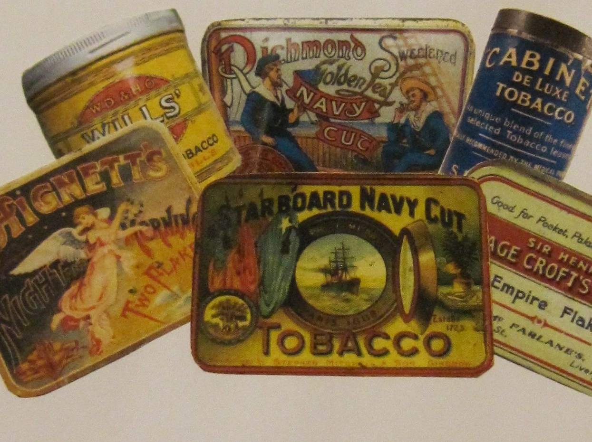
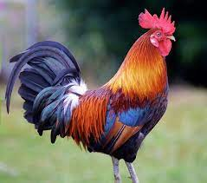
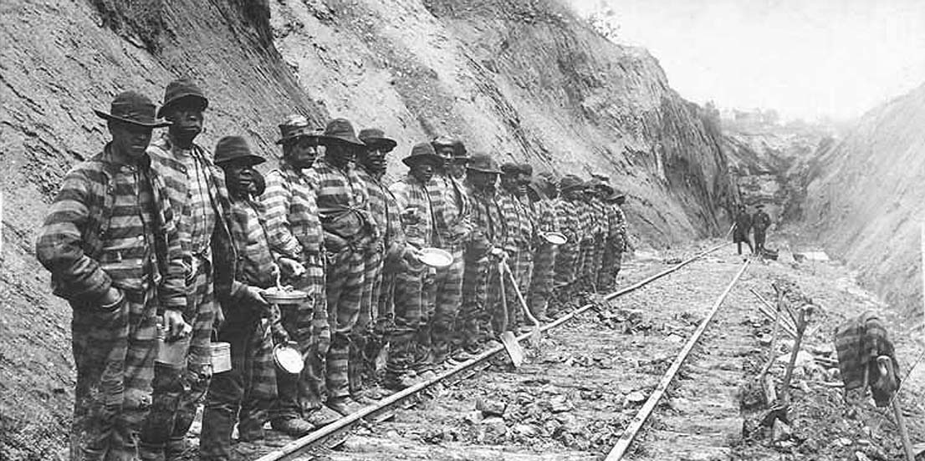


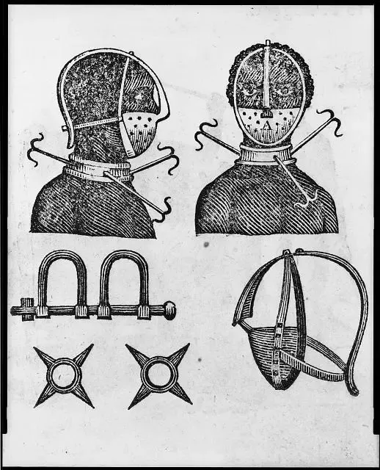
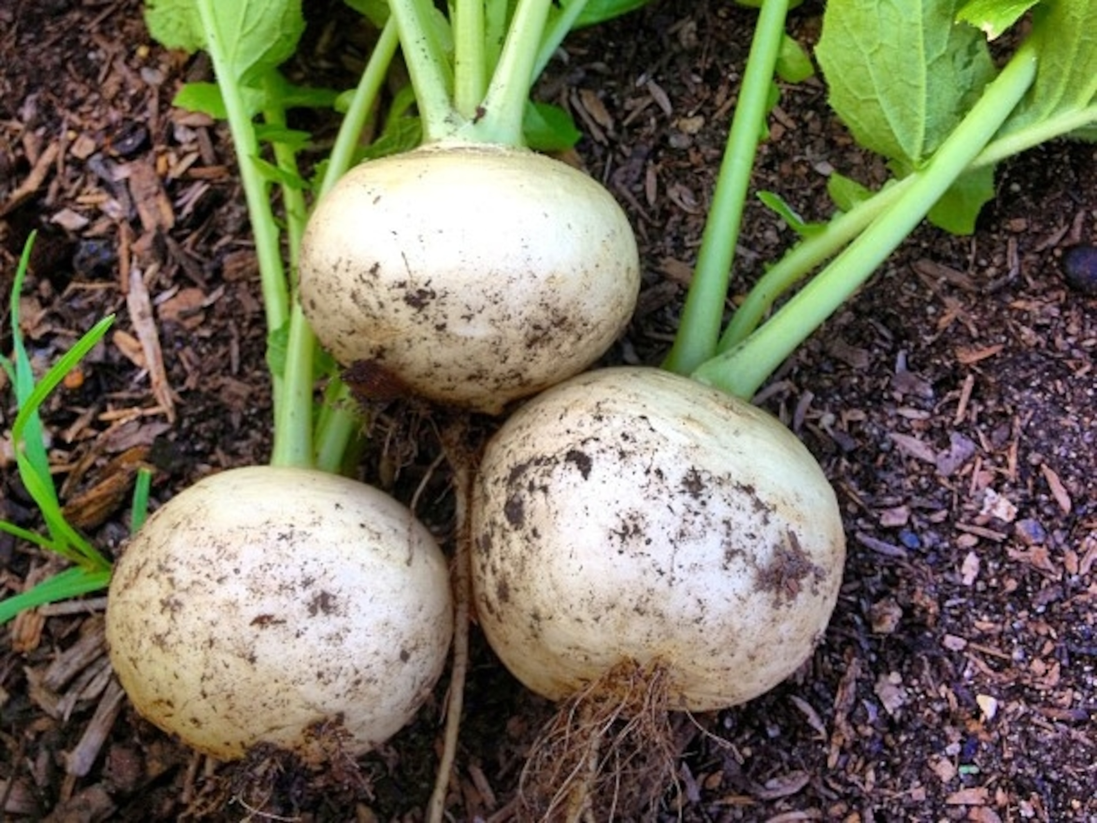
What can you infer about masculine gender roles based on these key symbols for Paul D?

Slide 20
Focus 3 - men and women: relationships and comparisons

Slide 21
Relationships between men and women: narrative Interweaving at the beginning of the novel
How does Morrison interweave the relationships between Halle and Sethe, and Paul D and Sethe years later?
24-26
31-33
What is the effect of interweaving these two encounters?
What can you infer about how Morrison present heterosexual relationships?
How would you read the image of the corn in relation to romantic love?

Slide 22
Relationships between men and women: How does this continue?
Decide on THREE key motifs for Paul D in your section. Describe each motif in your own words, in a sentence or two
What theme does this motif relate to? Hope – Love – Entrapment – Silencing – Listening
Choose one quotation each, and annotate it in detail
45-51: Singing and Making Plans
52-55: Jealousy and commitments
56-59: Hand-holding shadows at the carnival

Slide 23
The ending
319: Paul D returns
How are gender roles – masculine and feminine – presented at the end of the novel?

Slide 24
Create a mindmap comparing female and male characters in Beloved
Add quotes and context!
To what extent do you agree with these statements?
For Morrison's women, sexuality is the reward and burden of their gender.
For women, the suffering of childbirth is compounded by seeing offspring forced into the slave milieu and by knowing that children will have no choice but to go on producing more of their kind to stock the limitless slave rolls that power the plantation system.
Men are giving tender and nurturing roles in Beloved, although they still keep their emotions at bay
In many ways, the role of the provider in Beloved is shared – this is also due to the impact of slavery, which fragments families and disrupts the traditional patterns of a heterosexual nuclear family

