Slide 1


The past intrudes into the present
For Sethe,“the future was a matter of keeping the past at bay’
LO: to explore different forms of memory in ‘Beloved’

Slide 2
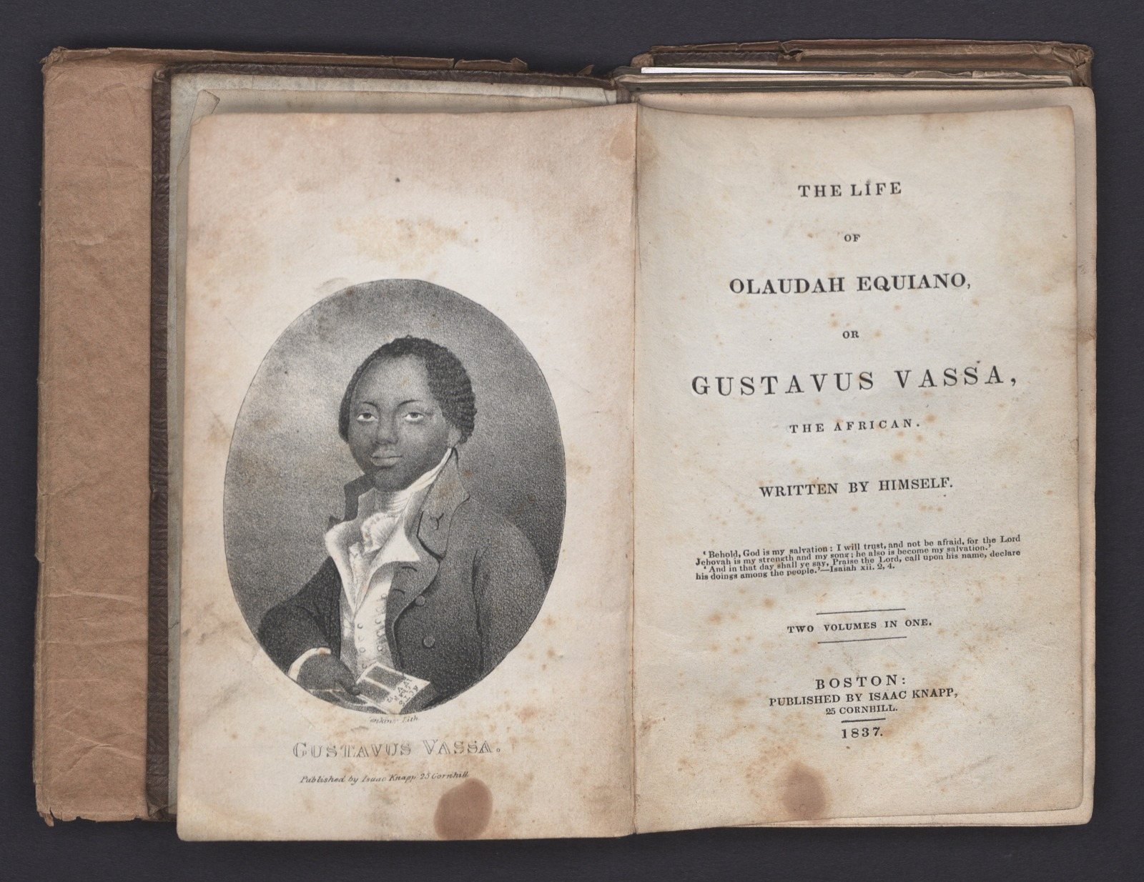
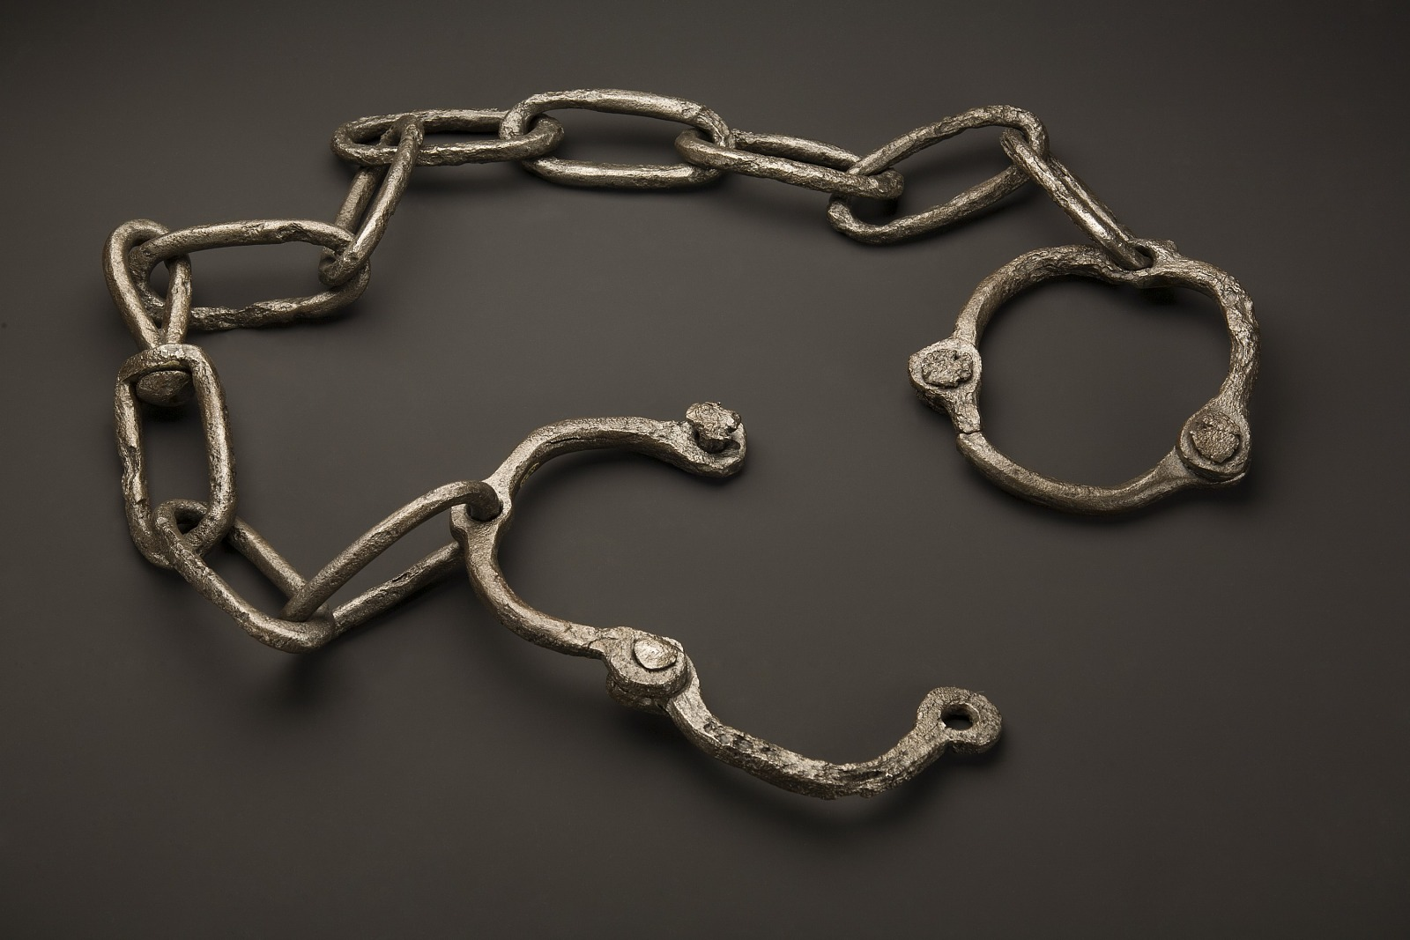
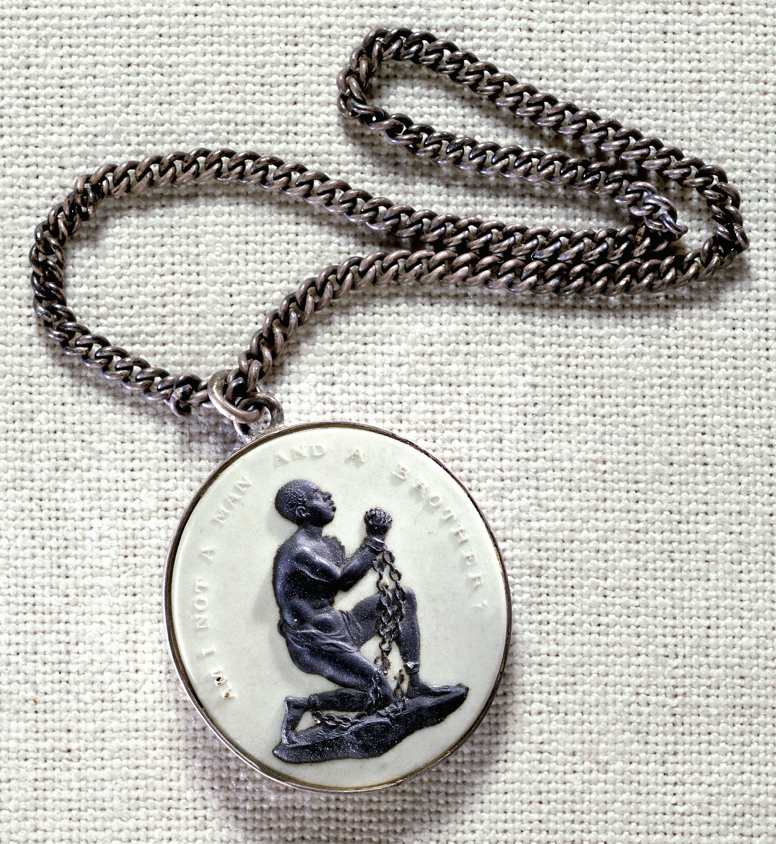
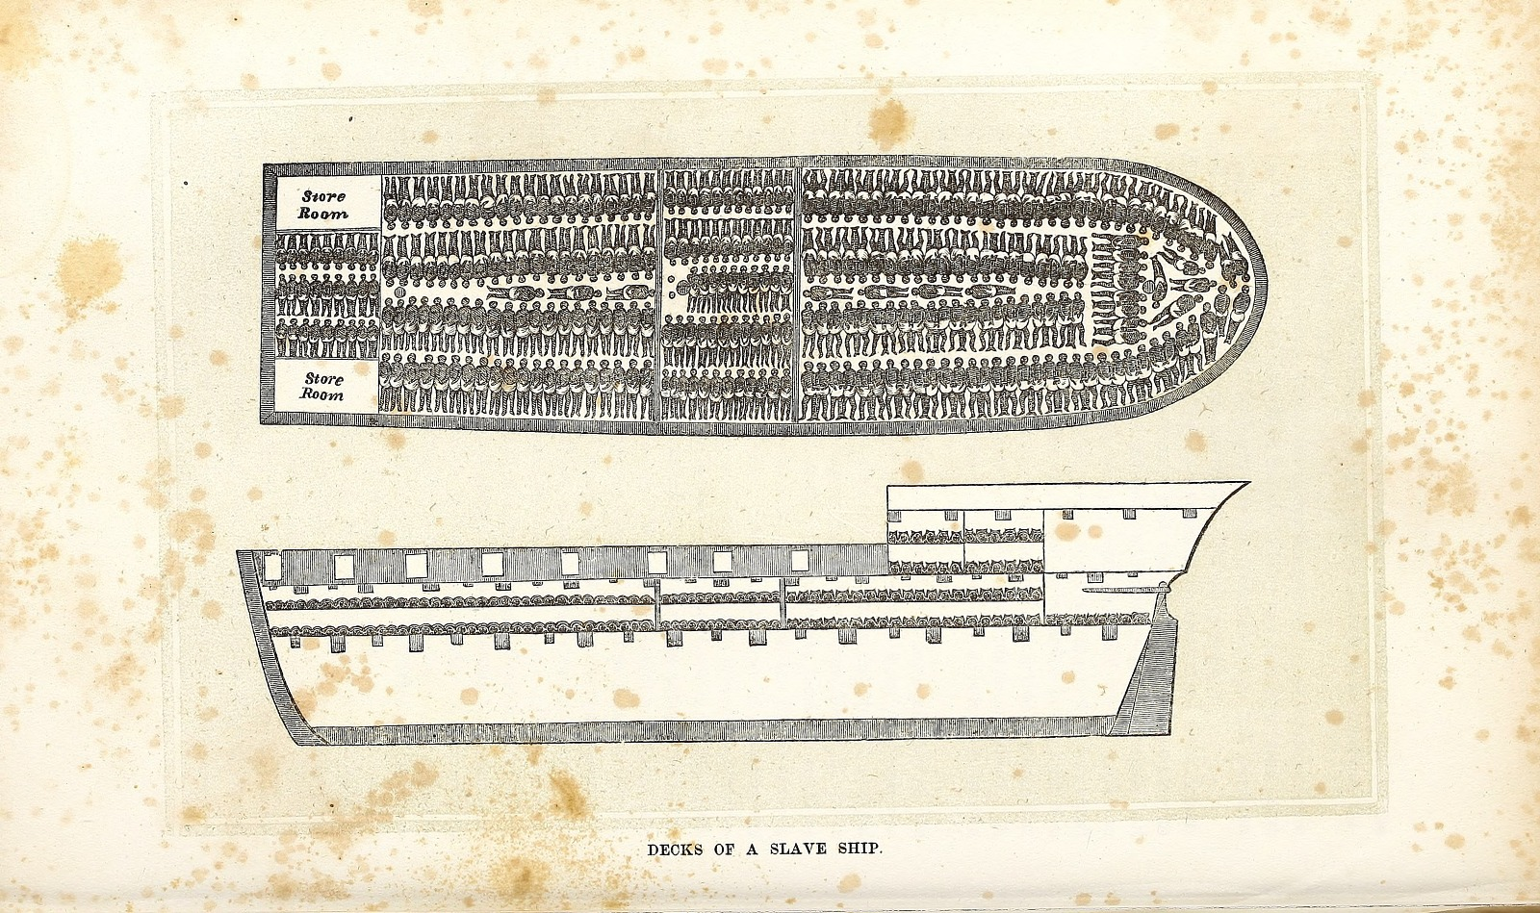
Objects and History:
What can these artefacts tell you about the history of slavery and its different facets?
Middle passage and Roots : https://youtu.be/0IJrhQE6DZk
Reconstruction, in U.S. history, the period (1865–77) that followed the American Civil War and during which attempts were made to redress the inequities of slavery and its political, social, and economic legacy.
Watch this video to learn more: https://www.britannica.com/event/Reconstruction-United-States-history

Slide 5
Starter: mind-map the protagonists!
Inside the figure: What desires does the character have / What does the character wish for?
Inside the figure: What are their main fears or traumata?
Inside the figure: How would you describe their personality?
Outside the figure: What is their situation and environment like? Add contextual ideas (key words: slavery, underground railroad, Margaret Garner, Middle Passage / triangle trade, abolition, fugitive slave acts)
On the ‘skin’ / border between inside and outside: What conflicts and struggles emerge from this?

Slide 6
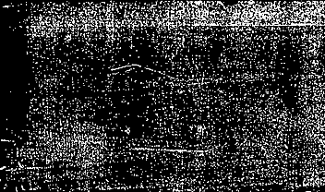
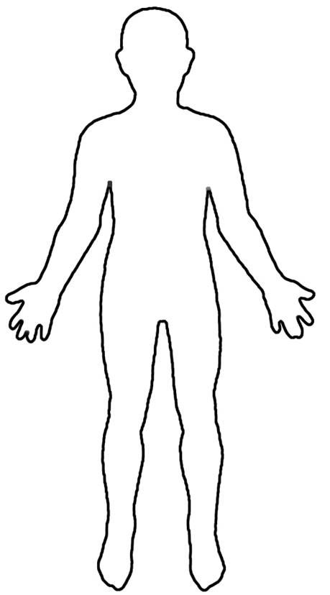

Sethe
Halle's girl--the one with iron eyes and backbone to match. […]A face too still for comfort; irises the same color as her skin, which, in that still face, used to make him think of a mask with mercifully punched out eyes. […] Even in that tiny shack, leaning so close to the fire you could smell the heat in her dress, her eyes did not pick up a flicker of light. They were like two wells into which he had trouble gazing. Even punched out they needed to be covered, lidded, marked with some sign to warn folks of what that emptiness held.

Slide 7
Paul D
For a man with an immobile face it was amazing how ready it was to smile, or blaze or be sorry with you. As though all you had to do was get his attention and right away he produced the feeling you were feeling. With less than a blink, his face seemed to change—underneath it lay the activity.

Slide 8
Baby Suggs
Her past had been like her present--intolerable—and since she knew death was anything but forgetfulness, she used the little energy left her for pondering color. "Bring a little lavender in, if you got any. Pink, if you don’t.”

Slide 9
Denver
DENVER'S SECRETS were sweet. Accompanied every time by wild veronica until she discovered cologne. The first bottle was a gift, the next she stole from her mother and hid among boxwood until it froze and cracked. That was the year winter came in a hurry at suppertime and stayed eight months.

Slide 10
Sixo
The kind of thing Sixo would do--like the time he arranged a meeting with Patsy the Thirty-Mile Woman. It took three months and two thirty-four-mile round trips to do it. To persuade her to walk one-third of the way toward him, to a place he knew. A deserted stone structure that Redmen used way back when they thought the land was theirs. Sixo discovered it on one of his night creeps, and asked its permission to enter. Inside, having felt what it felt like, he asked the Redmen's Presence if he could bring his woman there. It said yes and Sixo painstakingly instructed her how to get there,

Slide 11
Who’s Beloved?
The name ‘Beloved’ is non the gravestone, but it’s not actually the name of Sethe's daughter
This word is used at funerals and weddings – what does this signify?
She might be…
The executed daughter come to life (and perhaps willed into existence by Sethe and Denver)
A physical embodiment of the spiteful poltergeist and therefore a malignant presence
Incarnation of Sethe's guilt and her unforgiving memory
America’s past of slavery and the Middle Passage

Slide 12
What is memory?
Which of these ideas about memory are most relevant to ‘Beloved’? Why?
“Those who cannot remember the past are condemned to repeat it” (George Santayana, 1905)
Memory is the ‘past made present’(Michael Rothberg 2009)
“Our memory has no guarantees at all, and yet we bow more often than is objectively justified to the compulsion to believe what it says.” (Sigmund Freud)
On trauma: Pierre Janet (late 19th century) contrasted “traumatic” and “narrative” memory. Janet links traumatic memory to a bodily memory – might be triggered by smells, sounds, other sensations, or might occur in nightmares, too
On cultural memory: “Memory is cultural: it is our symbolic heritage conveyed in texts, rites, monuments, celebrations, objects, sacred scriptures and other media that serve as mnemonic triggers” (Jan Assmann)
TS Eliot: “Why, for all of us, out of all we have heard, seen, felt, in a lifetime, do certain images recur, charged with emotion, rather than others? The song of one bird, the leap of one fish, at a particular place and time, the scent of one flower, […]: such memories may have symbolic value, but of what we cannot tell, for they come to represent the depths of feeling into which we cannot peer.”

Slide 13
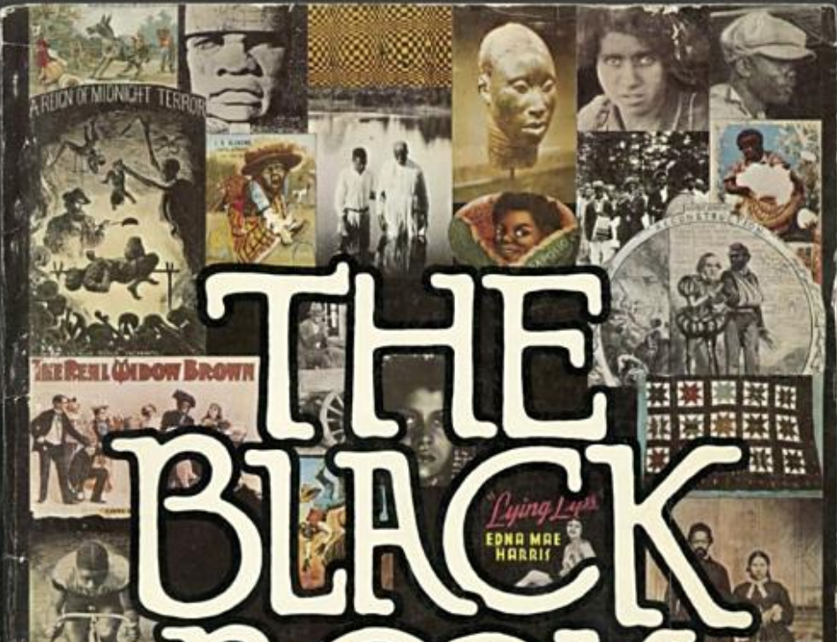
How does Toni Morrison Approach memory? The black book
PREFACE I am The Black Book. Between my top and my bottom, my right and my left, I hold what I have seen, what I have done, and what I have thought. I am everything I have hated: labor without harvest; death without honor; life without land or law. I am a black woman holding a white child in her arms singing to her own baby lying unattended in the grass. I am all the ways I have failed: I am the black slave owner, the buyer of Golden Peacock Bleach Creme and Dr. Palmer’s Skin Whitener, the selfhating player of the dozens; I am my own nigger joke. I am all the ways I survived: I am tun-mush, hoecake cooked on a hoe; I am Fourteen black jockeys winning the Kentucky Derby. I am the creator of hundreds of patented inventions; I am Lafitte the pirate and Marie Laveau. I am Bessie Smith winning a roller-skating contest; I am quilts and ironwork, fine carpentry and lace. I am the wars I fought, the gold I mined, the horses I broke, the trails I blazed. I am all the things I have seen: The New York Caucasian newspaper, the scarred back of Gordon the slave, the Draft Riots, darky tunes, and merchants distorting my face to sell thread, soap, shoe polish, coconut. And I am all the things I have ever loved: scuppernong wine, cool baptisms in silent water, dream books and number playing. I am the sound of my own voice singing “Sangaree.” I am ring-shouts, and blues, ragtime and gospels. I am mojo, voodoo, and gold earrings. I am not complete here; there is much more, but there is no more time and no more space . . . and I have journeys to take, ships to name, and crews. Toni Morrison, 1973

Slide 14
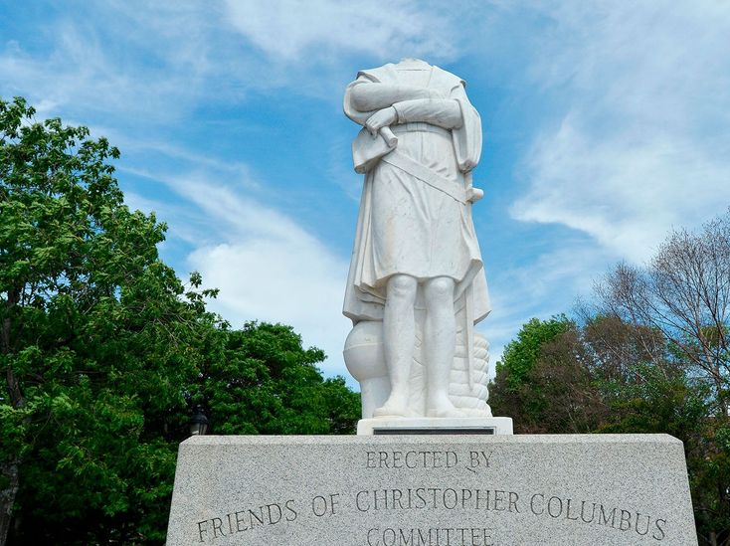
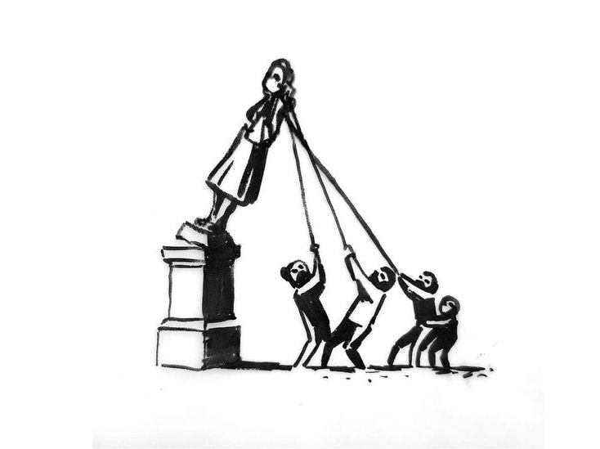
Cultural Memory: Contested Memory
Questions to discuss:
In Beloved, Toni Morrison evokes the memory of Margaret Garner, who is a contested figure, and was at the heart of controversies surrounding slavery and emancipation. Why would she have chosen this controversial figure? What kind of cultural memories is she interested in?
African American memory is often linked to oral culture / storytelling and folklore. Does this echo in Beloved, too? How does this influence Toni Morrison's style?
Watch this video as an example: https://youtu.be/-L5xOMTKf2A
Why is this the case? Read up on this here: https://theconversation.com/how-african-american-folklore-saved-the-cultural-memory-and-history-of-slaves-98427

Slide 15
So how does Toni Morrison present the past and memory?
Key Idea:
For Toni Morrison, memory (the deliberate act of remembering) is a form of willed creation. It is not an effort to find out the way it really was- that is research. The point is to dwell on the way it appeared and why it appeared in that particular way
Questions to ask:
Authoritative or subjective? Shared or solitary?
Reliable or unreliable?
Willed or suddenly occurring?
How related to forgetting?
Is remembering thinking or feeling?
Reminder on Style:
Beloved is characterised by a style that is elliptical, and time-scales that are quite elastic:
references are made to events or characters that are only explained later on: coherence is denied
memories (of Sweet Home, Sethe’s escape, etc) start here and there, so that the present is ‘shot through’ with the past – but they aren’t developed chronologically
Also, language is open to ambivalence, multiple meanings, and contradictory connotations:

Slide 16
Annotate your extract!
Key Idea:
For Toni Morrison, memory (the deliberate act of remembering) is a form of willed creation. It is not an effort to find out the way it really was- that is research. The point is to dwell on the way it appeared and why it appeared in that particular way
Questions to ask:
Authoritative or subjective? Shared or solitary?
Reliable or unreliable?
Willed or suddenly occurring?
How related to forgetting?
Is remembering thinking or feeling?
Reminder on Style:
Beloved is characterised by a style that is elliptical, and time-scales that are quite elastic:
references are made to events or characters that are only explained later on: coherence is denied
memories (of Sweet Home, Sethe’s escape, etc) start here and there, so that the present is ‘shot through’ with the past – but they aren’t developed chronologically
Also, language is open to ambivalence, multiple meanings, and contradictory connotations:

Slide 17
The Past intrudes into the Present: Excerpt 1, p. 4
Baby Suggs died shortly after the brothers
left, with no interest whatsoever in their
leave-taking or hers, and right afterward Sethe
and Denver decided to end the persecution by
calling forth the ghost that tried them so.
Perhaps a conversation, they thought, an
exchange of views or something would help. So
they held hands and said, "Come on. Come on.
You may as well just come on."
The sideboard took a step forward but
nothing else did.
"Grandma Baby must be stopping it," said
Denver. She was ten and still mad at Baby Suggs
For dying.
Sethe opened her eyes. "I doubt that," she
said.
"Then why don't it come?"
"You forgetting how little it is," said her
mother. "She wasn't even two years old when
she died. Too little to understand. Too little to
talk much even."
"Maybe she don't want to understand," said
Denver.
"Maybe. But if she'd only come, I could make
it clear to her."
Sethe released her daughter's hand and
together they pushed the sideboard back
against the wall. Outside a driver whipped his
horse into the gallop local people felt
necessary when they passed 124.
"For a baby she throws a powerful spell,"
said Denver.
"No more powerful than the way I loved
her," Sethe answered and there it was again.
The welcoming cool of unchiseled headstones;
the one she selected to lean against on tiptoe,
her knees wide open as any grave. Pink as a
fingernail it was, and sprinkled with glittering
chips. Ten minutes, he said. You got ten minutes
I'll do it for free.

Slide 18
The Past intrudes into the Present: Excerpt 2, p. 6
Baby Suggs rubbed her eyebrows.
"My first-born. All I can remember of her is
how she loved the burned bottom of bread. Can
you beat that? Eight children and that's all I
remember."
"That's all you let yourself remember,"
Sethe had told her, but she was down to one
herself-- one alive, that is--the boys chased off
by the dead one, and her memory of Buglar was
fading fast. Howard at least had a head shape
nobody could forget. As for the rest, she worked
hard to remember as
close to nothing as was safe. Unfortunately her
brain was devious. She might be hurrying
across a field, running practically, to get to the
pump quickly and rinse the chamomile sap from
her legs. Nothing else would be in her mind. The
picture of the men coming to nurse her was as
lifeless as the nerves in her back where the skin
buckled like a washboard. Nor was there the
faintest scent of ink or the cherry gum and oak
bark from which it was made.
Nothing. Just the breeze cooling her face as she rushed toward
water. And then sopping the chamomile away
with pump water and rags, her mind fixed on
getting every last bit of sap off--on her
carelessness in taking a shortcut across the
field just to save a half mile, and not noticing
how high the weeds had grown until the itching
was all the way to her knees.
Then something.
The plash of water, the sight of her shoes and
stockings awry on the path where she had flung
them; or Here Boy lapping in the puddle near
her feet, and suddenly there was Sweet Home
rolling, rolling, rolling out before her eyes, and
although there was not a leaf on that farm that
did not make her want to scream, it rolled itself
out before her in shameless beauty. It never
looked as terrible as it was and it made her
wonder if hell was a pretty place too. Fire and
brimstone all right, but hidden in lacy groves.
Boys hanging from the most beautiful
sycamores in the world. It shamed her--
remembering the wonderful soughing trees
rather than the boys. Try as she might to make
it otherwise, the sycamores beat out the
children every time and she could not forgive
her memory for that.

Slide 19
The Past intrudes into the Present: Excerpt 4, p. 19
"We was talking 'bout a tree, Sethe."
"After I left you, those boys came in there
and took my milk.
That's what they came in there for. Held
me down and took it. I told Mrs. Garner on em.
She had that lump and couldn't speak but her
eyes rolled out tears. Them boys found out I told
on em. Schoolteacher made one open up my
back, and when it closed it made a tree. It grows
there still."
"They used cowhide on you?"
"And they took my milk."
"They beat you and you was pregnant?"
"And they took my milk!"
The fat white circles of dough lined the
pan in rows. Once more Sethe touched a wet
forefinger to the stove. She opened the oven
door and slid the pan of biscuits in. As she raised
up from the heat she felt Paul D behind her and
his hands under her breasts. She straightened
up and knew, but could not feel, that his cheek
was pressing into the branches of her
chokecherry tree.
""What tree on your back?"
"Huh." Sethe put a bowl on the table and
reached under it for flour.
"What tree on your back? Is something
growing on your back?
I don't see nothing growing on your back."
"It's there all the same."
"Who told you that?"
"Whitegirl. That's what she called it. I've
never seen it and never will. But that's what she
said it looked like. A chokecherry tree.
Trunk, branches, and even leaves. Tiny
little chokecherry leaves. But that was eighteen
years ago. Could have cherries too now for all I
know.“
[…]

Slide 20
The Past intrudes into the Present: Excerpt 7, p. 35-36
And it was the tender
embrace of the dress sleeve that made Denver
remember the details of her birth--that and the
thin, whipping snow she was standing in, like the
fruit of common flowers. The dress and her
mother together looked like two friendly
grown-up women--one (the dress) helping out the
other.
And the magic of her birth, its miracle in fact,
testified to that friendliness as did her own name.
Easily she stepped into the told story that
lay before her eyes on the path she followed away
from the window. There was only one door to the
house and to get to it from the back you had to
walk all the way around to the front of 124, past
the storeroom, past the cold house, the privy, the
shed, on around to the porch. And to get to the
part of the story she liked best, she had to start
way back: hear the birds in the thick woods, the crunch of leaves
underfoot; see her mother making her way up into
the hills where no houses were likely to be. How
Sethe was walking on two feet meant for standing
still.

Slide 21
The Past intrudes into the Present: Excerpt 7, p. 43
"Not for anything. I don't pray anymore. I
just talk."
"What were you talking about?"
"You won't understand, baby."
"Yes, I will."
"I was talking about time. It's so hard for me
to believe in it.
Some things go. Pass on. Some things
just stay. I used to think it was my rememory.
You know. Some things you forget. Other
things you never do. But it's not. Places, places
are still there. If a house burns down, it's gone,
but the place--the picture of it--stays, and not
just in my rememory, but out there, in the
world. What I remember is a picture floating
around out there outside my head. I mean,
even if I don't think it, even if I die, the picture
of what I did, or knew, or saw is still out there.
Right in the place where it happened."
"Can other people see it?" asked Denver.
"Oh, yes. Oh, yes, yes, yes. Someday you
be walking down the road and you hear
something or see something going on. So clear.
And you think it's you thinking it up. A
thought picture. But no. It's when you bump
into a rememory that belongs to somebody
else.
Where I was before I came here, that
place is real. It's never going away. Even if the
whole farm- -every tree and grass blade of it
dies.
The picture is still there and what's more,
if you go there--you who never was there--if
you go there and stand in the place where it
was, it will happen again; it will be there for
you, waiting for you. So, Denver, you can't
never go there. Never. Because even though
it's all over--over and done with--it's going to
always be there waiting for you. That's how
come I had to get all my children out. No matter
what."
Denver picked at her fingernails. "If it's still
there, waiting, that must mean that nothing ever
dies."
Sethe looked right in Denver's face. "Nothing
ever does," she said.

Slide 22
The Past intrudes into the Present: Excerpt 10, p. 69
"Where your diamonds?" Beloved searched
Sethe's face.
"Diamonds? What would I be doing with
diamonds?"
"On your ears."
"Wish I did. I had some crystal once. A
present from a lady I worked for."
"Tell me," said Beloved, smiling a wide
happy smile. "Tell me your diamonds."
It became a way to feed her. Just as Denver
discovered and relied on the delightful effect
sweet things had on Beloved, Sethe learned the
profound satisfaction Beloved got from
storytelling. It amazed Sethe (as much as it
pleased Beloved) because every mention of her
past life hurt. Everything in it was painful or lost.
She and Baby Suggs had agreed without saying so
that it was unspeakable; to Denver's inquiries
Sethe gave short replies or rambling incomplete
reveries.
Even with Paul D, who had shared some of it
and to whom she could talk with at least a
measure of calm, the hurt was always there-like a
tender place in the corner of her mouth that the bit
left.
But, as she began telling about the earrings,
she found herself wanting to, liking it. Perhaps it
was Beloved's distance from the events itself, or
her thirst for hearing it—in any case it was an
unexpected pleasure.
[…]

Slide 23
The Past intrudes into the Present: Excerpt 11, p. 73
What Nan told her she had forgotten,
along with the language she told it in. The same
language her ma'am spoke, and which would
never come back. But the message--that was
and had been there all along. Holding the damp
white sheets against her chest, she was picking
meaning out of a code she no longer
understood. Nighttime.
Nan holding her with her good arm,
waving the stump of the other in the air. "Telling
you. I am telling you, small girl Sethe," and she
did that. She told Sethe that her mother and Nan were together from the sea. Both were
taken up many times by the crew. "She threw
them all away but you. The one from the crew
she threw away on the island. The others from
more whites she also threw away. Without
names, she threw them. You she gave the name
of the black man.
She put her arms around him. The others
she did not put her arms around. Never. Never.
Telling you. I am telling you, small girl Sethe."
As small girl Sethe, she was unimpressed.
As grown-up woman Sethe she was angry, but
not certain at what. A mighty wish for Baby
Suggs broke over her like surf. In the quiet
following its splash, Sethe looked at the two
girls sitting by the stove: her sickly,
shallow-minded boarder, her irritable, lonely
daughter. They seemed little and far away.
Sethe gathered hair from the comb and
leaning back tossed it into the fire. It exploded
into stars and the smell infuriated them. "Oh,
my Jesus," she said and stood up so suddenly
the comb she had parked in Denver's hair fell to
the floor.
"Ma'am? What's the matter with you,
Ma'am?"
Sethe walked over to a chair, lifted a sheet
and stretched it as wide as her arms would go.
Then she folded, refolded and double folded it.
She took another. Neither was completely dry
but the folding felt too fine to stop. She had to
do something with her hands because she was
remembering something she had forgotten she
knew.
Something privately shameful that had
seeped into a slit in her mind right behind the
slap on her face and the circled cross.
"Why they hang your ma'am?" Denver
asked. This was the first time she had heard
anything about her mother's mother. Baby
Suggs was the only grandmother she knew.
"I never found out. It was a lot of them,"
she said, but what was getting clear and clearer
as she folded and refolded damp laundry was
the woman called Nan who took her hand and
yanked her away from the pile before she could
make out the mark. Nan was the one she knew
best, who was around all day, who nursed
babies, cooked, had one good arm and half of
another. And who used different words.
Words Sethe understood then but could
neither recall nor repeat now. She believed that
must be why she remembered so little before
Sweet Home except singing and dancing and
how crowded it was.

Slide 24
Sum it up!
In what ways does the past intrude into the present in Beloved?

