Slide 1
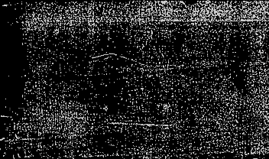
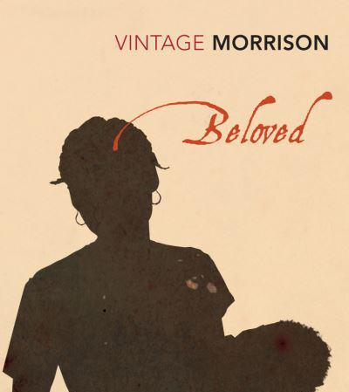


beloved
LO: How does the opening of the novel portray trauma and haunting memories?

Slide 2
Preliminary pages
What is the significance of this dedication?
What is the significance of this preliminary note?
Sixty Million and More
I will call them my people,
Which were not my people;
And her beloved,
Which was not beloved
(Romans 9:25)

Slide 3
Preliminary pages: The bible passage in more detail
I will call them my people,
Which were not my people;
And her beloved,
Which was not beloved
(Romans 9:25)
This introduces the issue of calling and identity
It also cites a New Testament passage, which repeats with little difference an Old testament passage
This suggests that there is some uncertainty as to the relation between the past and the present, or as to what ‘version’ of a truth is right

Slide 4
How are the main characters introduced?
Sethe
Denver
Paul D
The ghost
Baby Suggs
In your groups, collect quotes introducing these characters (focus on the first section, up to p. 23)
Think about:
How do their actions show their internal lives (emotions, hidden memories, etc)
Is there any important symbolic object or metaphoric image used to introduced this character? How would you interpret it? (for example: the ‘metal’ imagery for Sethe, Denver’s broken jar for jam and biscuits, Baby Sugg’s colours, Paul D’s trembling…)

Slide 5
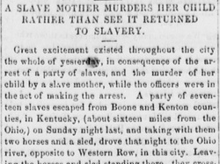

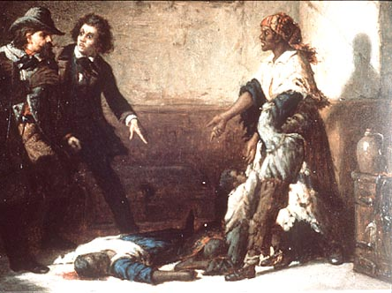

Characters in context: Margaret Garner
Beloved is based on the true story of an ex-slave named Margaret Garner, who attempted to kill her children to prevent them from returning to slavery.
Taking this event as the germ for her story, Morrison weaves it into a story about refugees from slavery, caught between remembering and forgetting what they have been through.
The novels also explores the intensity of a mother’s relationship with children, particularly under slavery.

Slide 6
Characters in context: Margaret Garner
Read up on Margaret Garner in Samuel May’s antislavery tract ‘The Fugitive Slave Law and Its Victims’
https://www.gutenberg.org/files/13990/13990-h/13990-h.htm
(The Fugitive Slave Acts were federal laws that allowed for the capture and return of runaway enslaved people within the territory of the United States. Enacted by Congress in 1793, it authorized local governments to seize and return escapees to their owners and imposed penalties on anyone who aided in their flight. Widespread resistance to the 1793 law led to the passage of the Fugitive Slave Act of 1850, which added more provisions regarding runaways and levied even harsher punishments for interfering in their capture. The Fugitive Slave Acts were among the most controversial laws of the early 19th century.)
Quote from the tract:
And the young wife and mother, into whose very soul the iron had entered, hearing the cry of the master: "Now we'll have you all!" turning from the side of her husband and father, with whom she had stood to repel the foe, seized a knife, and with a single blow nearly severed the head from the body of her darling daughter

Slide 7
Writing Trauma: How to read Toni Morrison’s style
Read up to p. 23
Beloved is characterised by a style that is elliptical, and time-scales that are quite elastic:
references are made to events or characters that are only explained later on: coherence is denied
memories (of Sweet Home, seethe’s escape, etc) start here and there, so that the present is ‘shot through’ with the past – but they aren’t developed chronologically
Also, language is open to ambivalence, multiple meanings, and contradictory connotations:
Symbolism of the chamomile
Description of Sethe’s baking vs the atrocities she is talking about
Imagery of milk
Select examples of such a style: in what ways is this Gothic? How does this create a sense of haunting? How does this haunting compare and contrast to other Gothic texts you have read?

Slide 8
How would you describe Morrison’s style in these quotations?
"The welcoming tool of unchiseled headstone; the one she selected to lean against on tiptoe, her knees wide open as any grave. Pink as a fingernail it was, and sprinkled with glittering chips."
"Suddenly there was Sweet Home rolling, rolling, rolling out before her eyes […] in shameless beauty. […] Boys hanging from the most beautiful sycamore trees in the world."
"Paul D tied his shoes together, hung them over his shoulder and followed her through the door straight into a pool of red and undulating light that locked him where he stood"
"her eyes did not pick up a flicker of light. They were like two wells into which he had trouble gazing […] Then schoolteacher arrived to put things in order. But what he did broke three more Sweet Home men and punched the glittering iron out of Sethe's eyes, leaving two open wells that did not reflect firelight."
"The five Sweet Home men looked at the new girl and decided to let her be. They were young and so sick with the absence of women they had taken to calves. Yet they let the iron-eyed girl be, so she could choose"
"I can't live here. Nobody speaks to us. Nobody comes by. Boys don't like me. Girls don’t either."
"Schoolteacher made one open my back and when it closed it made a tree. It grows there still. […]He rubbed his cheek on her back and learned that way her sorrow, the roots of it. Its wide trunk and intricate branches."

Slide 9
Key Concept: trauma
What is trauma?
Here are some quotations about trauma in literature:
Identify the key words in each quote – what can you infer about trauma?
Which are most helpful in explaining how Toni Morison presents memories?
Laura Di Prete: Trauma is a "foreign body" in the mind
trauma ‘can be best understood through plural, multi-disciplinary perspectives’ (Luckhurst 2008)
Coupland and Coupland (1997: 117) have called trauma a ‘discourse of the unsayable’.
"Perhaps the most striking feature of traumatic recollection is the fact that it is not a simple memory." (Cathy Caruth, 1995)
"The attempt to gain access to a traumatic history, then, is also the project of listening beyond the pathology of individual suffering, to the reality of a history that in its crises can only be perceived in unassimilable forms" (Cathy Caruth, 1995)
In trauma, "the body keeps the score" (Bessel van der Kolk)
Van der Kolk (2014: 21) stresses the enduring changes brought about by the experience of trauma:
"We have learned that trauma is not just an event that took place sometime in the past; it is also the imprint left by that experience on mind, brain, and body. This imprint has ongoing consequences for how the human organism manages to survive in the present. Trauma results in a fundamental reorganization of the way mind and brain manage perceptions. It changes not only how we think and what we think about, but also our very capacity to think.
Sigmund Freud, 1920: (People] think the fact that the traumatic experience is forcing itself upon the patient is a proof of the strength of the experience: the patient is, as one might say, fixated to his. trauma. I am not aware, however, that patients suffering from traumatic neurosis are much occupied in their waking lives with memories of their accident. Perhaps they are more concerned with not thinking of it. (Freud, 1920, 13)

Slide 10

How does Toni Morrison introduce memories of a violent history in the opening of her novel?
How does Toni Morrison introduce memories of a violent history in the opening of her novel?
Based on what we have just discussed, write a paragraph to evaluate this.
Use the following concepts:
Trauma
Elliptical style
Ambivalence / multiple meanings / contradictions

Slide 11
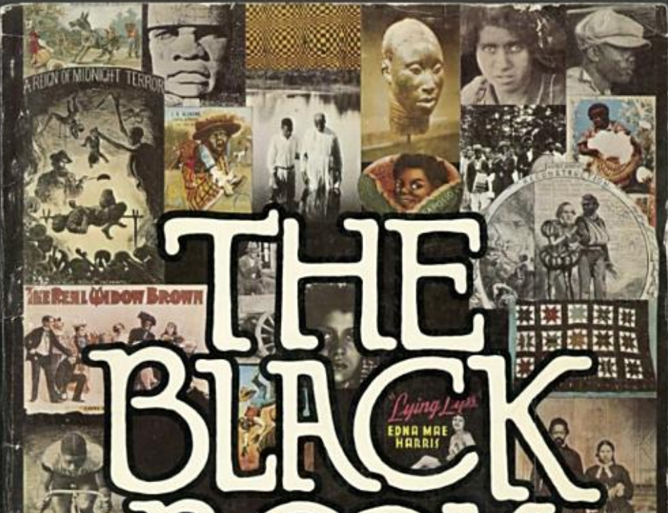
Toni Morrison and history:
The black book
The Black Book grew out of certain concerns Morrison had about race and language, one being Morrison’s sense that the “Black is beautiful” idea of the time reduced the complexity of Black American life to a slogan.
She was equally dissatisfied with academic treatises that did not get at the heart and spirit behind the culture.
Morrison worked with collectors of Black memorabilia and a graphic designer to put The Black Book together.
She wanted the largely visual work to be a kind of scrapbook, or panorama, of Black American life, largely free of language and thus cant, and valuable to the young.
“I was afraid that young people would come to believe that black history began in 1964,” she told an interviewer. “Or that there was slavery, there was a gap, and then there was 1964.”

Slide 12
What kind of ‘history writing’ can such a book offer?
From the PREFACE
I am The Black Book.
[…]
I am everything I have hated: labor without harvest; death without honor;
life without land or law. I am a black woman holding a white child in her
arms singing to her own baby lying unattended in the grass.
I am all the ways I have failed:
I am the black slave owner […]
I am all the ways I survived:
[…] I am quilts and ironwork,
fine carpentry and lace. I am the wars I fought, the gold I mined,
the horses I broke, the trails I blazed.
I am all the things I have seen:
The New York Caucasian newspaper, the
scarred back of Gordon the slave, the Draft Riots, darky tunes, and merchants
distorting my face to sell thread, soap, shoe polish, coconut.
And I am all the things
I have ever loved: scuppernong wine, cool baptisms in
silent water, dream books and number playing. I am the sound of my own
voice singing “Sangaree.” I am ring-shouts, and blues, ragtime and gospels. I am
mojo, voodoo, and gold earrings.
I am not complete here; there is much more,
but there is no more time and no more space . . . and I have journeys to take,
ships to name, and crews.
Toni Morrison, 1973

Slide 13
